Slide 1
Template Method Pattern

Slide 2
Overview
The Template Method Pattern allows you to:
Define the skeleton of an algorithm in an operation, deferring some steps to subclasses
Let subclasses to redefine certain steps of an algorithm without changing the algorithm’s structure
Reuse the skeleton of an algorithm (the steps) when some steps might be implemented in multiple ways
Delegate multiple ways to subclasses
Only specific steps implemented in subclasses
Define default implementations in super class

Slide 3
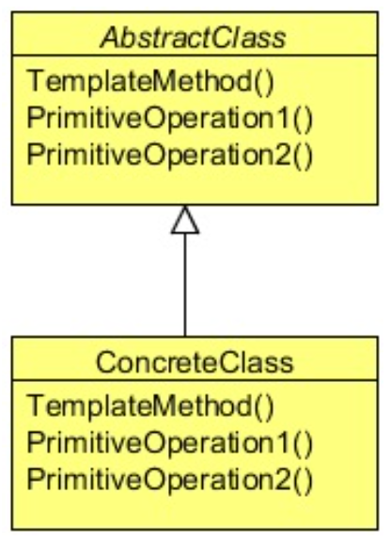
Class Diagram
Client gets the ConcreteClass
Client calls templateMethod()
templateMethod() sequences the steps

Slide 4
When to Use It?
Use the Template pattern:
To implement the invariant parts of an algorithm once and leave it up to subclasses to implement alternate behavior
When common behavior among subclasses should be factored and localized in a common class to avoid code duplication → DRY (Don’t Repeat Yourself)
First identify the differences in the existing code
Separate the differences into new operations
Replace the differing code with a template method that calls these new operations

Slide 5
Steps
The client references the Concrete Implementation
The client calls the templateMethod()
The templateMethod() calls:
step1(), then step2(), then step3(), then…
The templateMethod() returns data to client

Slide 6
Lab
File → /course/lesson-300-Creational-Patterns/instructions/TemplateMethod.docx
Follow the instructions

