Slide 1
Observer Design Pattern

Slide 2
Overview
The Observer Pattern:
Concerned with the assignment of responsibilities between objects
Shift your focus away from the flow of control to let you concentrate just on the way objects are interconnected
Defines a one-to-many dependency between objects so that when one object changes state, all its dependents are notified and updated automatically
The Observer pattern describes these dependencies
Is like Publisher-Subscriber relationship works

Slide 3
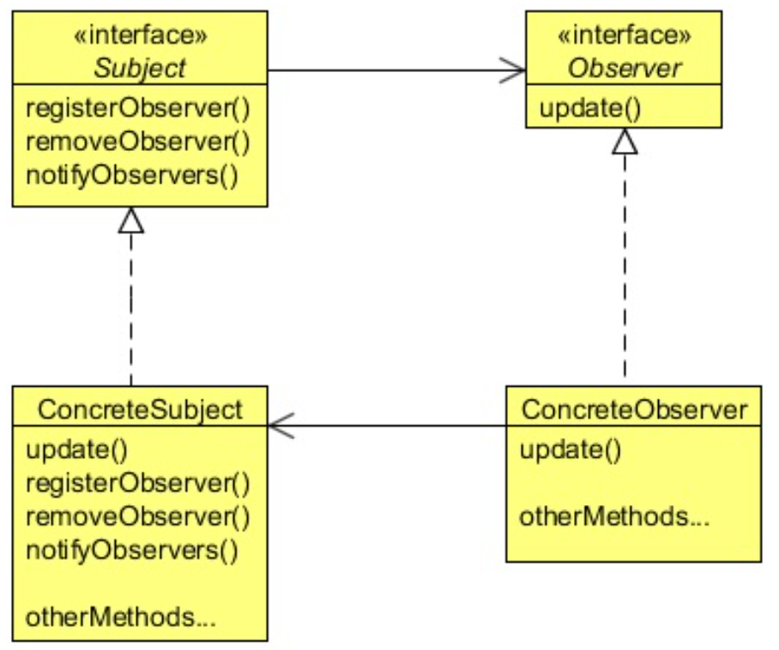
Class Diagram
Observer registers with what to Observe (Observed or Observable)
Observed changes and update()s all Observers

Slide 4
When to Use It?
Use the Observer pattern:
When an abstraction has two aspects, one dependent on the other
Encapsulating these aspects in separate objects lets you vary and reuse them independently
When a change to one object requires changing others, and you don’t know how many objects need to be changed
When an object should be able to notify other objects without making assumptions about who these objects are
In other words, you don’t want these objects tightly coupled

Slide 5
Steps
The Observer registers with the Observed
The client modifies the state in the Observed
The Observed calls update() on all registered Observers
The Observer gets the update() and does whatever
The Observed returns to the client

Slide 6
Lab
File → /course/lesson-300-Creational-Patterns/instructions/Observer.docx
Follow the instructions

