Slide 1
Strategy Design Pattern

Slide 2
Overview
The Strategy Pattern:
Defines a family of algorithms, encapsulating each one, and making them interchangeable
Strategy lets the algorithm vary independently from the clients that use it
Useful when there is a set of related algorithms and a client object needs to be able to dynamically pick and choose an algorithm from this set that suits its current need
Keeps the implementation of each algorithm in a separate class

Slide 3
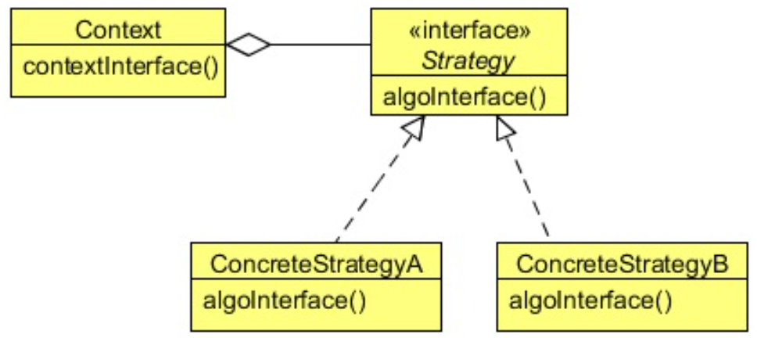
Class Diagram
Strategy defines multiple algorithms
Same interface
Client determines which one to use based on its criteria

Slide 4
When to Use It?
Use the Strategy pattern when:
Many related classes differ only in their behavior
Strategies provide a way to configure a class with one of many behaviors
You need different variants of an algorithm
When these variants are implemented as a class hierarchy of algorithms
An algorithm uses data that clients shouldn’t know about
Avoid exposing complex, algorithm- specific data structures.

Slide 5
Steps
The client somehow selects the Strategy algorithm
The client invokes the algorithm
The algorithm does its work
The algorithm returns to the client
The client is happy!!!

Slide 6
Lab
File → /course/lesson-300-Creational-Patterns/instructions/Strategy.docx
Follow the instructions

