Slide 1
Kafka Core Concepts

Slide 2
Topics and Partitions
Messages in Kafka are categorized into topics
Think of a topic as a database table or folder in a filesystem
Topics are broken down into a number of partitions
A topic generally has multiple partitions

Slide 3
Topics and Partition Concerns
DevOps concerns
Bandwidth consumption → Size of messages, `serdes`, etc.
Fault tolerance and availability → Size of cluster, replication factor, etc.
Performance → Partitions, message size, cost of serialization, etc.
Producer concerns
Ease of production → Clear schema, cost of serialization, delivery guarantees, etc.
Consumer concerns
Can I subscribe to only what I need → Topics and partitions
Latency → Cluster size, performance, etc.

Slide 4
How Topics and Partitions Influence Concerns?
Topic topology
Schema (structure, format, etc.)
Temporal constraints (frequency, triggers, etc.)
Do you use topics to allow for fine grain subscriptions?
Partitions
Determines throughput (but not without cost)
Can be used for fine-grained subscription (requires use of low level API)
Recommendation
Use topics to convey semantics
Use partition to control throughput

Slide 5
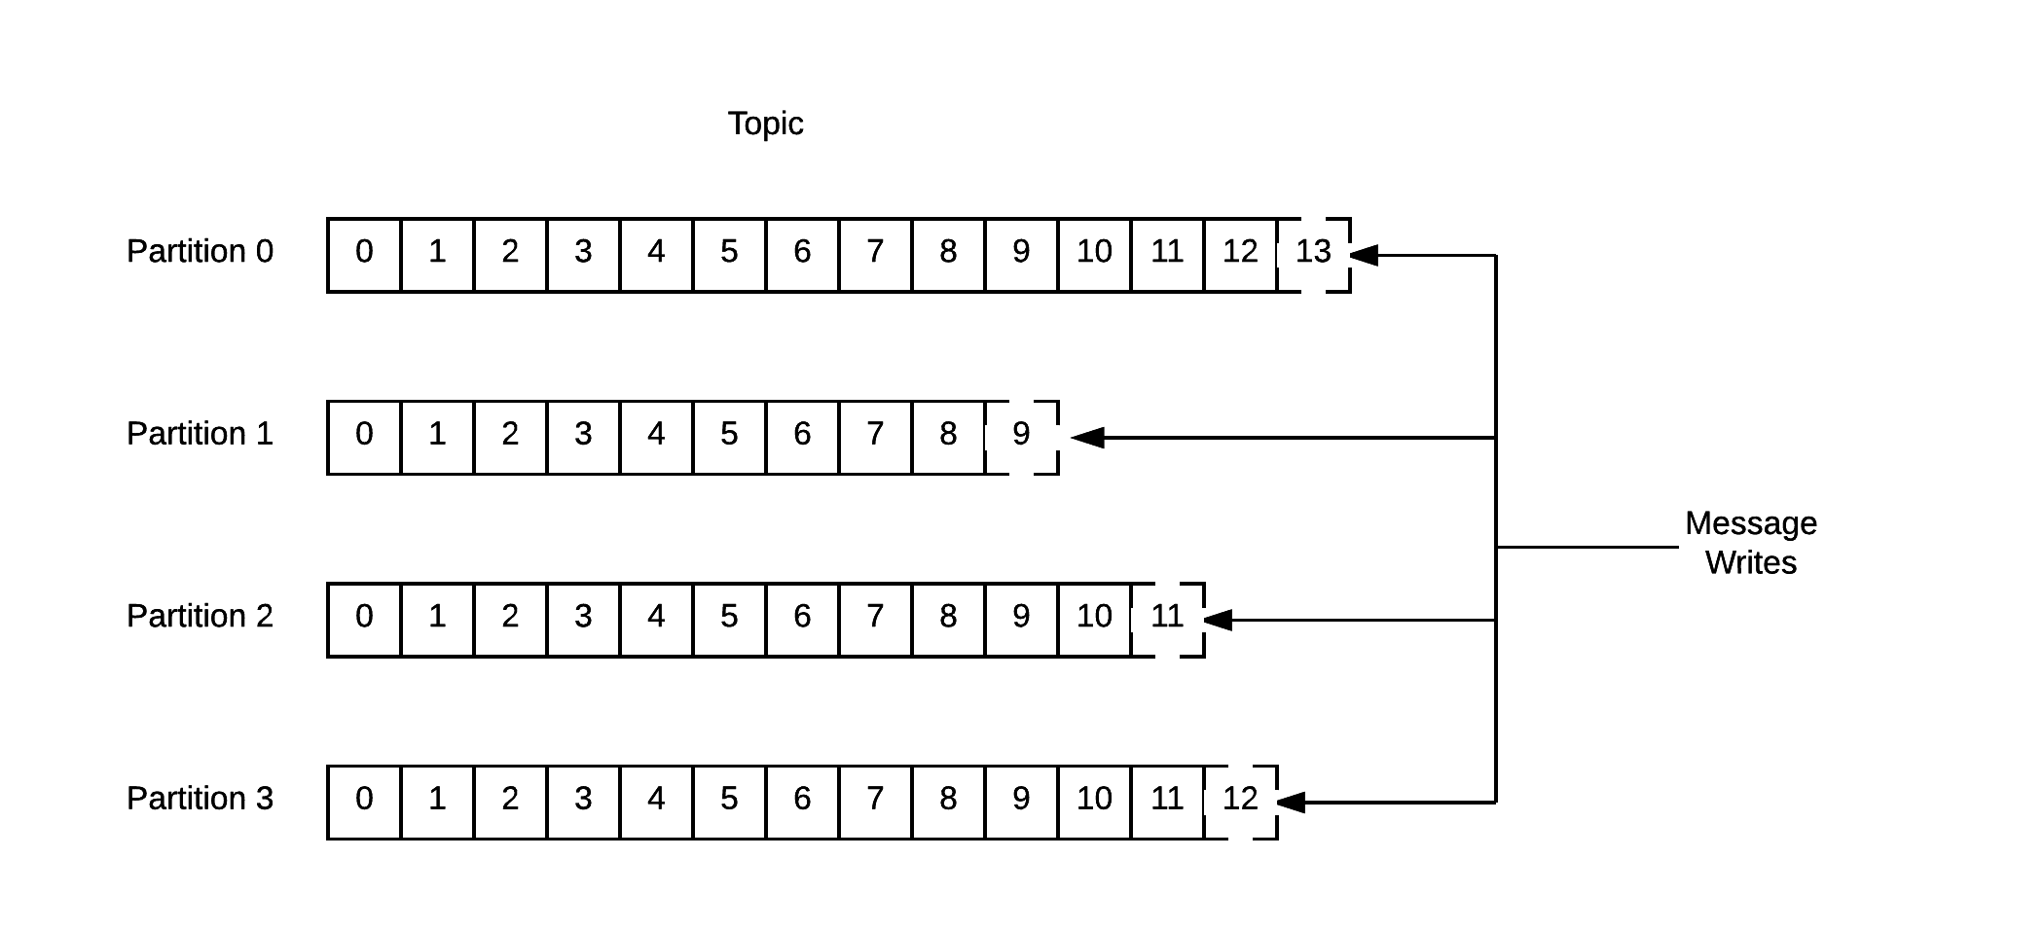
Topics and Partitions

Slide 6
Producers
Producers create new messages
In general, a message will be produced to a specific topic
By default, a producer will balance messages over all partitions of a topic evenly
It is possible to direct messages to a specific partition with the use of a message key
Partitioner assures all messages produced with a given key will get written to the same partition

Slide 7
Consumers
Consumers read messages
A consumer subscribes to one or more topics and reads messages in the order they were produced
Consumer keeps track of read messages by keeping track of the offset of messages
The offset is metadata that Kafka adds to each message as it is produced

Slide 8
Consumer Groups
Consumers work as part of a consumer group
One or more consumers that work together to consume a topic
Group assures that each partition is only consumed by one member
Mapping of a consumer to a partition is called ownership of the partition by the consumer

Slide 9
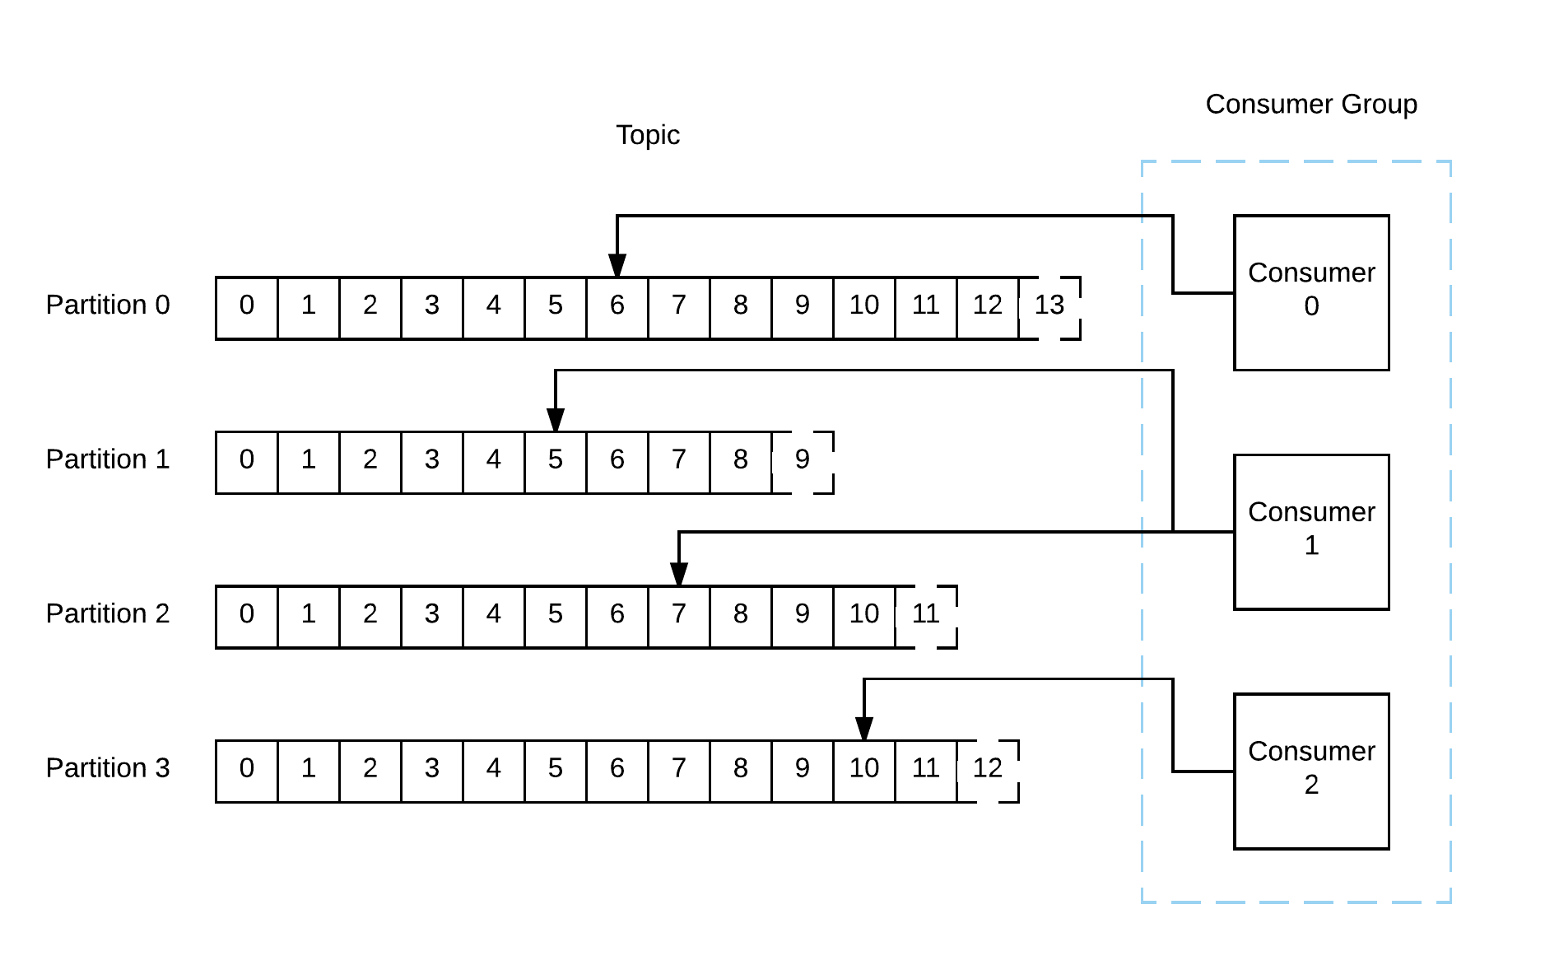
Consumer Group Illustrated

Slide 10
Brokers
A single Kafka server is called a broker
The broker receives messages from producers, assigns offsets to them, and commits the messages to storage on disk
Responds to consumer fetch requests with the messages in the requested partition
A single broker can handle thousands of partitions and millions of messages per second

Slide 11
Clusters
Kafka brokers operate as part of a cluster
Within a cluster of brokers, one broker acts as the cluster controller
The controller handles administrative operations such as assigning partitions to brokers and monitoring for broker failures
A partition is owned by a single broker in the cluster known as the leader for the partition
Another broker can take over leadership if there is a broker failure
All consumers and producers on that partition must connect to the leader

Slide 12
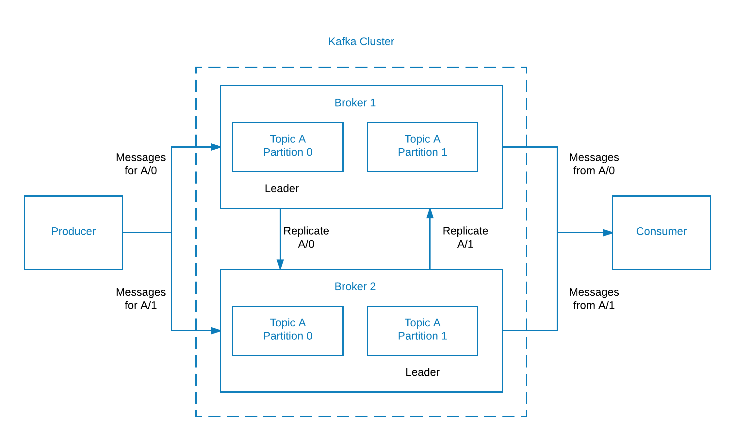
Replication of Partitions in a Cluster

Slide 13
Retention
Kafka brokers are configured with a default retention setting for topics either retaining messages for some period of time or until the topic reaches a certain size in bytes
When limits are reached, messages are expired and deleted
Topics can be configured with their own retention settings
Application metrics may only be useful for a few hours
Tracking topics may be useful for several days
Topics can be log compacted – Kafka only retains the last message produced with a specific key
For example, changelog data where only the last update is useful

Slide 14
Compression
In some of the largest Kafka deployments, hundreds of billions of messages per day are processed amounting to moving hundreds of terabytes of data
Enabling compression allows you to reduce network utilization which can be a bottleneck when sending messages to Kafka
Compression is an optional configuration setting in the broker and producer

Slide 15
Supported Compression Algorithms
snappy
Created by Google
Provides good compression ratio with low CPU overhead
Recommended when both performance and bandwidth are a concern
gzip
Uses more CPU and time but results in better compression ratios
Recommended where network bandwidth is more restricted
lz4
Newest algorithm to Kafka
Faster than gzip and smaller than snappy

Slide 16
Compression Overview
Multiple messages are bundled and compressed
The compressed messages are then appended to Kafka's log file
Compression works on a batch of messages rather than individual to take advantage of the fact that compressors work more efficiently with bigger data

Slide 17
Multiple Clusters
As your Kafka deployment grows, it can be advantageous to have multiple clusters:
Segregation of types of data
Isolation for security requirements
Multiple datacenters (disaster recovery)
With multiple datacenters, messages must be copied between them
Replication within a Kafka cluster only works within a single cluster, not between multiple clusters

Slide 18
Cluster Mirroring
Kafka includes a tool called Mirror Maker to mirror a source Kafka cluster into a target (mirror) cluster
Uses a Kafka consumer to consume messages from the source cluster and re-publishes the messages to the local (target) cluster using an embedded Kafka producer

Slide 19
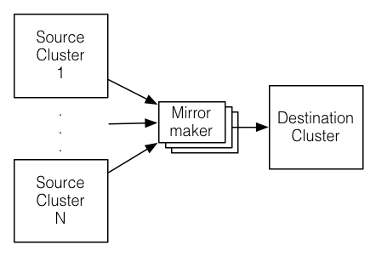
Mirror Maker Illustrated

Slide 20
Summary
Topics and Partitions
Producers and Consumers
Consumer Groups
Brokers
Clusters
Retention
Compression
Mirror Maker

