Slide 1
Kafka Administration and Integrations

Slide 2
Kafka Integration with Apache Storm
Integration between Apache Kafka and Apache Storm is a popular and natural integration
Let's take a whirlwind tour of Apache Storm and what it provides

Slide 3
Apache Storm
Apache Storm - Distributed and fault-tolerant realtime computation
Allows reliable processing of unbounded streams of data
Developed by BackType initially and then acquired by Twitter and open-sourced
Comparable to other streaming engines such as Spark Streaming and Flink

Slide 4
Major Storm Concepts
Topology
Logic for an application that is analogous to a MapReduce job except that a topology runs forever or until killed
Streams
An unbounded sequence of tuples
Storm provides a way to transform incoming data in a distributed and reliable way
For example, you may transform a stream of tweets into a stream of trending topics
Spouts
A source of streams in a topology (e.g. the Twitter API)
Spouts read tuples from an external source and emit them into the topology

Slide 5
Major Storm Concepts
Bolts
All processing in topologies is done in bolts
They are responsible for tasks such as filtering, aggregations, joins, talking to databases, etc
Complex stream transformations can require multiple steps and thus multiple bolts

Slide 6
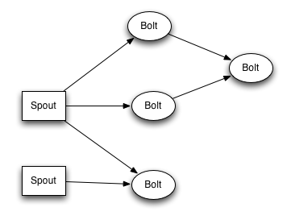
A Storm Topology

Slide 7
Kafka and Storm Integration
Storm has a built-in module called storm-kafka-client which is compatible with Kafka 0.10+
Legacy version of this module for Kafka 0.8 is called storm-kafka
storm-kafka-client has a Storm spout implementation to consume data from Kafka using the consumer API
It would also be possible of course to write a Storm bolt to produce data to Kafka although this is not as common

Slide 8
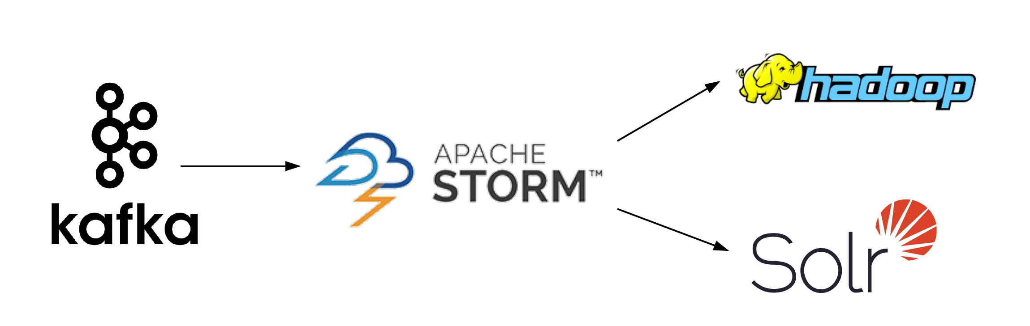
A Sample Data Flow

Slide 9
Kafka Integration with Hadoop
Another common use case is consuming Kafka data directly into Hadoop
Hadoop is a large scale distributed batch processing framework which parallelizes data processing across many servers
Its strength is in the ability to scale across thousands of commodity servers that don't share memory or disk space

Slide 10
Major Functional Components
Hadoop can be thought of as an ecosystem comprised of many different components that work together to create a single platform
Two key functional components:
HDFS – a scalable file system that distributes and stores data across all machines in Hadoop cluster
MapReduce – the system used to efficiently process the large amount of data stored in HDFS. Large data is divided into smaller and smaller tasks in a pipeline.

Slide 11
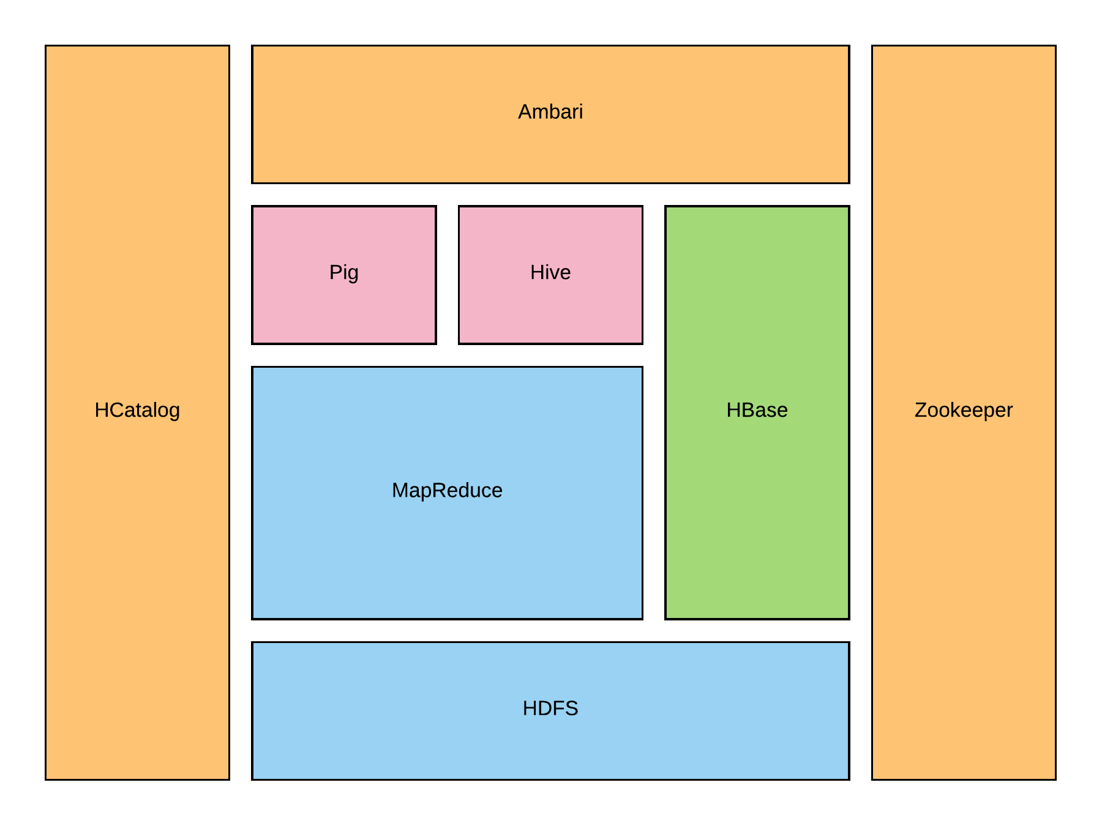
Hadoop Cluster Components

Slide 12
Kafka Integration with Hadoop
In earlier versions of Kafka (0.8), integration with Hadoop could be achieved with an extension directly in the Kafka code base
This was great news for Hadoop users but a lot of code would need to be written for other integrations
S3
HBase
JDBC
Cassandra

Slide 13
Kafka Connect and Confluent
Confluent is a startup that was founded in 2014 by the creators of Kafka
Kafka Connect is a feature in Apache Kafka 0.9+ developed by Confluent that makes building and managing stream data pipelines easier
Kafka Connect abstracts away common problems that every connector to Kafka needs to solve such as
fault tolerance
partitioning
offset management
monitoring

Slide 14
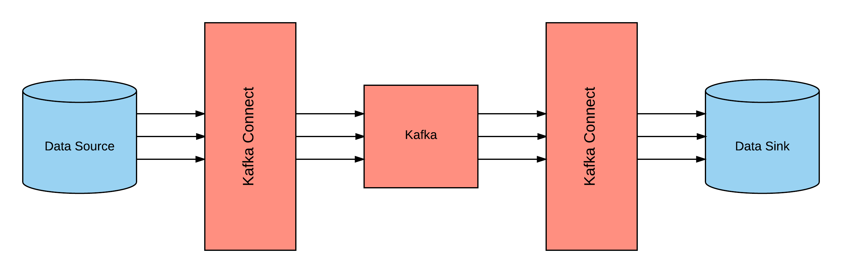
High Level Look at Kafka Connect

Slide 15
Certified Connectors
Confluent maintains the HDFS (Sink) connector using the Kafka Connect framework
Other certified connectors from Confluent include
JDBC (Source)
Elastic Search (Sink)
Attunity (Source)
Couchbase (Source)
GoldenGate (Source)
JustOne (Sink)
Syncsort DMX (Source)
Syncsort DMX (Sink)
Vertica (Source)
Vertica (Sink)

Slide 16
Additional Community Connectors
Other notable community connectors utilizing Kafka Connect
Cassandra (Source and Sink)
Elastic Search (Sink)
FTP (Source)
HBase (Sink)
InfluxDB (Sink)
Bloomberg Ticker (Source)
MongoDB (Source)
Mixpanel (Source)
MQTT (Source)
Solr (Sink and Source)
And more!

Slide 17
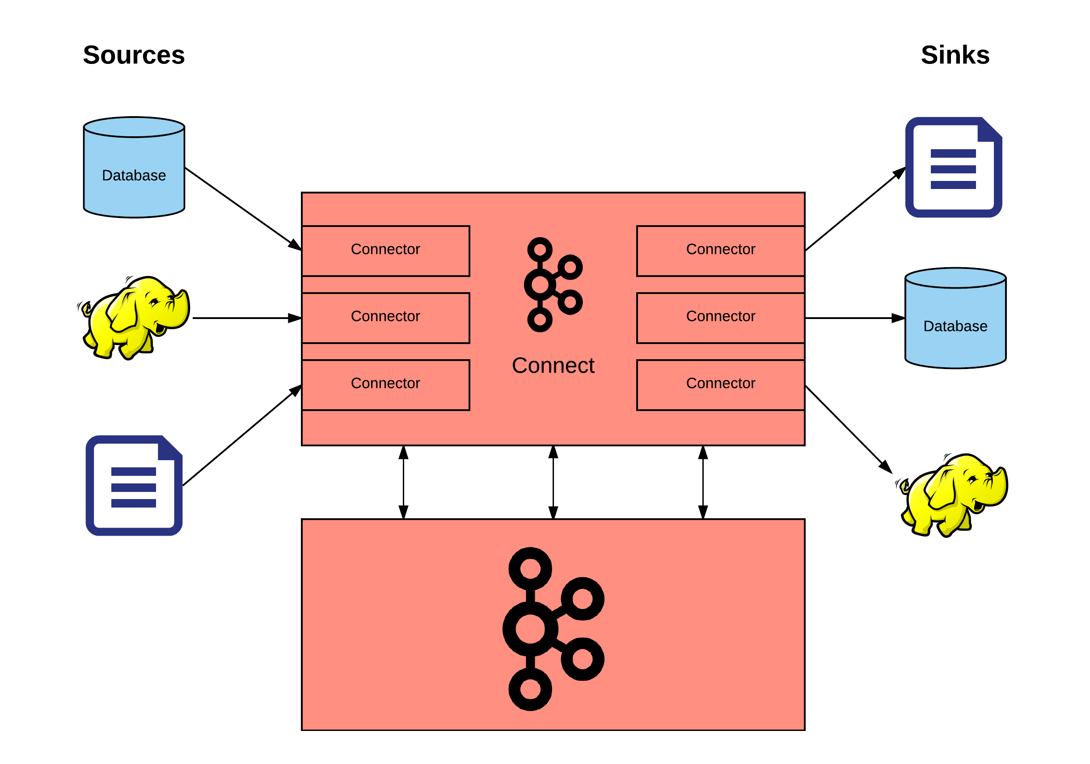
Another Kafka Connect View

Slide 18
Kafka Administration
There are a number of useful operations that are not automated and must be triggered using one of the tools that ship with Kafka
Adding/deleting topics
Modifying topics
Graceful shutdown
Balancing leadership
Checking consumer position
Mirroring data between clusters
Expanding a cluster
Decommissioning brokers
Increasing replication factor

Slide 19
Adding and Deleting Topics
Topics can be added manually or you can have them be created automatically when data is first published to a non-existent topic
Topics are added and removed with the topic tool
kafka-topics.sh --zookeeper zk_host:port --create --topic my_topic_name --partitions 20 --replication-factor 3 --config x=y
kafka-topics.sh --zookeeper zk_host:port --delete --topic my_topic_name

Slide 20
Modifying Topics
Changing the configuration or partitioning of a topics can be done with the same topic tool
kafka-topics.sh --zookeeper zk_host:port/chroot --alter --topic my_topic_name --partitions 40
The partition count controls how many logs the topic will be sharded into

Slide 21
Graceful Shutdown
A Kafka cluster will automatically detect any broker shutdown or failure and elect new leaders for the partitions on that machine
When a broker is brought down intentionally for configuration changes, Kafka supports a more graceful shutdown that comes with two optimizations
All logs are synced to disk to avoid needing to validate checksums when restarting. This speeds up intentional restarts
Partitions the server is the leader for will be migrated to other replicas prior to shutting down. This will make leadership transfer faster and minimize the time each partition is unavailable to a few milliseconds

Slide 22
Graceful Shutdown Continued
To take advantage of this graceful shutdown, the following setting is required
controlled.shutdown.enable=true

Slide 23
Checking Consumer Position
The following command will show the position of all consumers in a consumer group and how far behind the end of the log they are
kafka-run-class.sh kafka.tools.ConsumerOffsetChecker --zookeeper localhost:2181 --group test

Slide 24
Mirroring Data Between Clusters
Replicating data between Kafka clusters is known as mirroring which is not to be confused with the replication that happens amongst the nodes in single cluster
Kafka comes with a tool for this purpose called kafka-mirror-maker
A common use case is to provide a replica in another datacenter

Slide 25
Expanding a Cluster
To add servers to a Kafka cluster, just assign them a unique broker id and start
The new servers will not automatically be assigned any data partitions so unless partitions are moved to them they won't be doing any work until new topics are created
Most of the time when you add machines to the cluster you will migrate some existing data with the kafka-reassign-partitions tool
Check out the documentation for examples and usage!

Slide 26
Decommissioning Brokers
The partition reassignment tool cannot automatically generate a reassignment plan for decommissioning brokers
The admin must come up with a plan to move the replica for all partitions hosted on the broker to be decommissioned to the rest of the brokers
Can be tedious!
Tooling support for this task is planned in the future

Slide 27
Increasing Replication Factor
To increase the replication factor of an existing partition, the extra replicas must be specified in a JSON file
The following example increases the replication factor of partition 0 of topic test from 1 to 3
increase-replication-factor.json:
{"version":1,"partitions":[{"topic":"test","partition":0,"replicas":[5,6,7]}]}
kafka-reassign-partitions.sh --zookeeper localhost:2181 --reassignment-json-file increase-replication-factor.json --execute

Slide 28
Monitoring
Kafka uses Yammer Metrics for metrics reporting in both the server and client
You can use jconsole and attach to a running Kafka clinet or server to see all the metrics available with JMX

Slide 29
Security
In release 0.9, Kafka added a number of security related features to Kafka
Authentication of connection to brokers from clients using SSL or SASL (Kerberos)
Authentication of connections from brokers to Zookeeper
Encryption of data transferred between brokers and clients, between brokers, or between brokers and tools using SSL
Authorization of read/write operations by clients
Authorization is pluggable and can be integrated with external authorization services

Slide 30
Summary
Kafka Integrations
Apache Storm
Apache Hadoop
Kafka Connect
Administration
Command line tools for modifying topics, graceful shutdown, mirroring data, checking consumer position, etc.
Monitoring
Security

