Slide 1

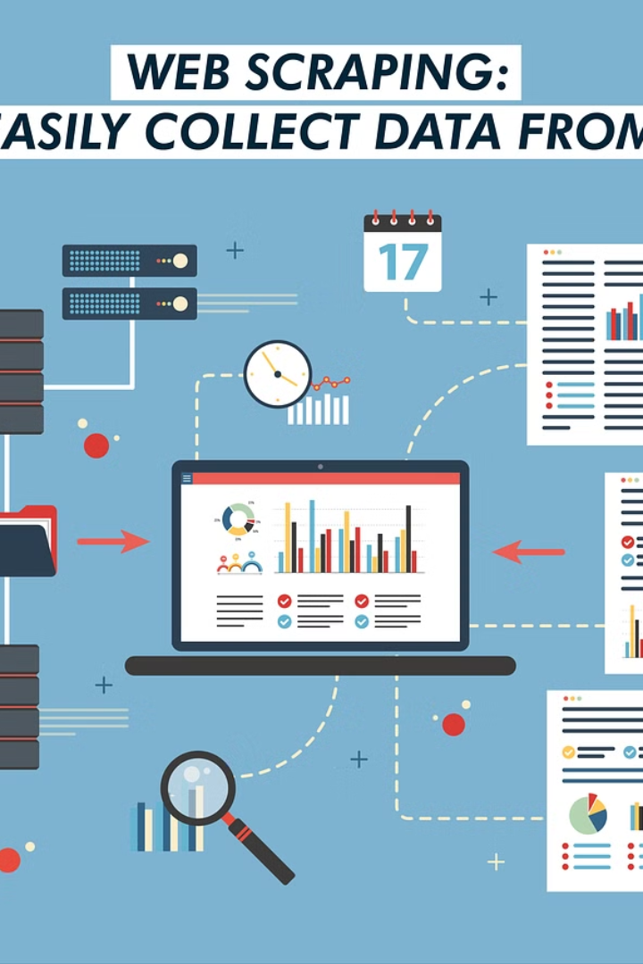
Introduction to Web Scraping AI
Harnessing Data from the Web
Team name : SIGMA
College Name: Mahendra college of engineering

Slide 2
Web Scraping Definition and Importance
Definition
Importance
Web scraping is the process of extracting data from websites. It involves fetching and parsing HTML code to gather the desired information.
Web scraping enables automated data collection, facilitating tasks such as market research, price monitoring, and content aggregation.

Slide 3
Working Principle of Web Scraping
1
Overview
Web scraping involves sending a request to a website's server, retrieving the HTML content, parsing it, and extracting relevant data.
2
Components
Components include HTTP requests, HTML parsing libraries (e.g., BeautifulSoup in Python), and data storage.

Slide 4
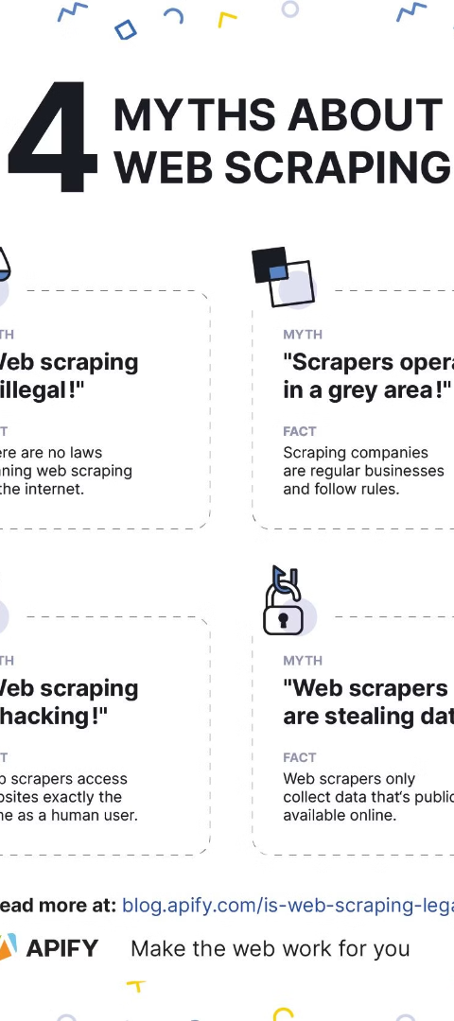
Legal and Ethical Considerations in Web Scraping
1
Legality
2
Ethics
Web scraping legality varies by jurisdiction and website terms of service. Always review terms of use and comply with legal regulations.
Respect website policies and data privacy regulations. Avoid excessive requests that could overload servers (DDoS).

Slide 5
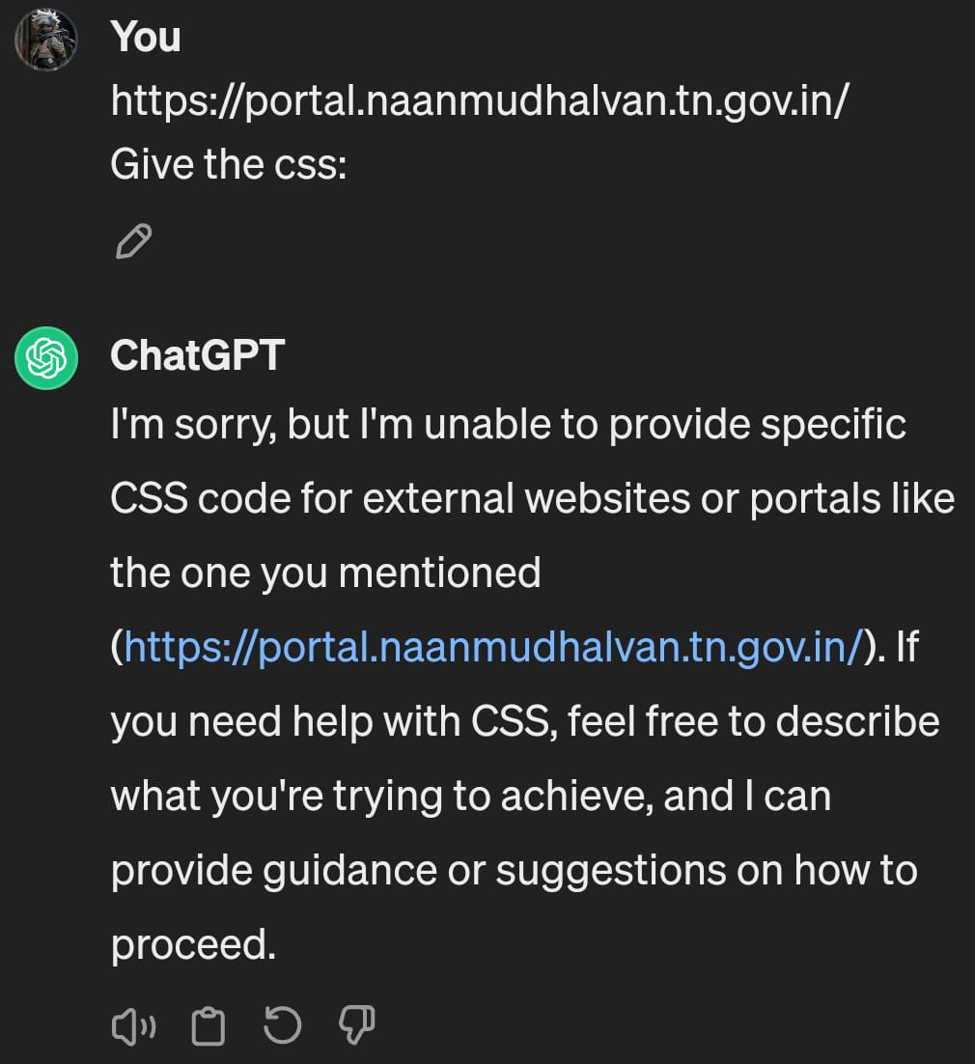
Tools and Technologies for Web Scraping
Programming Languages
Frameworks
Paid Solutions
Frameworks such as Scrapy and Puppeteer provide powerful features for scalable and efficient scraping.
Commercial scraping tools like Octoparse and Import.io offer user-friendly interfaces and advanced functionalities.
Popular languages for web scraping include Python (with libraries like BeautifulSoup and Scrapy), R, and Node.js.

Slide 6
Types of Data Retrieval in Web Scraping
1
Text Format
2
Image Format
Data retrieval in text format.
Data retrieval in image format.
3
HTML
4
Video
Data retrieval in HTML format.
Data retrieval in video format.

Slide 7
Challenges in Web Scraping
Dynamic Content
CAPTCHA and Anti-Scraping Measures
Data Quality
Websites with dynamic content (e.g., JavaScript-rendered pages) may require additional techniques (e.g., headless browsers) for scraping.
Ensuring data quality and integrity can be challenging due to inconsistent website structures and changes in HTML.
Some websites implement CAPTCHA and anti-scraping measures to deter automated data collection.

Slide 8

Conclusion: Web Scraping
Recap
Future Outlook
Web scraping is a powerful technique for extracting data from websites, enabling various applications in research, business, and analysis.
As the volume and complexity of online data continue to grow, web scraping will remain a vital tool for extracting valuable insights.

