Slide 1


MAHENDRA COLLEGE OF ENGINEERING
CATCH ‘25 – Hackathon
Name of the College : Mahendra College of Engineering
Name of the Team : Sigma
Name of the Team Leader : Rajesh S
Name of the Department : Information Technology
Problem Statement : Smart Attendance System: Build a facial
recognition-based attendance system for scholls/colleges
Date : 04/03/2025

Slide 2
CREW DETAILS
NAME OF THE STUDENT | YEAR | DEPARTMENT | DESIGNATION | E MAIL ID
RAJESH S | III | Information Technology | Team Leader | rajkrish2255@gmail.com
PRAKASHRAM J | III | Information Technology | Team Member | jprakashram11@gmail.com
PRAVEEN KUMAR S | III | Information Technology | Team Member | pk3977293@gmail.com
MURALI R | III | Information Technology | Team Member | mr5486563@gmail.com
MOHANRAJ S | III | Information Technology | Team Member | rajmohankd22102003@gmail .com

Slide 3
MODULE LIST
ABSTRACT
IDEA/APPROACH DETAILS
FLOW CHART
TECH STACK AND DEPENDENCIES
METHODOLIGIES OR ALGORITHMS FOCUSED
ANALYSIS PART OF THEIR PROJECT
EXPECTED OUTCOME
SOCIAL RELEVANCE
CONCLUSION AND FUTURE WORK

Slide 4
ABSTRACT
Traditional attendance systems are time-consuming & error-prone.
We propose an AI-based Face Recognition Attendance System using OpenCV & face_recognition.
The system captures students' faces, recognizes them, and marks attendance automatically.
Attendance is stored in an Excel file (YYYY-MM-DD.xlsx) and sent via automated email.
Improves efficiency, accuracy, and security in attendance tracking.

Slide 5
IDEA/APPROACH DETAILS
Face Registration: Student images are stored in the Images/ folder.
Face Detection & Recognition:
Uses OpenCV & face_recognition to detect faces from a live camera feed.
Matches faces with stored images in Images/.
Attendance Marking:
Matches student names from data.xlsx.
Marks "Present" in YYYY-MM-DD.xlsx if within the time slot.
Email Automation:
At 09:35 AM & 04:25 PM, the system sends the daily attendance report via email.

Slide 6
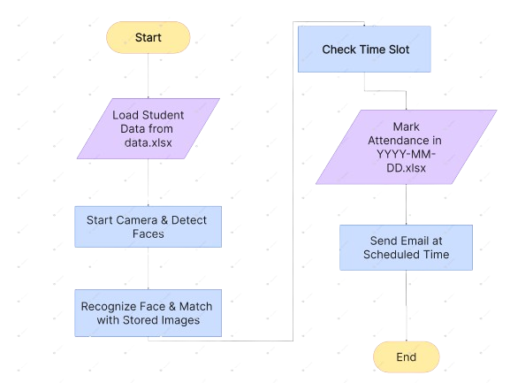
FLOW CHAT

Slide 7

METHODOLIGIES OR ALGORITHMS FOCUSED
📌 Technologies Used:
OpenCV → For face detection
face_recognition (Dlib-based) → For face matching
OpenPyXL → For handling Excel files
SMTP (smtplib) → For email automation
Schedule Library → For timed email sending
📌 Algorithm Used:
Haar Cascade Classifier (for face detection)
HOG + CNN-based Face Recognition

Slide 8
ANALYSIS OF THE PROJECT
📌 Performance & Accuracy:
Faster than manual attendance (~1 second per student).
Face recognition accuracy ~95% in good lighting.
Prevents proxy attendance (only real-time face scanning).
Works in real-time using a standard laptop camera.

Slide 9
EXPECTED OUTCOME
📌 What We Achieve:
✔ Accurate & real-time attendance marking 📸
✔ Eliminates proxy attendance & manual errors ✍
️
✔ Saves time & reduces workload for teachers ⏳
✔ Fully automated attendance reports via email 📧
✔ Easy to maintain, scalable, and cost-effective 💰

Slide 10
SOCIAL RELEVANCE
📌 Impact on Education & Workplaces:
✔ Reduces administrative workload → No need for manual roll calls.
✔ Prevents fraud → Stops proxy attendance in schools, colleges, and offices.
✔ Eco-friendly → No paper registers needed (digital attendance).
✔ Time-efficient → Increases productivity in classrooms & offices.
✔ Can be used in exams, voting, office attendance, and public security

Slide 11
CONCLUSION AND FUTURE WORK
📌 Final Takeaways:
Smart Face Recognition Attendance System is a fast, secure, and automated solution.
Helps teachers, organizations, and workplaces by reducing manual work.
Future Improvements:
Adding Cloud Storage for centralized access.
Mobile App Integration for real-time monitoring.
Using AI to improve face detection in low-light conditions.
A step towards a digital & smart future! 🚀

Slide 12
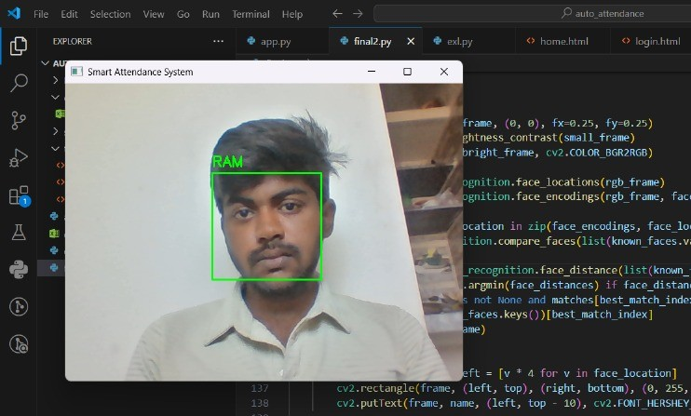
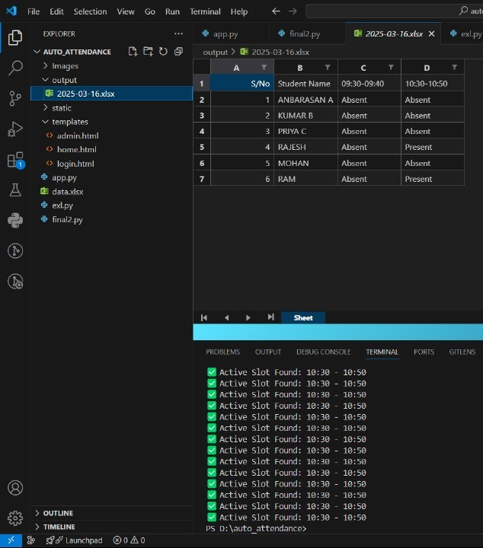
Output

Slide 13
THANK YOU !

