Slide 1
C Programming
Mr. Rohit Kumar

Slide 2
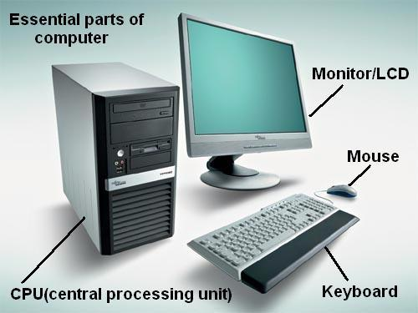
Introduction to Computers
1. What is a Computer?
A computer is an electronic programmable device that accepts data as input,
processes it according to instructions, stores data when required, and
produces useful output.
Computer = Input → Processing → Output → Storage

Slide 3
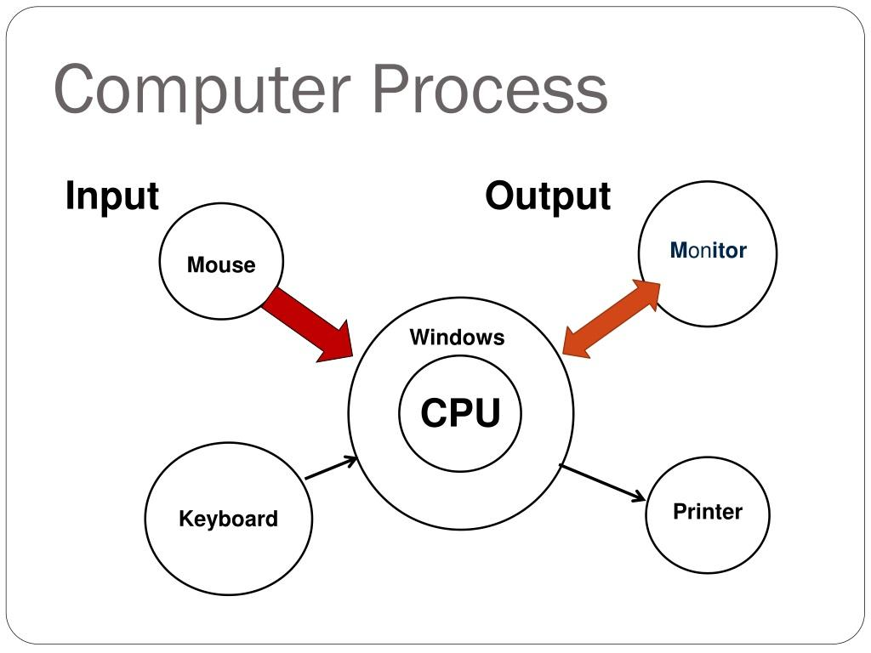
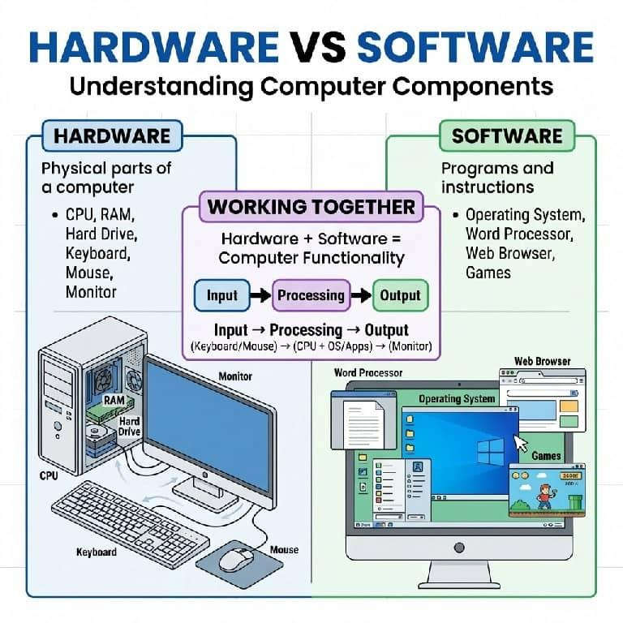

Slide 4
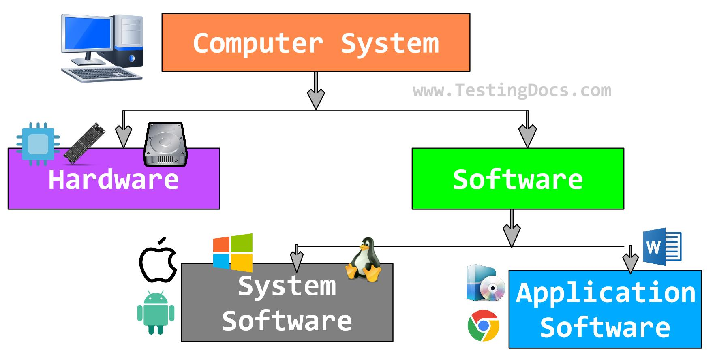

Slide 5
Input Devices
Input devices are used to enter data and instructions into the computer.
Device | Purpose
Keyboard | Enter text, numbers and commands
Mouse | Point, click and select
Scanner | Convert physical documents/images into digital data
Microphone | Input sound
Webcam | Input images/video
Touchscreen | Accept touch input

Slide 6
CPU – Central Processing Unit
The CPU is the main processing unit of a computer. It executes instructions and performs calculations and logical operations.
CPU
│
┌───────┼────────┐
↓ ↓ ↓
ALU CU Registers
│ │ │
Arithmetic Control Temporary
& Logical Unit Data
Operations

Slide 7
Memory
Memory holds programs and data that the computer needs during operation.
RAM – Random Access Memory
RAM is temporary/volatile memory.
ROM – Read Only Memory
ROM stores information that generally remains available even when power is removed.

Slide 8
Storage
Storage is used for long-term data storage.
Examples:
SSD
HDD
USB/pen drive
Memory card

Slide 9
Output Devices
Output devices present the processed result to the user.
Examples:
Monitor
Printer
Speaker
Projector

Slide 10
Types of Programming Languages
1. Machine Language
Machine language is the lowest-level programming language. It consists of binary instructions (0 and 1) that the CPU can execute directly.
Example:
10110000 01100001

Slide 11
2. Assembly Language
Assembly language uses mnemonics instead of binary instructions.
Example:
MOV AX, 10
ADD AX, 20
Here:
MOV → move data
ADD → addition

Slide 12
3. High-Level Languages
High-level languages are designed to be easier for humans to read, write, and understand.
Examples:
C
C++
Java
Python
JavaScript
C#
Go
Rust

Slide 13
4. Procedural Programming Languages
A procedural language organizes a program as a sequence of procedures/functions.
Examples:
C
Pascal
FORTRAN

Slide 14
5. Object-Oriented Programming Languages
Object-oriented programming (OOP) organizes programs around objects and classes.
Class
Object
Encapsulation
Inheritance
Polymorphism
Abstraction
Examples:
Java
C++
C#
Python

Slide 15
6. Functional Programming Languages
Functional programming focuses on functions and expressions.
Examples:
Haskell
Lisp
Erlang
F#
Scala

Slide 16
7. Scripting Languages
Scripting languages are commonly used for automation, web development, and system tasks.
Examples:
JavaScript
Python
PHP
Ruby
Bash

Slide 17
Compiler
A compiler is a system software that translates a program written in a high-level programming language into machine code or another lower-level form that a computer can execute.
High-Level Source Code
↓
Compiler
↓
Machine/Object Code
↓
Executable
↓
CPU

Slide 18
Interpreter
Interpreter = Translates and executes program during runtime.
High-Level Source Code
↓
Interpreter
↓
Translate / Execute
↓
Output

Slide 19
Linker
A linker is a system program that combines object files and required libraries to create a final executable program.
Your C Program
↓
Compiler
↓
Object File
↓
+ ← C Library
↓
Linker
↓
Executable File

Slide 20
Loader
A loader is a system program that loads an executable program into main memory, performs necessary preparation such as relocation and runtime linking support, and transfers control to the program for execution.

Slide 21
C Source Code
↓
Compiler
↓
Object Code
↓
Linker
↓
Executable File
↓
Loader
↓
RAM
↓
CPU
↓
Program Runs

Slide 22
Algorithm
Algorithm = Step-by-step instructions to solve a problem.
Step 1: Start
Step 2: Read A
Step 3: Read B
Step 4: Calculate Sum = A + B
Step 5: Display Sum
Step 6: Stop

Slide 23
Algorithm vs Program
Algorithm | Program
Problem-solving procedure | Implementation of algorithm
Language independent | Written in a programming language
Written using steps/pseudocode | Written using code
Focuses on logic | Focuses on implementation
Can be represented using flowcharts | Executed by computer

Slide 24
Characteristics of an Algorithm
1. Input
An algorithm should accept zero or more inputs.
Example:
Input: A, B
2. Output
An algorithm should produce at least one output.
Example:
Output = 30

Slide 25
3. Definiteness
Every step must be clear, precise, and unambiguous.
Calculate Sum = A + B
4. Finiteness
An algorithm must terminate after a finite number of steps.
Example:
Step 1
Step 2
Step 3
Step 4
Stop

Slide 26
5. Effectiveness
Every instruction should be simple enough to be performed in a finite amount of time.
example:
Read A
Read B
Calculate A + B
Display result

Slide 27
Complexity Notations
Big O → O()
Big Omega → Ω()
Big Theta → Θ()

Slide 28
Big O Notation — O()
Big O notation describes an asymptotic upper bound on an algorithm's growth.
O(1)
O(log n)
O(n)
O(n log n)
O(n²)
O(2ⁿ)
O(n!)

Slide 29
Big Omega — Ω()
Big Omega notation describes an asymptotic lower bound on the growth of an algorithm.
Ω(1)

Slide 30
Big Theta — Θ()
Big Theta notation describes a tight asymptotic bound when the upper and lower bounds have the same order of growth.
for (int i = 0; i < n; i++) {
printf("%d", i);
}
Θ(n)

