Slide 1
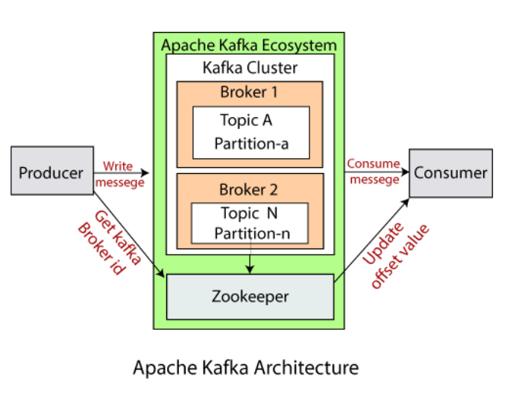
Apache Kafka - Simple Consumer Example
How to Create a Kafka Consumer in Java?
Create the consumer properties
Create a consumer
Subscribe the consumer to a specific topic
Create a Poll loop to receive data

Slide 2
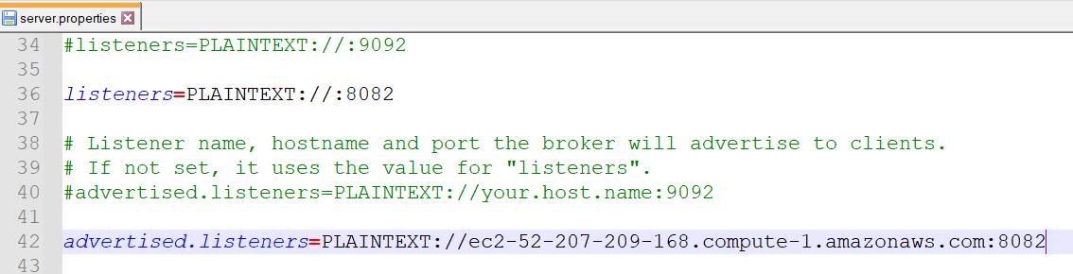
Apache Kafka - Simple Consumer Example

Slide 3
Apache Kafka - Simple Consumer Example
Create Kafka Consumer properties
Similar to the producer properties, Apache Kafka offers various different properties for creating a consumer as well.
To know about each consumer property, visit https://kafka.apache.org/documentation/#consumerconfigs Apache Kafka > Documentation > Configuration > Consumer Configs.
key.deserializer: It is a Deserializer class for the key, which is used to implement the org.apache.kafka.common.serialization.Deserializer interface.
value.deserializer: A Deserializer class for value which implements the org.apache.kafka.common.serialization.Deserializer interface.
bootstrap.servers: It is a list of host and port pairs that are used to establish an initial connection with the Kafka cluster. It does not contain a full set of servers that a client requires. Only the servers which are required for bootstrapping are required.
group.id: A unique string that identifies the consumer group this consumer belongs to.
auto.offset.reset: This property is required when no initial offset is present or if the current offset does not exist anymore on the server. There are the following values used to reset the offset values:
earliest: This offset variable automatically reset the value to its earliest offset.
latest: This offset variable reset the offset value to its latest offset.
none: If no previous offset is found for the previous group, it throws an exception to the consumer.
These are some essential properties that are required to implement a consumer

Slide 4
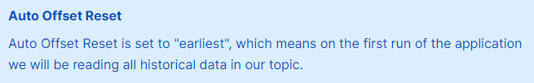
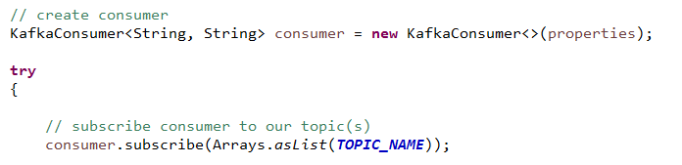
Apache Kafka - Simple Consumer Example
Create an object of KafkaConsumer leveraging our properties.
To read the messages from a topic, we need to connect the consumer to the specified topic. Here, we use Arrays.asList(),as it allows our consumer to subscribe to multiple topics.
Below code shows the implementation of subscription of the consumer to one topic.

Slide 5
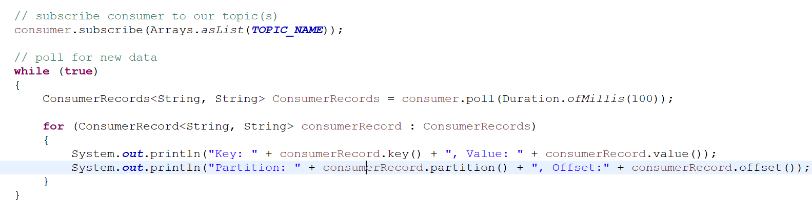
Apache Kafka - Simple Consumer Example
Poll for some new data:
The consumer reads data from Kafka through the polling method. The poll method returns the data that hasn't been fetched yet by the consumer subscribed to the partitions.
The duration of the poll call for example .poll(Duration.ofMillis(100)) is the amount of time to block on this call before returning an empty list in case no data was returned (also called long polling)

Slide 6
Apache Kafka - Simple Consumer Example
Read messages from the beginning:
In the last section, we assigned a group id of “Group99” to the consumer.
Stop the consumer application, and re-run it. You will notice there are no messages displayed in the console. This is due to the fact that Kafka keeps track of consumer reads (consumer groups offsets) and therefore the consumer will not encounter the same messages twice.
Change the group id to “Group100” and run the application you will see all the messages in the console
Partition Rebalance:
Moving partition ownership from one consumer to another is called a rebalance. Rebalances are important because they provide the consumer group with high availability and scalability.
Currently, we only have one consumer in our group, and therefore that consumer reads from all the topic partitions.
To see rebalances in action, launch another consumer by running the same consumer application.

Slide 7
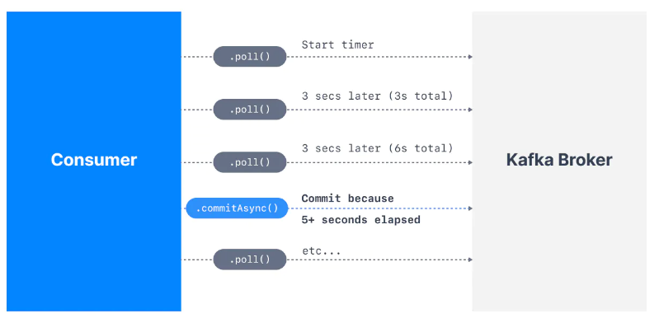
Automatic Offset Committing Strategy
Apache Kafka - Simple Consumer Example
Using the Kafka Consumer Java API, offsets are committed regularly and automatically in order to enable at-least-once reading scenarios.
By default, the property enable.auto.commit=true and therefore offsets are committed automatically with a frequency controlled by the config auto.commit.interval.ms.
The process of committing the offsets happens when the .poll() function is called and the time between two calls to .poll() is greater than the setting auto.commit.interval.ms (5 seconds by default).
This means that to be in an "at-least-once" processing use case (the most desirable one), you need to ensure all the messages in your consumer code are successfully processed before performing another .poll() call (which is the case in the sample code defined above). If this is not the case, then offsets could be committed before the messages are actually processed, therefore resulting in an "at-most once" processing pattern, possibly resulting in message skipping (which is undesirable).
In that (rare) case, you must disable enable.auto.commit, and most likely most processing to a separate thread, and then from time to time call .commitSync() or .commitAsync()with the correct offsets manually.

Slide 8
Apache Kafka - Simple Consumer Example
Graceful Shutdown of Consumer
Currently our consumer is running an infinite loop with while(true) but we can catch an Exception that happens when our consumer is shutting down.
For this, we need to call consumer.wakeup() which will trigger a WakeupException next time the .poll() function is called.
The WakeupException itself does not need to be handled, but then in a finally{} block we can call consumer.close() which will take care of: committing the offsets if needed and close the connection to Kafka
In order to call consumer.wakeup() we need to use a ShutdownHook. That ShutdownHook needs to be linked to the main thread in order to wait for all threads to complete before shutting down the program.

