Slide 1


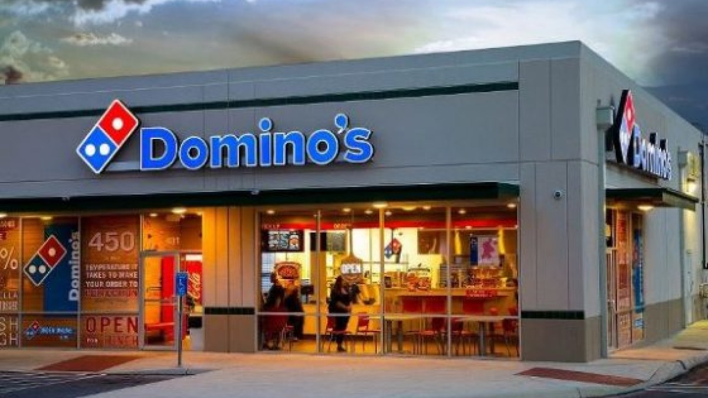
Proxy Explained Simply: Forward and Reverse Proxies Unveiled
Proxy: Imagine you want to order a pizza, but you don't want the pizza shop to know your exact address. So, you ask a friend to go and pick up the pizza for you. In this scenario, your friend acts as a proxy. The friend take your request (ordering pizza) and deliver it to the pizza shop on your behalf. Then, friend bring the pizza back to you without revealing your address to the pizza shop.
Proxy
Pizza Shop

Slide 2
Proxy Explained Simply: Forward and Reverse Proxies Unveiled
Forward Proxy: Continuing with the pizza analogy, let's say you're at school or Company, and the school or company has restrictions on what websites you can visit. But you really want to order a pizza online. So, you ask another friend who is outside of the school or company network to help you order the pizza. This friend acts as a forward proxy. They are outside the restricted network and can access the websites (like the pizza ordering website) that you can't. They take your request (ordering pizza) and fetch the pizza for you, then bring it back to you at school or company.
School or Company
(Restricted Network)
Forward Proxy
(Outside of Restricted Network)
Pizza Shop
Cannot access Pizza website

Slide 3


Proxy Explained Simply: Forward and Reverse Proxies Unveiled
Reverse Proxy: Now, let's flip the scenario. Imagine you have a popular food truck, and there's a huge line of people waiting to order from your truck. To make the process smoother, you hire someone to stand in front of your truck and take orders from the customers. This person acts as a reverse proxy. This person receive all the orders from the customers and pass them to you in an organized manner. You prepare the food and give it back to the reverse proxy, who then hands it out to the customers. The customers only interact with the reverse proxy and don't directly communicate with you (the food truck owner).
People waiting to order
from your truck
Reverse Proxy
Food Truck

Slide 4
Proxy Explained Simply: Forward and Reverse Proxies Unveiled
So, in summary:
Proxy: Acts on behalf of someone else, hiding their identity or location.
Forward Proxy: Helps you access restricted websites from within a restricted network by fetching content on your behalf.
Reverse Proxy: Helps manage incoming requests from clients to servers, acting as an intermediary between them, often used for load balancing, caching, or security purposes.

