Slide 1

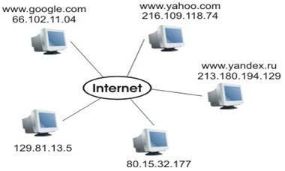

Internet Addresses Demystified: What is an IP Address and Port, Explained Simply
Imagine that you want to send a letter to a friend who lives in a different town. To make sure your letter reaches your friend's house, you need two important things: their home address and a specific mailbox where they collect their mail.
House == Computer
Address of the House == IP Address

Slide 2
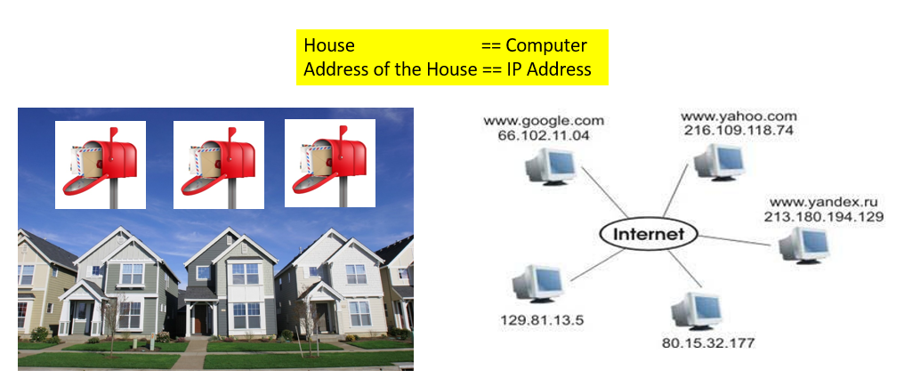
Internet Addresses Demystified: What is an IP Address and Port, Explained Simply
In the world of computers and the internet, an IP (Internet Protocol) address is like your friend's home address. It's a unique set of numbers that identifies a specific computer or device on the internet. Every computer connected to the internet has its own IP address, just like every house has a unique street address.
Now, think of the port number as the specific mailbox at your friend's house. Just like your friend may have different mailboxes for different purposes (one for regular mail, another for newspapers, etc.), computers use different port numbers to receive specific types of data. For example, a web server might use port 80 to receive web page requests, and an email server might use port 25 to accept incoming emails.
House == Computer
Address of the House == IP Address
Specific mailbox == Port Number

Slide 3
Internet Addresses Demystified: What is an IP Address and Port, Explained Simply
So, when you send data over the internet, it's like sending a digital letter. The IP address ensures it goes to the right computer (just as an address on an envelope ensures your letter reaches the correct house), and the port number tells the computer which specific "mailbox" to put the data in so that the right application or service can receive and process it.
In summary, an IP address is like a computer's home address on the internet, and a port number is like a specific mailbox at that address where data is delivered for a particular purpose. Together, they make sure your digital information gets to the right place on the internet.
House == Computer
Address of the House == IP Address
Specific mailbox == Port Number

