Slide 1
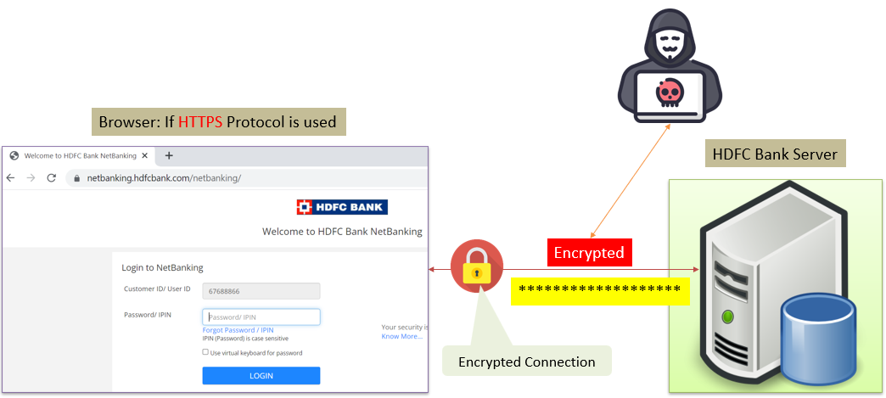
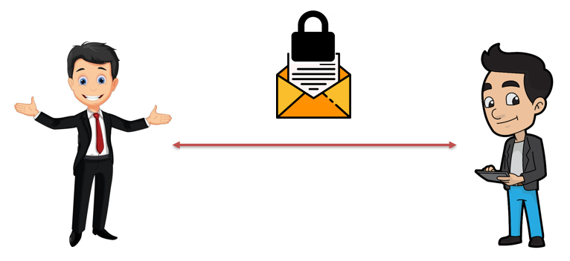
SSL, TLS, HTTPS Explained
Imagine you want to send a secret message to your friend, but you don't want anyone else to understand it.
SSL, TLS, and HTTPS are like special envelopes and locks that keep your message safe while it travels from your computer to a website's server.

Slide 2
SSL, TLS, HTTPS Explained
SSL (Secure Sockets Layer) and TLS (Transport Layer Security):
SSL and TLS are security technologies that make sure your message is encrypted, meaning it's scrambled into a secret code that only your friend's computer and the website's server can understand. This way, even if someone tries to peek at your message while it's moving across the internet, they won't be able to make sense of it because it's encrypted.

Slide 3
SSL, TLS, HTTPS Explained
HTTPS (Hypertext Transfer Protocol Secure):
HTTPS is like a special address that tells your web browser to use SSL or TLS to secure your communication with the website.
When you see "https://" in the website's address, it means your connection to that site is protected, and it's safe to share sensitive information like passwords, credit card numbers, or personal details.

Slide 4
SSL, TLS, HTTPS Explained
In summary, SSL and TLS are the technologies that encrypt your messages, and HTTPS is the secure way of sending and receiving information on the internet, keeping your data safe from prying eyes.
Just remember, when you see "https://" in the address bar, you can feel confident that your online interactions are secure.

