Slide 1

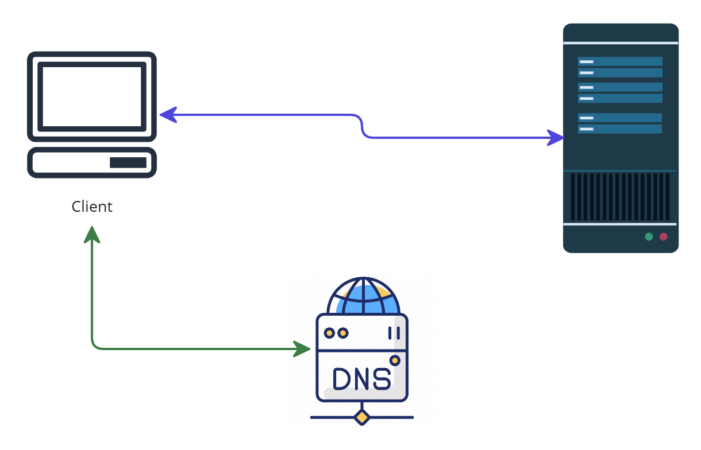


What happens when you type a URL into your browser?
Peter enters a URL into the browser and hits enter. What happens next?
Web Server
DNS Server

Slide 2
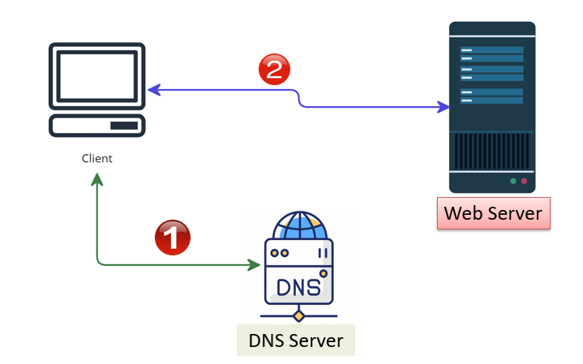
What happens when you type a URL into your browser?
DNS Resolution
Establishing a Connection
Sending the Request
Processing the Request
Server Response
Downloading the Content
Rendering the Page
Additional Requests
Page Display

Slide 3
What happens when you type a URL into your browser?
1. DNS Resolution: The browser first extracts the domain name (e.g. www.google.com) from the URL and sends a request to a DNS (Domain Name System) server. DNS servers translate the domain name into an IP address, which is a unique identifier for the web server hosting the website.
2. Establishing a Connection: Once the IP address is obtained, the browser establishes a connection with the web server using the HTTP (Hypertext Transfer Protocol) or HTTPS (HTTP Secure) protocol. HTTPS is a secure version of HTTP that encrypts the data transmitted between the browser and the server.
3. Sending the Request: The browser sends an HTTP request to the web server, including the specific page or resource requested, along with additional headers that provide information about the browser and supported content types.
4. Processing the Request: The web server receives the request and processes it accordingly. This may involve running server-side scripts, accessing databases, or retrieving files from the server's storage.
5. Server Response: After processing the request, the web server generates an HTTP response. This response contains the requested web page's content, along with metadata such as response headers, status codes, and cookies.

Slide 4
What happens when you type a URL into your browser?
6. Downloading the Content: The browser starts downloading the response content, which typically includes HTML, CSS, JavaScript files, and any additional resources like images or videos referenced in the HTML.
7. Rendering the Page: As the browser receives the downloaded content, it interprets and renders it according to the specifications defined by the web standards. HTML is used to structure the page, CSS styles it, and JavaScript adds interactivity and dynamic behavior
8. Additional Requests: During the rendering process, the browser may encounter additional resources referenced in the HTML, such as images, scripts, or stylesheets. It sends separate requests to fetch these resources, allowing the complete rendering of the web page.
9. Page Display: Once all the resources are downloaded and processed, the browser displays the fully rendered web page to the user, allowing interaction and navigation with the website.

