Slide 1

Demystifying URLs: The Internet's Address System Made Simple
Imagine the internet as a vast network of roads, and each website or webpage is like a house or building located somewhere along these roads.
Now, think of a URL (Uniform Resource Locator) as the address that tells your web browser exactly where to find a specific house or building on this internet road network.
Internet == Network of Roads
Website or Webpage == House or Building

Slide 2
Demystifying URLs: The Internet's Address System Made Simple
A URL is like a set of directions that includes all the information needed to reach a particular website or web page. It's made up of several parts:
Protocol: This is like telling your browser which type of vehicle to use on the internet roads. The most common one is "http://" or "https://," which determine whether you'll use a regular or secure path.
Domain Name: Think of this as the street name where the house or building is located. For google, "www.google.com" tells your browser to go to Google's street.
Internet == Network of Roads
Website or Webpage == House or Building

Slide 3
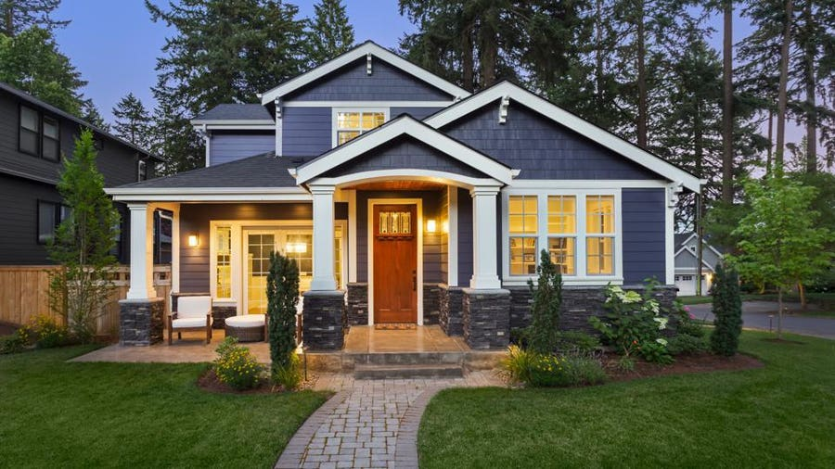
Demystifying URLs: The Internet's Address System Made Simple
Port (optional): Sometimes, a house or building might have multiple entrances or doors. The port is like specifying which door to use. It's usually left out, and the browser figures it out.
Path: If a website is like a big building with many rooms, the path is like telling your browser which room or floor to visit. For instance, "/images" might take you to a folder with pictures on the website.
Parameters (optional): These are like special instructions you might give to the person at the house, such as, "I'm looking for information on cats." Parameters help the website understand what you're looking for.
So, in simple terms, a URL is an address that helps your web browser find and display a specific webpage on the internet. It's like a combination of a street address and directions that lead you to the right place on the web.
Port == Door
Path == Room or Floor

Slide 4
Demystifying URLs: The Internet's Address System Made Simple
Website Homepage:
URL: https://www.google.com
Explanation: This is the web address for the homepage of a website named "google.com."
Specific Webpage:
URL: https://www.google.com/about-us
Explanation: This URL leads to a page on the same website, specifically the "About Us" page.
Image File:
URL: https://www.google.com/images/pic.jpg
Explanation: This URL points to an image file named "pic.jpg" located within a folder called "images" on the same website.
Search Query:
URL: https://www.google.com/search?q=flowers
Explanation: This URL includes a search query parameter "q" with the value "flowers," indicating that the user is searching for information about flowers on the website.
Login Page:
URL: https://www.google.com/login
Explanation: This URL takes you to the login page of the website, where users can log in to their accounts.
PDF Document:
URL: https://www.google.com/documents/report.pdf
Explanation: This URL links to a PDF document named "report.pdf" hosted on the website.
These examples demonstrate how URLs are used to navigate the internet and access specific websites, pages, files, or perform actions like searching or logging in.

