Slide 1
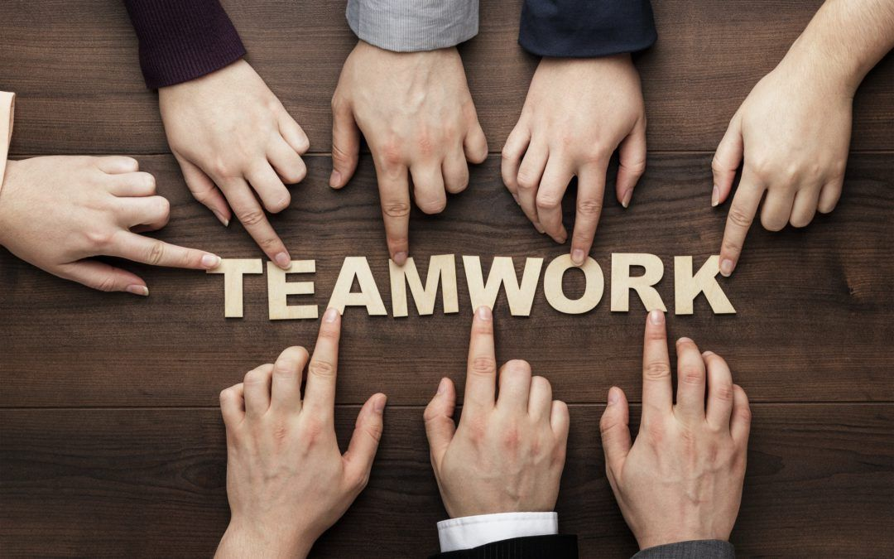
Scrum Demystified: Simplifying Teamwork for Project Success
Imagine you're part of a team tasked with building a really cool project, like creating a new video game or designing a fun app. Now, think of Scrum as a way to organize and manage this team's work to make sure everything gets done smoothly and efficiently.
In Scrum, the work is divided into smaller parts called "sprints." Each sprint is like a mini-race where the team focuses on completing specific tasks or goals within a short timeframe, usually around 1-4 weeks

Slide 2
Scrum Demystified: Simplifying Teamwork for Project Success
How Scrum works:
Team Collaboration: The team works closely together, almost like players on a sports team. Everyone has a role and knows what needs to be done.
Daily Stand-ups: Imagine having a quick team huddle every day to discuss what everyone did yesterday, what they're doing today, and if they have any challenges. It's like keeping everyone on the same page.
Backlog and Prioritization: There's a "backlog" or a list of all the tasks that need to be completed. The team, along with the project owner or manager, decides what's most important and prioritizes these tasks.
Iterative Progress: Instead of trying to do everything at once, Scrum encourages doing a little bit at a time and continuously improving. Each sprint builds upon the last one, like adding pieces to a puzzle until the whole picture is complete.
Review and Adapt: At the end of each sprint, the team looks back at what was accomplished and discusses what could be done better next time. This helps the team learn and adapt as they go along.

Slide 3
Scrum Demystified: Simplifying Teamwork for Project Success
Summary
Overall, Scrum is like a game plan that helps teams stay organized, work efficiently, and deliver awesome results. It's flexible enough to handle changes and challenges, making it a popular method for many modern projects.
So, if you hear someone talking about Scrum, just think of it as a smart and effective way for teams to tackle big tasks and create amazing things together!

