Slide 1
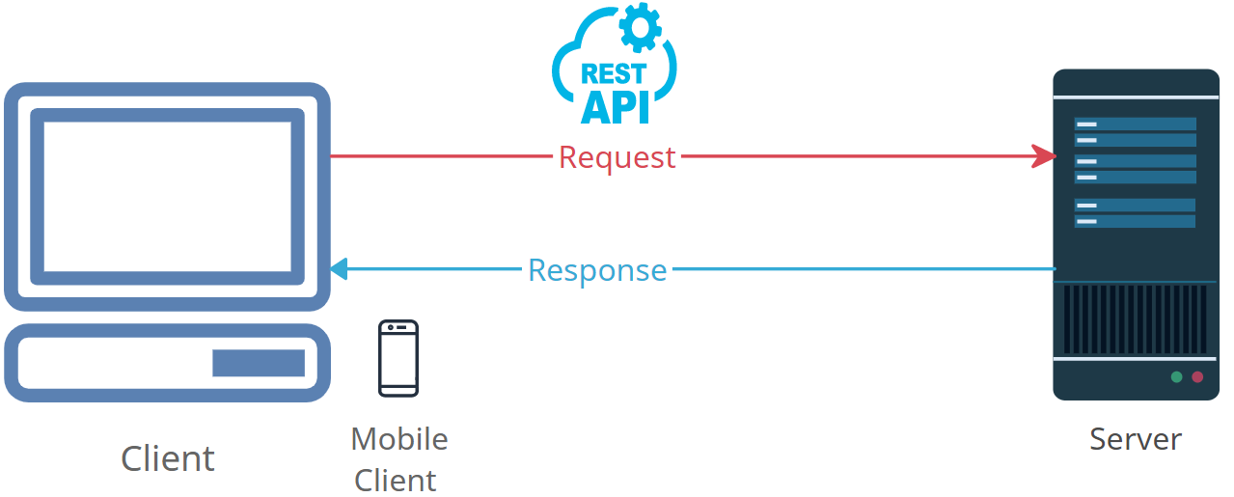
Demystifying HTTP Requests: How the Internet Fetches Web Pages
HTTP, or Hypertext Transfer Protocol, is a set of rules that helps computers communicate with each other over the internet.
When you use a web browser to visit a website, your browser sends something called an "HTTP request" to the server where that website is stored.

Slide 2
Demystifying HTTP Requests: How the Internet Fetches Web Pages
You Make a Request: Imagine you want to visit a website, like "www.google.com." So, you type this web address into your browser and hit "Enter.“
The Request is Sent: When you hit "Enter," your web browser sends an HTTP request to the server where "www.google.com" is located. This request is like saying, "Hey, I'd like to see what's on this website.“
The Server Responds: The server on the other end (where the website is hosted) receives your request. It then processes your request and sends back an "HTTP response." This response contains all the information needed to display the website on your screen.
Website Appears: Your web browser receives the response, unpacks it, and displays the website's content on your screen. You can now see the text, images, and other elements that make up the website.

Slide 3
Demystifying HTTP Requests: How the Internet Fetches Web Pages
In essence, an HTTP request is like a question you ask a server to fetch a specific web page for you. The server then provides the answer (the web page) that your browser displays. This process happens every time you click a link, enter a web address, or interact with a website on the internet. It's the foundation of how we access and view web content.

