Slide 1
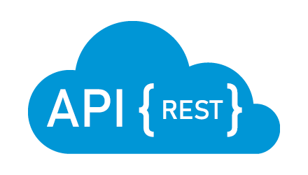
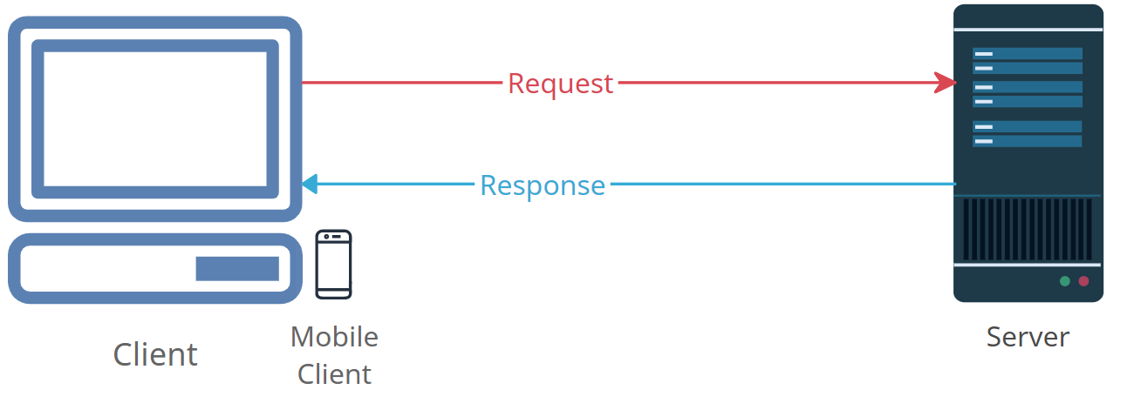
What Is REST API? Examples And How To Use It
REST is the most common communication standard between computers over Internet. We will see why it is so much popular?

Slide 2
What Is REST API? Examples And How To Use It
API stands for Application Programming Interface.
API is a way for two computers to talk to each other.

Slide 3
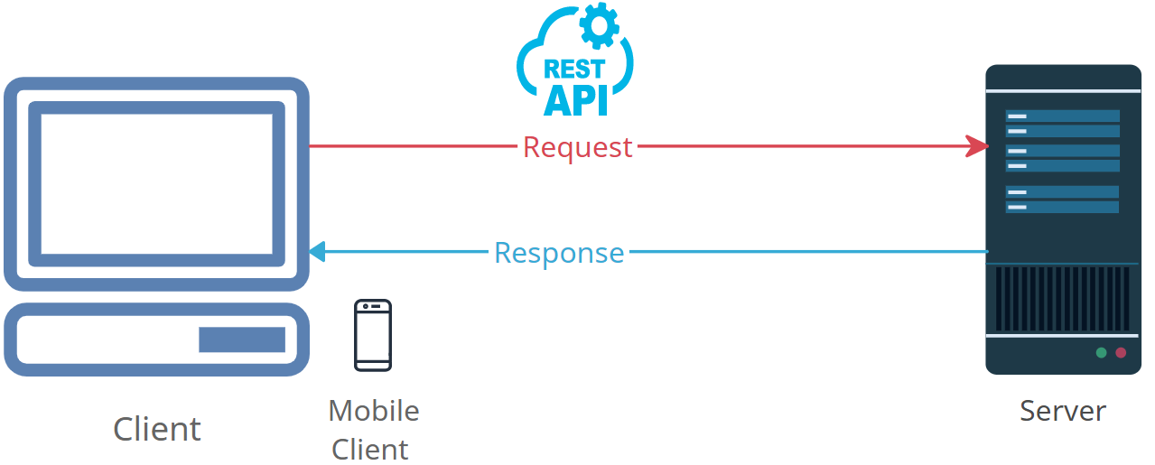
What Is REST API? Examples And How To Use It
The common API standard used by most mobile and web applications to talk to the servers is called REST.
REST stands for REpresentational State Transfer.

Slide 4
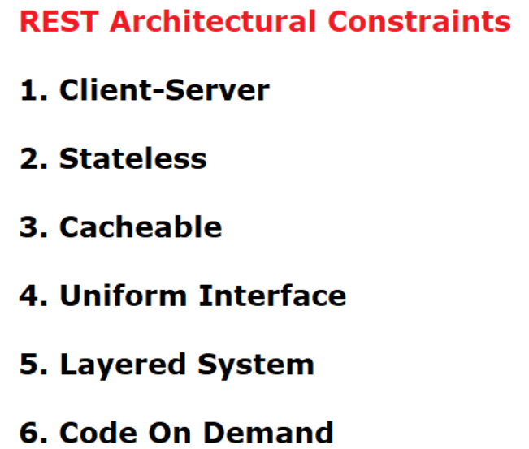
What Is REST API? Examples And How To Use It
REST is not a specification. REST is a new set of rules that has been the common standard for building
web API since the early 2000s.
An API that follows the REST standard is called a RESTful API. Some real-life examples are Facebook, Twitter and Google Maps.

Slide 5
What Is REST API? Examples And How To Use It
A RESTful API organizes resources into a set of unique URIs, or Uniform Resource Identifiers.
URIs
https://www.hdfc.com/api/v1/products
https://www.hdfc.com/api/v1/users

Slide 6
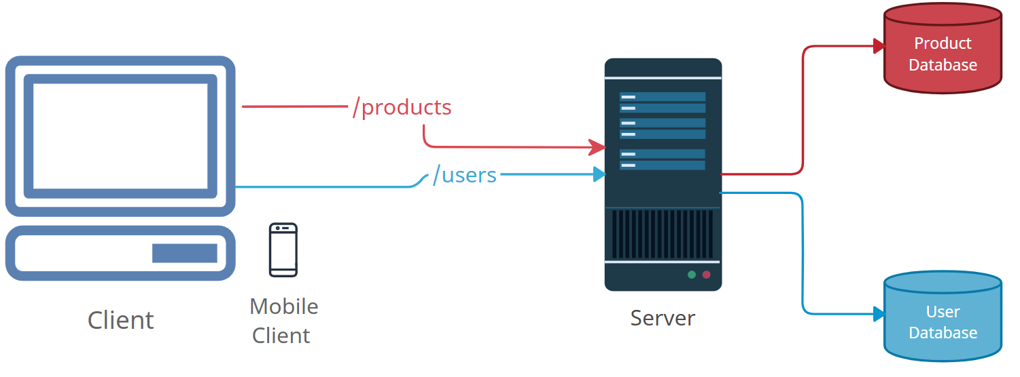
What Is REST API? Examples And How To Use It
The URIs differentiate different types of resources on a server.
The resources should be grouped by noun [e.g. products and users] and not verb
https://www.hdfc.com/api/v1/products
https://www.hdfc.com/api/v1/users

Slide 7

What Is REST API? Examples And How To Use It
An API to get all products should be slash products and not slash getAllProducts.
URIs
https://www.hdfc.com/api/v1/products
https://www.hdfc.com/api/v1/getAllProducts

Slide 8
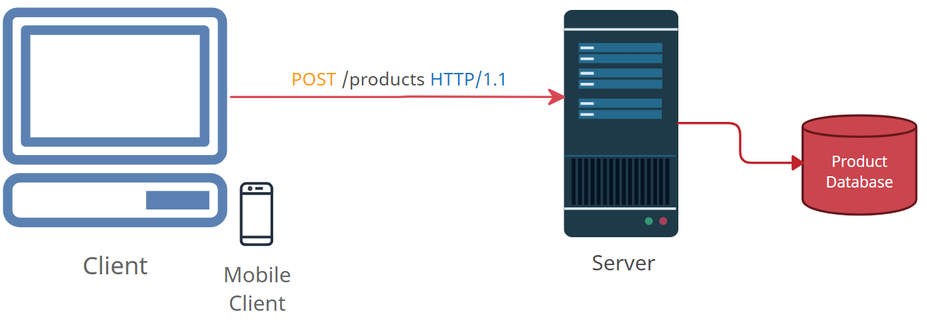
What Is REST API? Examples And How To Use It
A client interacts with a resource (i.e. products) by making a request to the endpoint for the resource (i.e. products) over HTTP. The request contains the URI for the resource (i.e. products) we'd like to access.
The URI is preceded by an HTTP verb (POST) which tells the server what we want to do with the resource (i.e. products) .
HTTP Verb
Resource

Slide 9
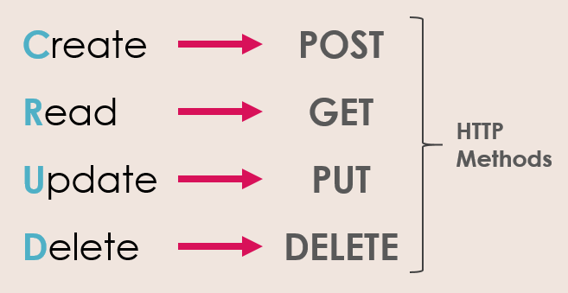
What Is REST API? Examples And How To Use It
A POST request means we want to create a new resource.
A GET means we want to read the data about an existing resource.
A PUT is for updating an existing resource.
A DELETE is for removing an existing resource.

Slide 10
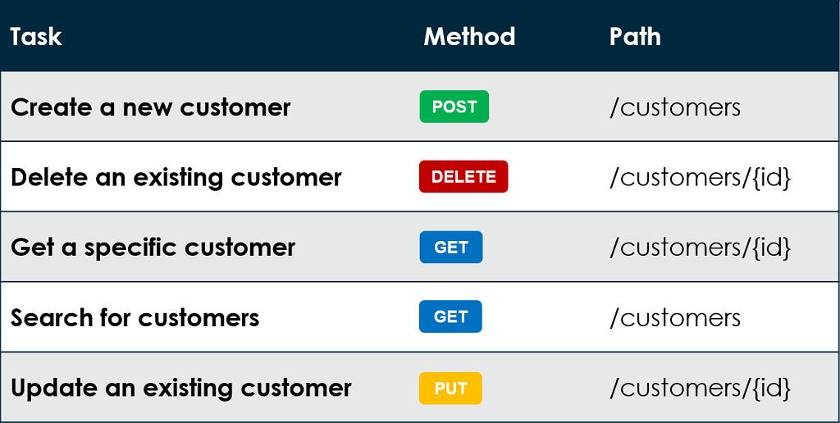
What Is REST API? Examples And How To Use It

Slide 11
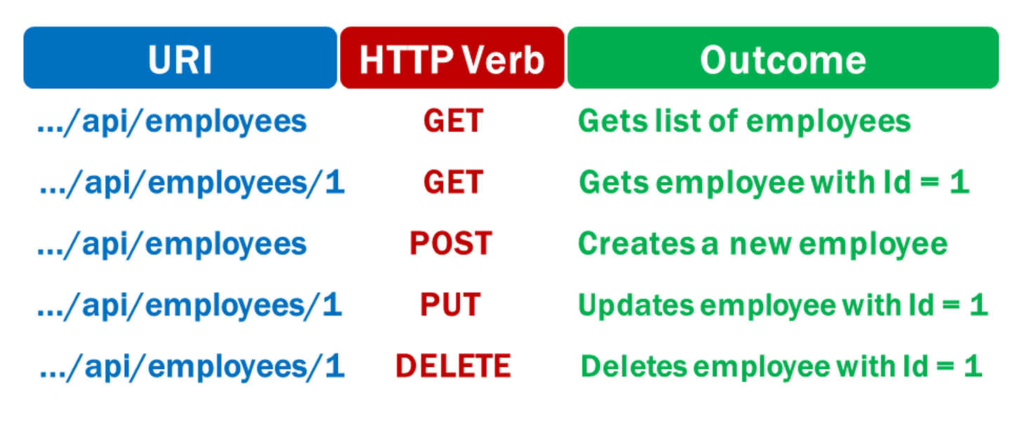
What Is REST API? Examples And How To Use It

Slide 12
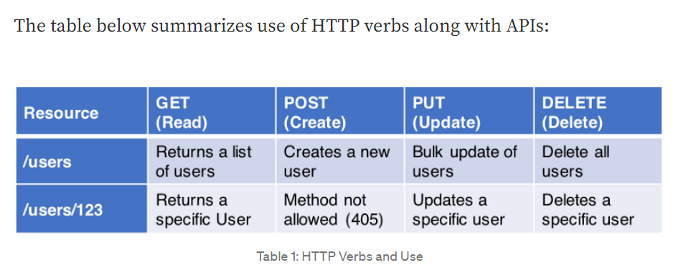
What Is REST API? Examples And How To Use It

Slide 13
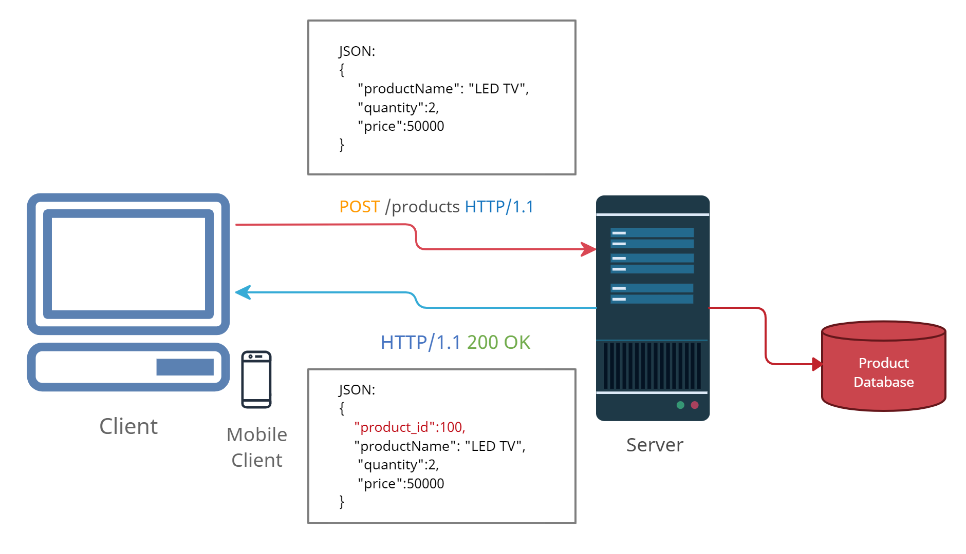
What Is REST API? Examples And How To Use It
In the body of these requests, there could be an optional HTTP request body that contains a custom payload of data, usually the data will be in JSON format.
The server receives a request, processes it, and formats the result into a response. The first line of the response contains the HTTP status code tell the client what happened to the request.
The response body is optional and could contain the data payload and is usually formatted in JSON.

Slide 14
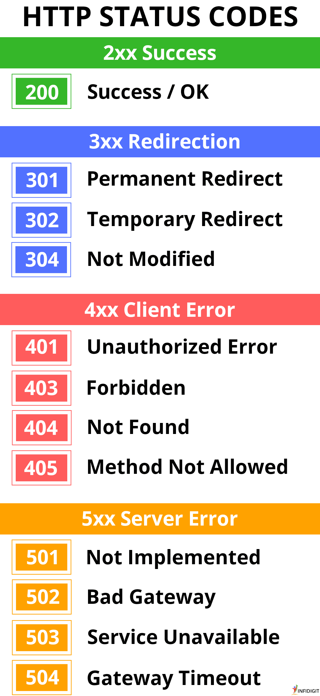
What Is REST API? Examples And How To Use It
A well-implemented RESTful API returns proper HTTP status codes.
The 200-level codes mean the request was successful.
The 400-level codes means something was wrong with our request. For example the requests contain incorrect syntax.
At the 500- level, it means something went wrong at the server level. For example, the service was unavailable.

Slide 15
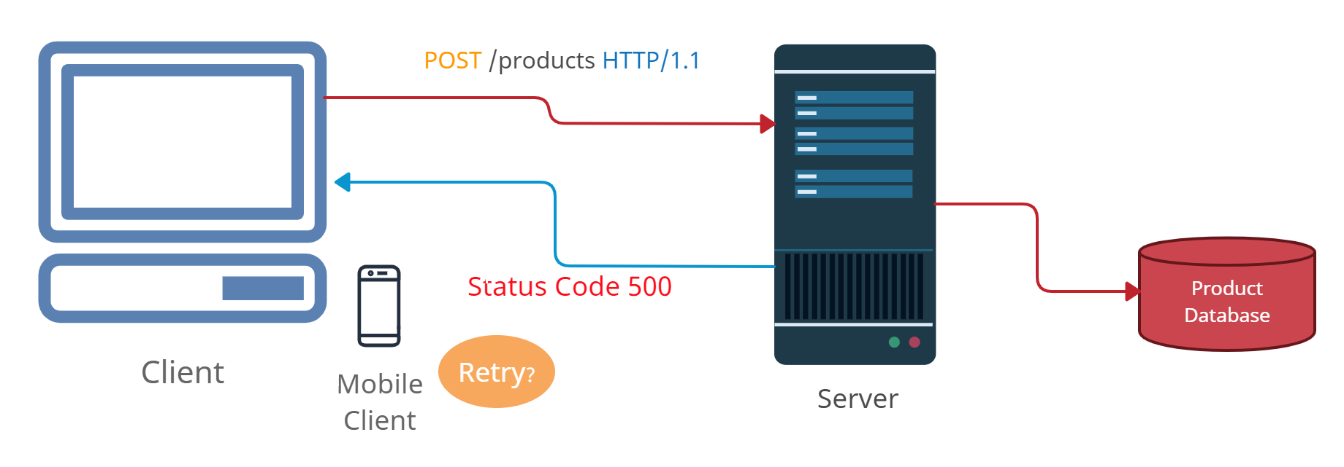
What Is REST API? Examples And How To Use It
A well-behaved client could choose to retry a failed request if the status code is 500 level. When client choose to retry client has to do carefully because some actions are not idempotent.
If the actions are not idempotent, then those action require extra care when the client retrying.

Slide 16
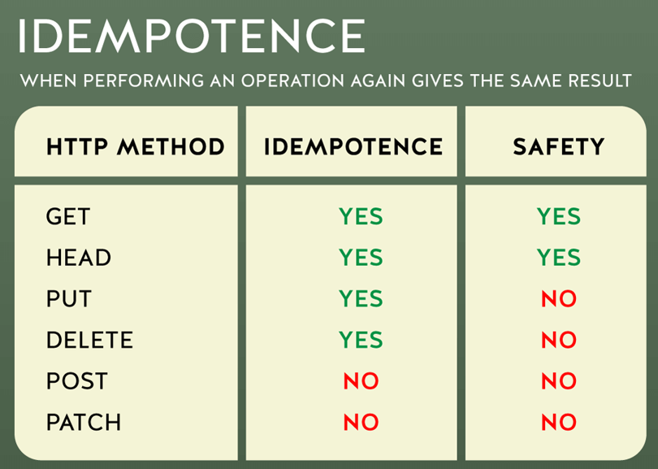
What Is REST API? Examples And How To Use It
When an API is idempotent, making multiple identical requests has the same effect as making a single request. This is usually not the case for a POST request because it will create a new resource.

Slide 17
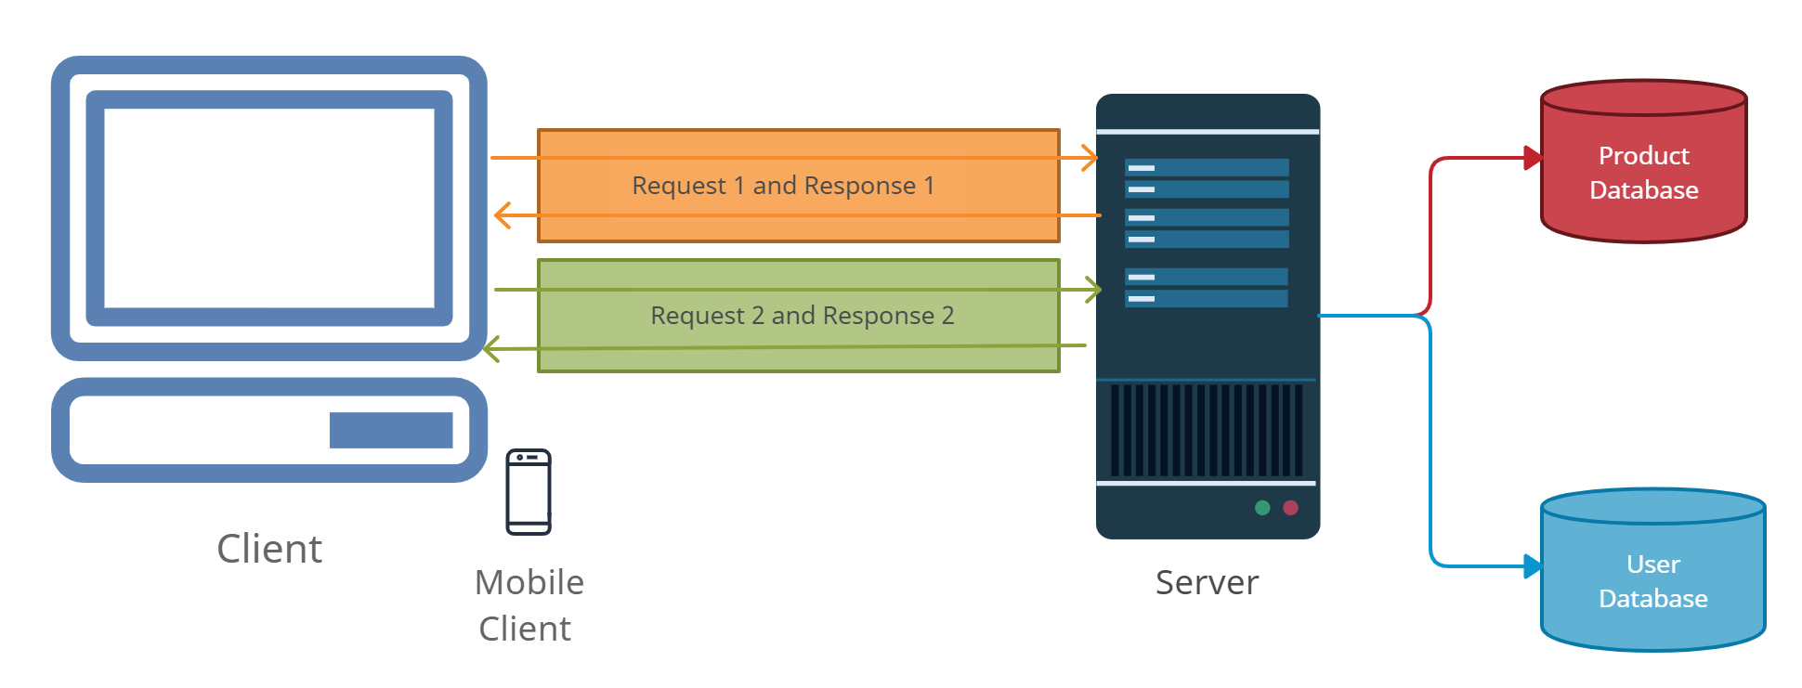
What Is REST API? Examples And How To Use It
A REST implementation should be stateless. It means the client and the server don't need to store any information about each other, and every request and response (cycle) is independent from all others. This leads to web applications that are easy to scale and well behaved.
Do not store state info
Do not store state info

Slide 18
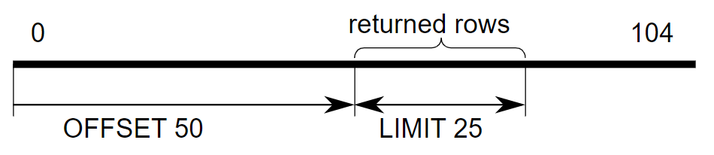
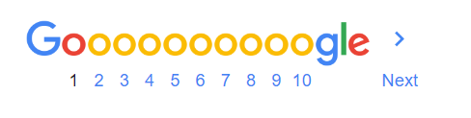
What Is REST API? Examples And How To Use It
If an API endpoint returns a huge amount of data, we have to use pagination.
A common pagination scheme uses "limit" and "offset" as parameters. If they are not specified, the server should use sensible default values.
/products?limit=25&offset=50

Slide 19
What Is REST API? Examples And How To Use It
Versioning of an API is very important. Versioning allows an implementation to provide backward compatibility, so that if we introduce breaking changes from one version to another, consumers can get enough time to move to the next version.
There are many ways to version an API. The most straight forward is to prefix the version before the resource on the URI.
/v1/products
/v2/products
/v3/products

