Slide 1
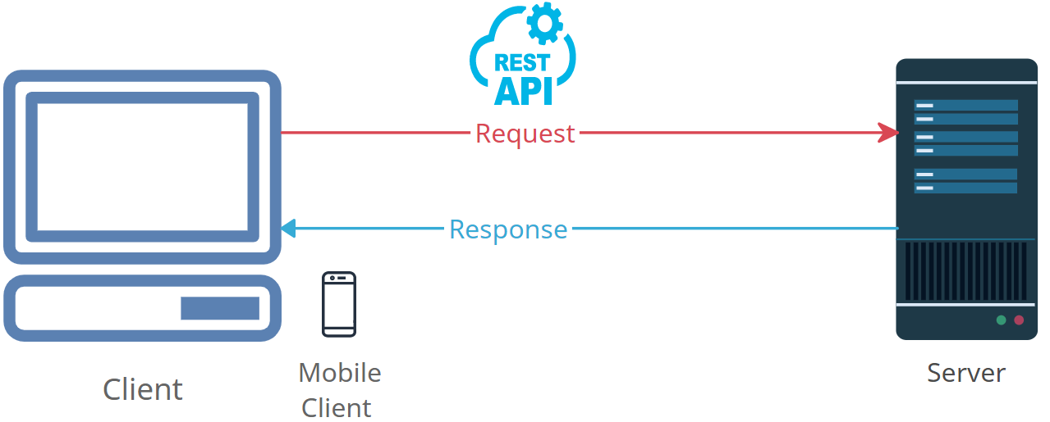
HTTP Methods Demystified: A Beginner's Guide to Web Requests
GET: This is like asking for information. When you use a GET request, you're telling the server, "Give me this web page or data." It's similar to opening a web page in your browser.
POST: Think of this as sending information to the server. When you make a POST request, you're saying, "Here is some data, please do something with it." It's like submitting a form online with your information.
PUT: Imagine you have an document with content, and you're putting new content in it. When you use PUT, you're saying, "Replace the existing data at this location with this new data." It's like overwriting a file with new content.
DELETE: This is like telling the server, "I want to get rid of something." When you use DELETE, you're asking the server to remove a resource, like a file or a record in a database.

Slide 2
HTTP Methods Demystified: A Beginner's Guide to Web Requests
PATCH: Think of PATCH as making small changes. Instead of sending a whole new document like with PUT, you're saying, "Please update this part of the data." It's like editing a specific section of a document without rewriting the whole thing.
HEAD: This is like asking for the headers of a response without getting the actual content. It's useful when you want to know metadata about a resource, like when a web page was last modified, without downloading the whole page.
OPTIONS: Think of this as asking the server, "What can I do here?" It's like checking the menu before ordering in a restaurant. The server tells you which HTTP methods are allowed for a particular resource.
These HTTP methods are like different actions or requests you can make when interacting with websites and web services, and they help you do various things like fetching data, sending data, updating, or deleting resources.

