Slide 1
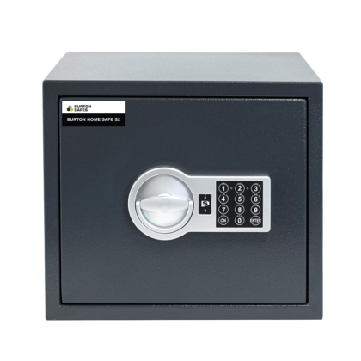
What Is Encryption at Rest, and Why Is It Important for Your Business?
Think of "Encryption at REST" like locking up your valuables in a safe.
When you store information, like your passwords, personal details, or important files, on a computer or a server, it's stored "at rest." Just like you'd want to keep your valuable belongings safe by putting them in a locked safe, encryption at rest is like putting a digital lock on that stored information.
Encryption is a way to turn your data into a secret code that's extremely hard for anyone without the right key to understand. So, when your data is "at rest" (stored somewhere), encryption makes sure that even if someone unauthorized tries to access it, they won't be able to understand it without the right digital key to unlock and decipher it.

Slide 2
What Is Encryption at Rest, and Why Is It Important for Your Business?
It's a bit like hiding your valuables in a locked safe – even if someone finds the safe, without the right key, they can't open it to see what's inside. Encryption at rest does the same thing for your stored digital information, keeping it safe and unreadable to anyone who doesn't have the special key to unlock it.

Slide 3
What Is Encryption at Rest, and Why Is It Important for Your Business?
Implementing "Encryption at REST" involves securing your stored data by converting it into an unreadable format using encryption techniques, ensuring its protection from unauthorized access. Here's a simplified step-by-step guide:
Understand Encryption: Encryption is like converting your sensitive information into a secret code using algorithms. It scrambles your data so that it appears as gibberish to anyone without the specific decryption key.
Choose Encryption Tools: Select encryption tools or software that suit your needs. There are various encryption methods, such as AES (Advanced Encryption Standard), which is widely used for securing data.
Identify Sensitive Data: Determine the sensitive information you need to protect, such as personal details, financial records, passwords, etc.
Encrypt Your Data: Use the chosen encryption tools to encrypt the identified sensitive data before storing it. This encryption process converts the data into an unreadable format using complex algorithms.
Secure Your Keys: Safeguard the decryption keys used to revert the encrypted data back to its original readable form. Store these keys separately and securely, ensuring only authorized individuals have access to them.

Slide 4
What Is Encryption at Rest, and Why Is It Important for Your Business?
Implement Encryption Tools or Services: If you're using databases, cloud storage, or specific platforms, explore and apply encryption features they offer. Many modern systems have built-in encryption options.
Regularly Update and Monitor Security: Keep your encryption tools updated and monitor the security of your encrypted data regularly. Stay informed about new encryption techniques and updates in the field of data security.
Remember, encryption is just one part of a broader security strategy. It's essential to complement it with other security measures like strong access controls, regular backups, and secure data handling practices to create a robust security environment for your stored data.
Always seek expert guidance or consult with professionals if you're dealing with sensitive information to ensure proper implementation of encryption practices.

