Slide 1
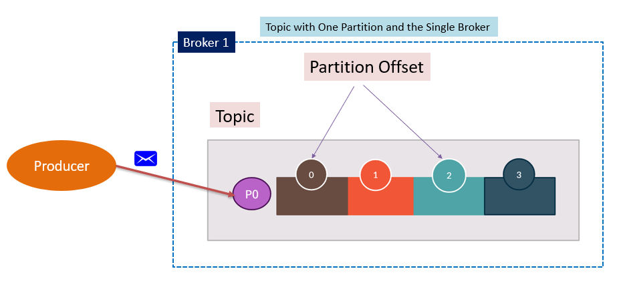


Consumer Group in Kafka with 1 partition and 2 consumer
Both consumers are registered to the same consumer group
One consumer will be sitting idle
The same partition cannot be assigned to multiple consumers in the same group
Consumer Group
Consumer 1
Consumer 2

