Slide 1
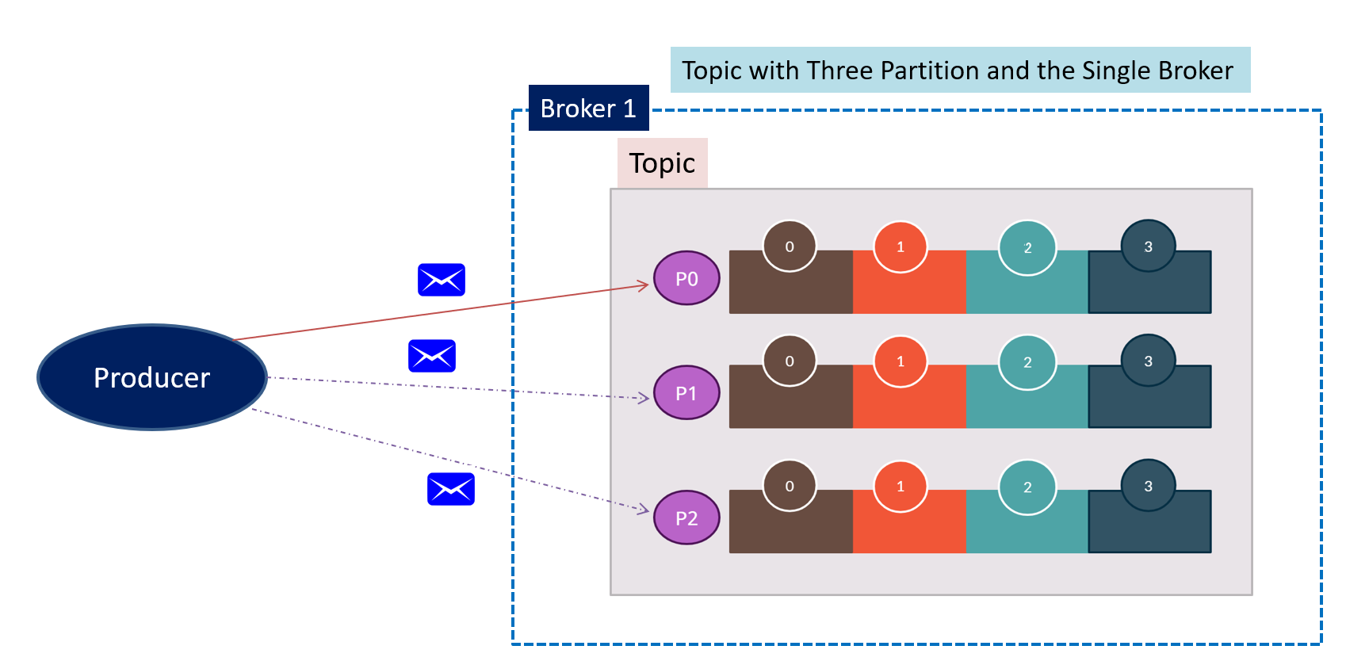
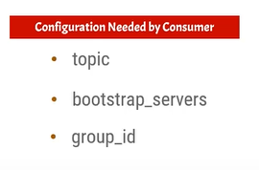
What is Kafka Consumer & Consumer Group?
Consumers are Kafka components that consume messages from the Kafka Topic
Internally consumer consume messages from the Kafka partition
Every consumer is always assigned to the consumer group
if no group_id is provided then a random group id is assigned
Consumer Group
Consumer 1

Slide 2
What is Kafka Consumer & Consumer Group?
A consumer group can be defined as a logical group of one or more consumers
It is mandatory for a consumer to register itself to a consumer group
Consumer instances are a separate process
Consumer instances of the same consumer group can be on different nodes
India
Consumer Group
Node 1
C1
USA
Node 2
C2
C3

Slide 3
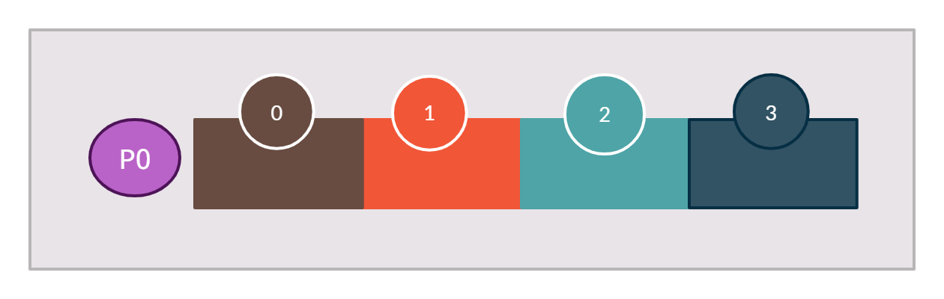

What is Kafka Consumer & Consumer Group?
All the messages will be published to a single partition
All the messages will be consumed by “Consumer 1”
Topic with One Partition and the Single Broker
Broker 1
Consumer Group
Partition Offset
C1
Topic
Producer

