Slide 1

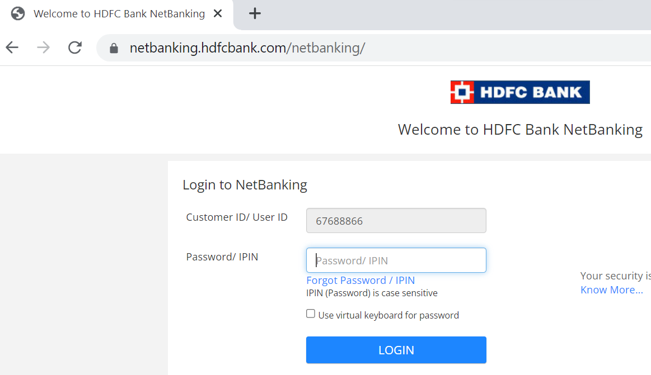

How does HTTPS work?
Without HTTPS, the communication between the browser and the server is in plain text.
This means that the password you enter, or the credit card number you send over internet, can be read by anyone who has the ability to intercept it.
Browser: If HTTP Protocol is used
HDFC Bank Server
Credit Card Number:
4545-9898-9876-1234
Password:1989898KL

Slide 2

How does HTTPS work?
HTTPS is designed to solve this problem - to make the data sent over the Internet unreadable by anyone other than the sender and the receiver.
HTTPS is an extension of the HTTP protocol. With HTTPS, data is sent in an encrypted form using something called TLS. TLS stands for Transport Layer Security. If the encrypted data gets intercepted by a hacker, all they could see is jumbled data. This is where TLS handshake comes in. Let's take a look at how this handshake works.
Browser: If HTTPS Protocol is used
HDFC Bank Server
Encrypted
*******************
Encrypted Connection

Slide 3
How does HTTPS work?
1.TCP Handshake
The browser establishes a TCP connection with the server.
Client
HDFC Bank Server
TCP SYN
TCP SYN + ACK
TCP ACK
Connection Established

Slide 4


How does HTTPS work?
In Step 2 TLS handshake begins. The browser sends a "client hello" to the server. In this hello message, the browser tells the server the following things:
1) What TLS versions the browser can support. It could be TLS 1.2, TLS 1.3, so on and so forth.
2) What cipher suites browser supports.
A cipher suite is a set of encryption algorithms to use to encrypt data.
Asymmetric Encryption
2.Certificate Check
Public key
Private key
Client
HDFC Bank Server
Client Hello
Server Hello
Certificate
Server Hello Done

Slide 5
How does HTTPS work?
After receiving the "client hello" the server gets to choose the cipher suite and the TLS version to use based on the options it got from the client. The server sends those in a "server hello" message back to the client.
The server then sends a certificate to the client. The certificate includes a lot of different things. One of the key things is the public key for the server.
The client uses the public key in asymmetric encryption. In asymmetric encryption, a piece of data that is encrypted by a public key can only be decrypted by the private key. This concludes step two - the hello phase of the TLS handshake. At this point, the client has a server certificate, and the client and the server have agreed on the TLS version and the cipher suite
Asymmetric Encryption
2.Certificate Check
Public key
Private key
Client
HDFC Bank Server
Client Hello
Server Hello
Certificate
Server Hello Done

Slide 6
How does HTTPS work?
In step three, the client and the server come up with a shared encryption key to use to encrypt data. and, this is where asymmetric encryption comes into picture. With asymmetric encryption, the data encrypted on the client side using the public key from the server, data can only be decrypted by the server using the private key.
This is how the client sends an encryption key safely to the server over the wide open internet. All this is done in the "client key exchange" message. The exact detail varies depending on the cipher suite used.
Asymmetric Encryption
3.Key Exchange
Public key
Private key
Client
HDFC Bank Server
Client Key Exchange
Change Cipher Spec
Finished
Change Cipher Spec
Finished

Slide 7
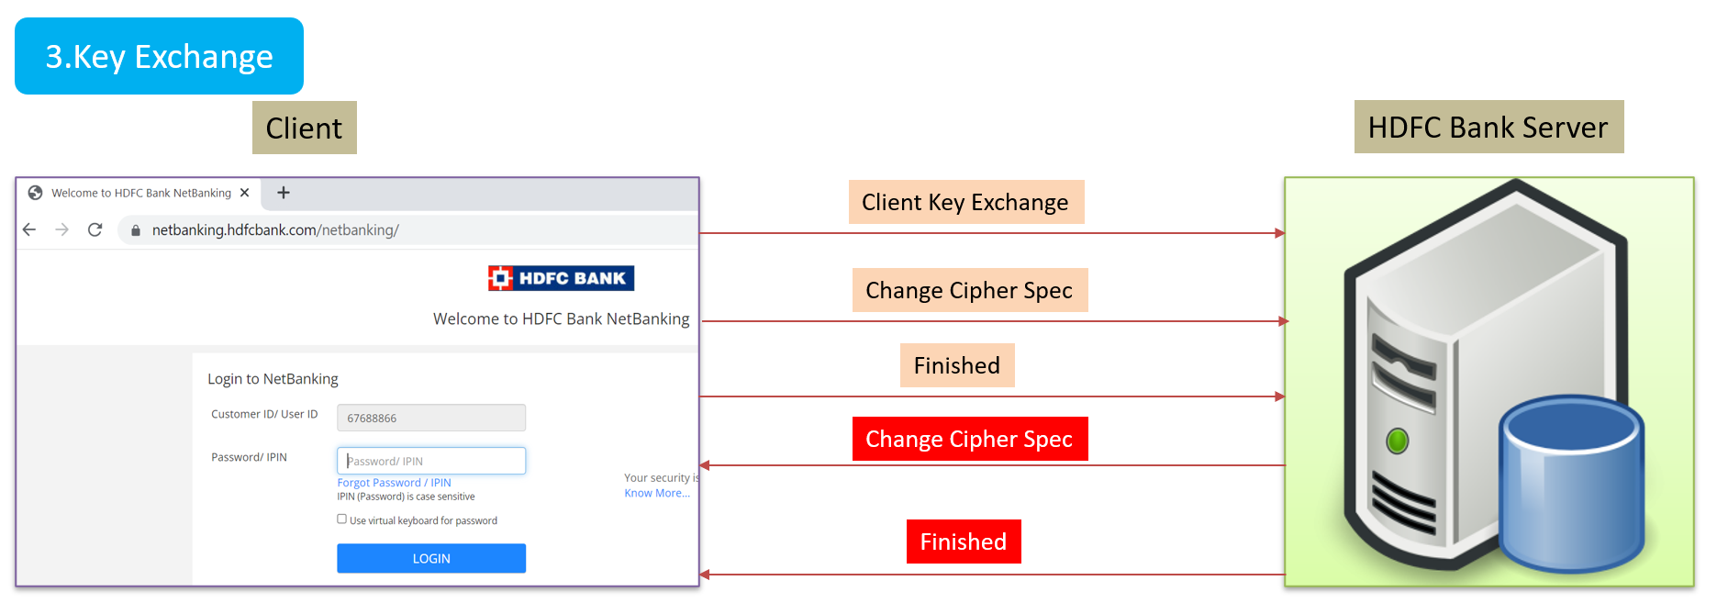

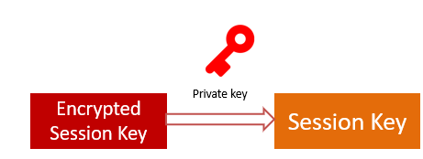
How does HTTPS work?
If we use RSA cipher suite as an example, then with RSA, the client generates an encryption key (also called a session key), encrypts session key with the server's public key using Asymmetric Encryption, and sends the encrypted session key to the server over the internet.
The server receives the encrypted session key and decrypts it with this private key. So now the server has the session key, too. Now, both sides hold the session key.
Asymmetric Encryption

Slide 8
How does HTTPS work?
In the Step 4 of TLS handshake, Where they use the session key and agreed-upon cipher suite to send encrypted data back and forth in a secure bi-directional channel.
Why don't we just use asymmetric encryption for everything? Why switch to symmetric encryption at all? The main reason is that asymmetric encryption is computationally expensive. This is not something suitable for bulk data transmission.
4.Data Transmission
Symmetric Encryption
Client
HDFC Bank Server
Encrypted Data
Session Key
Encrypted Data

Slide 9
How does HTTPS work?
The handshake we talked about applied to TLS 1.2, while the latest version of TLS is 1.3. And, TLS 1.3 is supported on all major browsers. As we can see in our explanation, TLS 1.2 takes two network round trips to complete. but TLS 1.3 optimizes the handshake to reduce the number of network round trip to 1. The core concepts in TLS 1.2 still apply to TLS 1.3.
In the above explanation, we used RSA for asymmetric encryption to securely exchange the symmetric session key. Again we chose RSA because it is easy to understand.
However, asymmetric encryption is not the only way to share the session key between the client and the server. In fact, in TLS 1.3, RSA is no longer supported as a method for key exchange. Diffie-Hellman is a more common way nowadays for exchanging session keys. Diffie-Hellman is complicated, but in a nutshell, it uses some advanced math involving large prime numbers to derive a shared session key, without ever transmitting a public key over the network.

