Slide 1
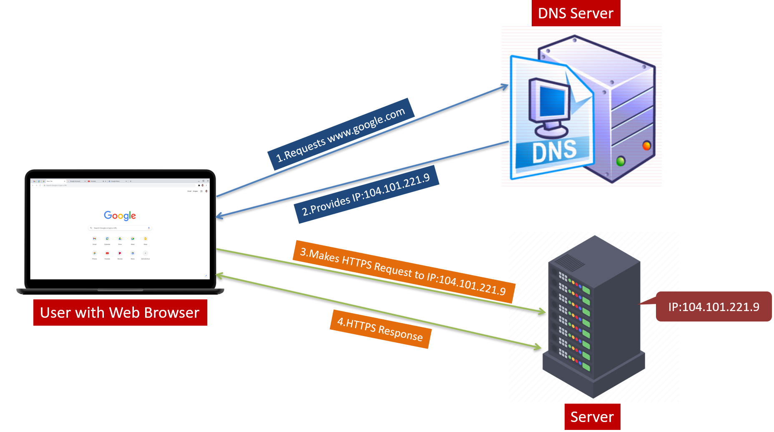
Understanding DNS: A Beginner's Guide
What is DNS?
DNS stands for Domain Name System. It's like a big directory or phonebook for the internet. Instead of phone numbers, DNS matches website names (like google.com) to their unique internet addresses, called IP addresses.

Slide 2
Understanding DNS: A Beginner's Guide
How does DNS work?
When you type a website name into your browser, your computer doesn't know where to find it. So, it asks a DNS server.
The DNS server looks up the website's name and finds its IP address. It's like looking up a friend's address in a phonebook.
Once your computer knows the website's IP address, it can connect to that website and load its content.

Slide 3
Understanding DNS: A Beginner's Guide
Why is it important?
DNS makes it easy for us to use the internet. Imagine having to remember long strings of numbers for every website you visit!
With DNS, we just need to remember website names, and DNS takes care of finding the right addresses for us.

Slide 4
Understanding DNS: A Beginner's Guide
How does it help?
DNS helps us find websites quickly and accurately. It's like having a GPS for the internet!
It also helps websites change servers or locations without you even noticing. DNS updates the directory so your computer can still find the website.

Slide 5
Understanding DNS: A Beginner's Guide
In Summary:
DNS is a system that matches website names to their IP addresses, making it easy for us to navigate the internet.
It's like a big directory or phonebook that helps our computers find the right addresses for websites we want to visit.

