Slide 1

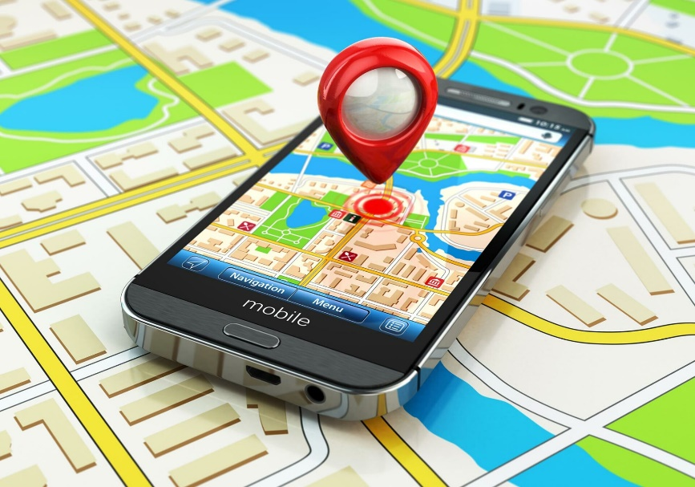
What is Service Discovery in Microservices?- Microservices Basics Tutorial
Imagine you're in a big city, and you're looking for a particular shop or restaurant. You could use a map or GPS to find it, right? Well, think of your computer network as a big city, and the different programs and services running on it as shops and restaurants.
Now, let's say you have lots of these services running, and they're all like little shops scattered around the city. Service Discovery is like having a friendly guide who knows where every shop is located. Instead of you having to memorize all the addresses, this guide keeps track of where each shop is and helps you find them easily.
Service Discovery
Big City
Map or GPS

Slide 2
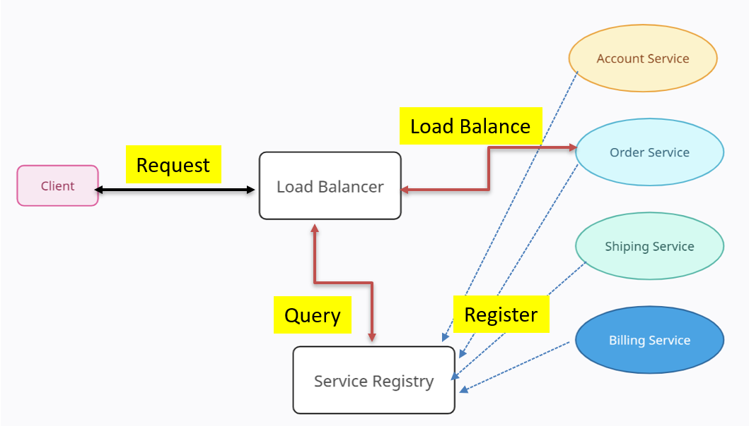
What is Service Discovery in Microservices?- Microservices Basics Tutorial
In the digital world, Service Discovery is a system that helps different parts of your applications and services find each other on the network. It's like a special map or directory that lists where everything is, so they can connect and work together without you needing to know exactly where each piece is located.
So, just like the friendly guide in our city, Service Discovery is your digital helper that makes sure your computer programs can find and talk to each other, even in a complex and busy network.

