Slide 1


What is Single Sign-On (SSO) | Why do we need SSO?
Imagine you have a bunch of different rooms in your house, and each room requires a different key to unlock the door.
Every time you want to enter a new room, you have to search for the correct key, and it can be quite frustrating and time-consuming.

Slide 2
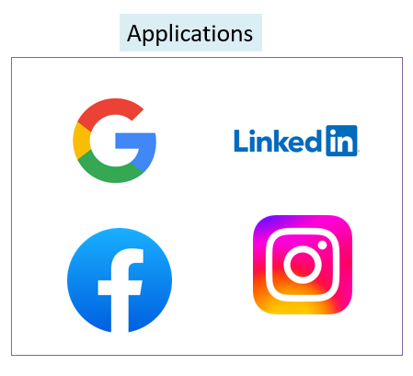
What is Single Sign-On (SSO) | Why do we need SSO?
Now, think of each room as a different website or application you use, and each key as a unique username and password you need to remember.
If you have many websites and apps, you end up with a lot of keys (usernames and passwords) to keep track of, which can become overwhelming.
One Room == One Website or Application
One Key == One Unique username and password

Slide 3


What is Single Sign-On (SSO) | Why do we need SSO?
Single Sign-On (SSO) is like having a magic key that can unlock all the doors in your house.
With SSO, you only need one key (one set of login credentials) to access multiple websites and applications.
So, instead of remembering different usernames and passwords for each site, you just use your magic key (SSO credentials) to get into all of them.
SSO credentials
(One Set of Login Credential)

Slide 4
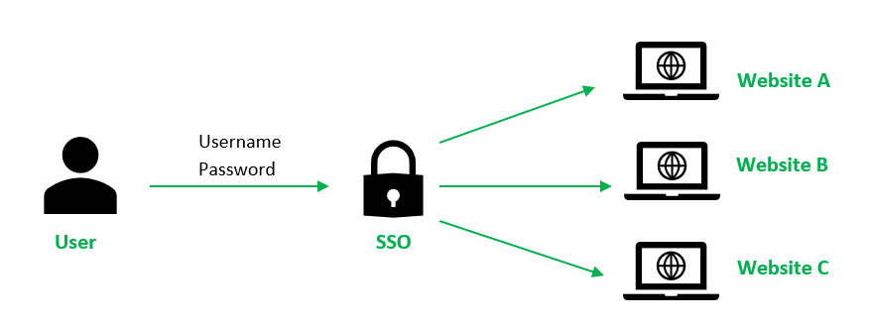
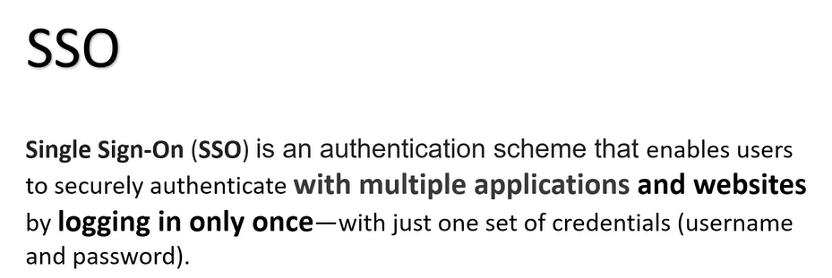
What is Single Sign-On (SSO) | Why do we need SSO?
SSO makes things much more convenient because you don't have to waste time searching for the right key (username and password) every time you want to use a different website or app.
SSO simplifies the process and saves you from the hassle of remembering and managing multiple sets of login information. Moreover, it also enhances security, as you only need to remember one strong and secure magic key instead of several different ones.

