Slide 1
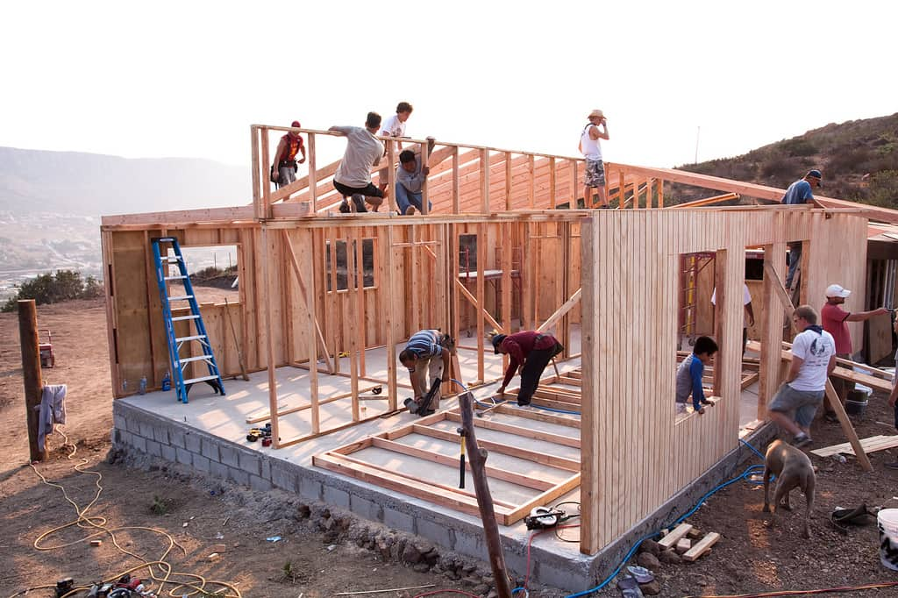
Scrum Explained Simply: What You Need to Know
Imagine you're part of a team working on a project, like building a new house. You have a group of people with different skills—carpenters, plumbers, electricians—all working together to complete the house. Now, think of Scrum as a way to organize and manage this team's work effectively.
In Scrum, the project is broken down into smaller parts called "sprints." Each sprint is like a short race where the team works intensely to finish a specific part of the project. For example, in one sprint, the team might focus on building the walls of the house.
During a sprint, the team holds quick daily meetings called "stand-ups" to discuss progress and any challenges. These meetings are short and focused, usually standing up to keep them brief.

Slide 2
Scrum Explained Simply: What You Need to Know
At the beginning of each sprint, the team decides what they can accomplish based on their capacity and the project's requirements. This is called "sprint planning.“
At the end of each sprint, the team shows what they've completed to the project owner or stakeholders. This is called the "sprint review." They also reflect on what went well and what could be improved in a meeting called "sprint retrospective.“
The idea behind Scrum is to be flexible and adapt to changes quickly. It's like running a series of short races (sprints) instead of one long marathon. This allows the team to respond to feedback, make adjustments, and deliver value to customers sooner.

Slide 3
Scrum Explained Simply: What You Need to Know
Summary
Overall, Scrum helps teams collaborate efficiently, stay focused on goals, and continuously improve their work. It's like having a structured game plan that helps the team achieve success step by step.

