Slide 1
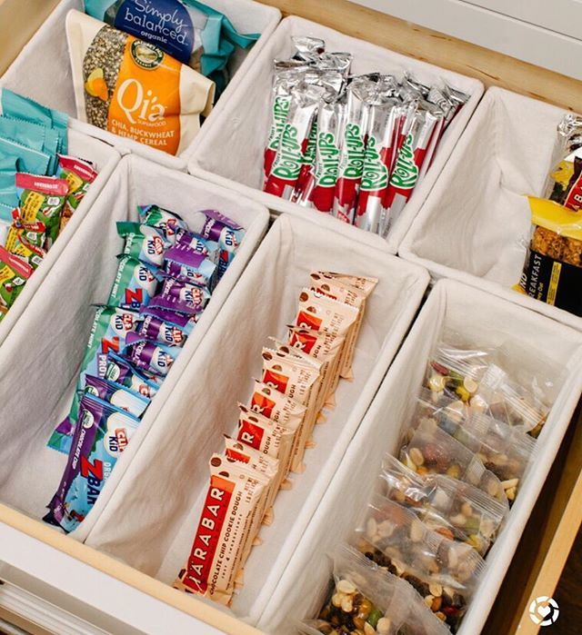
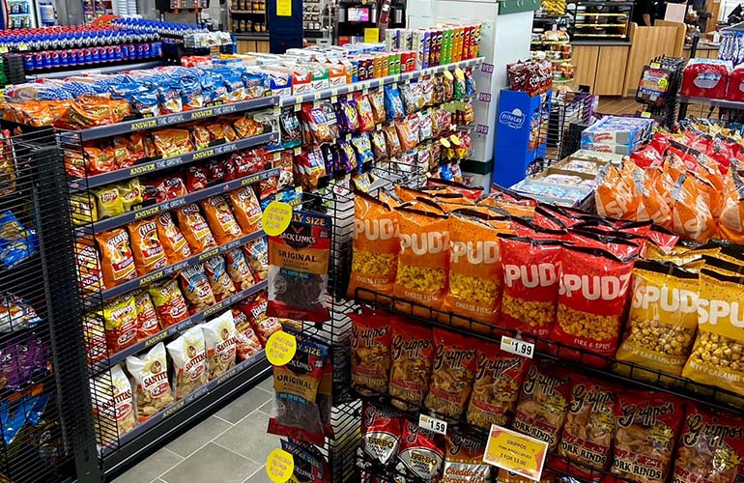

Caching Simplified: Your Quick Data Shortcut
Imagine you have a favorite snack in your kitchen, like a bag of chips. Instead of going to the store every time you want a snack, you keep a small supply of chips in a special drawer in your kitchen. This drawer is like your "cache."
Now, when you're hungry and want a snack, you don't have to make the trip to the store. You can quickly grab a bag of chips from your cache. It's convenient and saves you time.
Kitchen Drawer with Snacks
Store

Slide 2
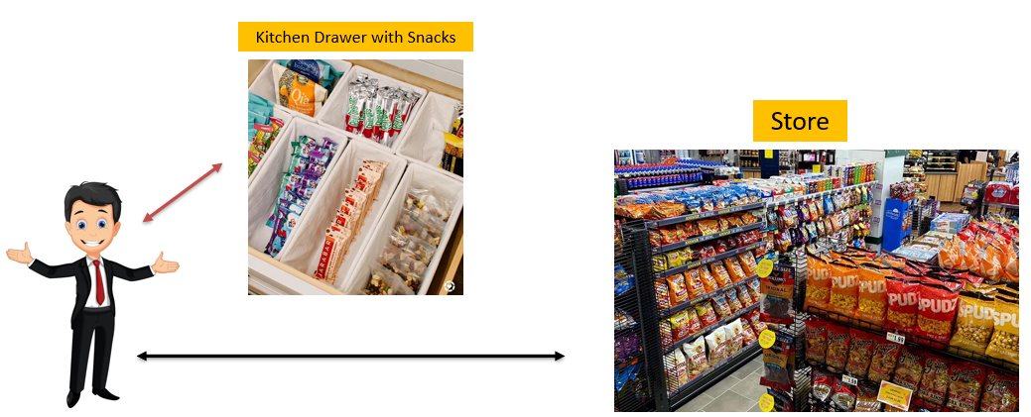
Caching Simplified: Your Quick Data Shortcut
In the world of computers, a cache works similarly. It's a small, high-speed storage space that stores frequently used information from your computer's memory. Instead of fetching this information from the main memory, which takes more time, the computer can quickly access it from the cache. This speeds up tasks and makes your computer work more efficiently, just like having your favorite snack ready in your kitchen drawer.
So, in simple terms, a cache is like a quick-access storage area that helps your computer run faster by keeping important data close at hand, just like your stash of snacks in the kitchen.

