Slide 1
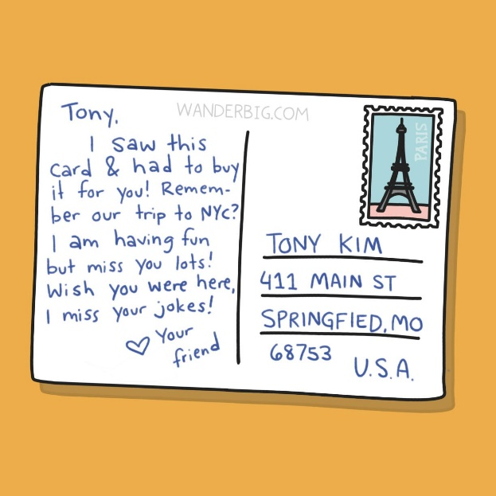

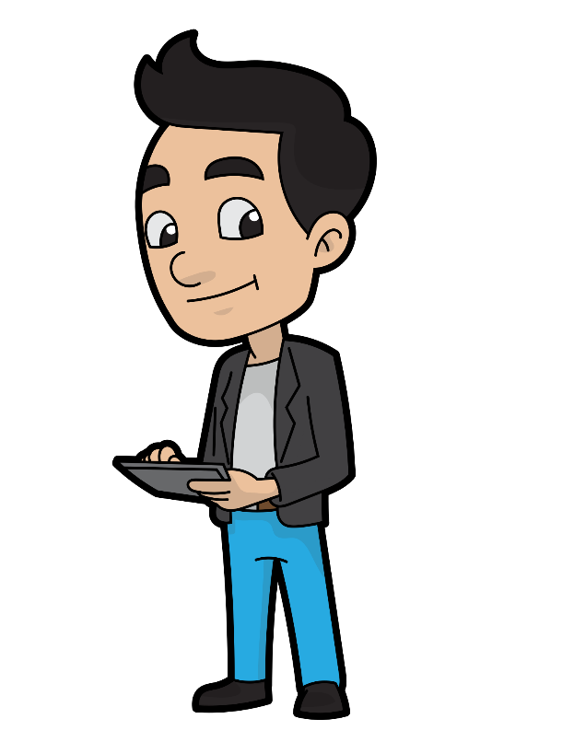
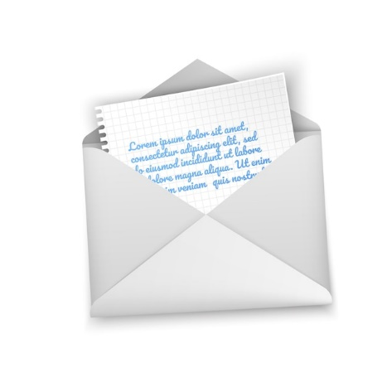
Demystifying VPNs: Your Simple Guide to What a VPN is and How it Safeguards Your Online Privacy!
Imagine you are sending a letter:
When you send a letter to someone, you typically put it in an envelope to keep it private. Without the envelope, anyone could read the letter as it travels from your home to its destination.
Now, think of the internet as a highway for information, and your data is like that letter. When you use the internet without a VPN, it's a bit like sending an open postcard—people might see what you're doing online.

Slide 2

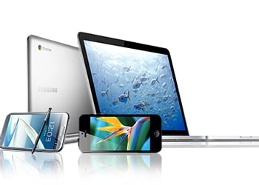
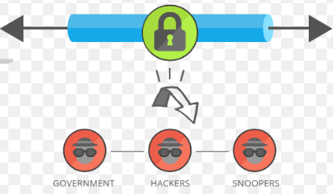
Demystifying VPNs: Your Simple Guide to What a VPN is and How it Safeguards Your Online Privacy!
Now, let's introduce the VPN:
A VPN is like having a magic tunnel for your online activities. When you connect to a VPN, it's as if you're putting your internet data into a super-secure envelope.
This virtual envelope ensures that your data is private and protected as it travels across the internet.
VPN Secures your Data
You

Slide 3
Demystifying VPNs: Your Simple Guide to What a VPN is and How it Safeguards Your Online Privacy!
How a VPN works:
Encrypting your data: Just like sealing an envelope, a VPN encrypts (or scrambles) your data. This means even if someone tries to peek at your online activities, they won't be able to understand what's inside.
VPN Secures your Data
You

Slide 4
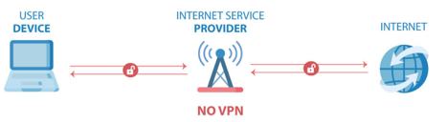
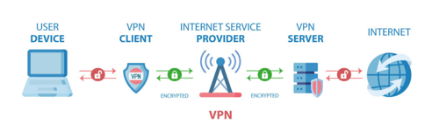
Demystifying VPNs: Your Simple Guide to What a VPN is and How it Safeguards Your Online Privacy!
How a VPN works:
Connecting through a server: When you use a VPN, your internet connection goes through a special server in a location of your choice. It's like having a friend who lives in a different city receive and send your mail. This server helps make your online presence more anonymous.
Masking your IP address: Your IP address is like your online address. A VPN can hide your real IP address and show the IP address of the server. It's like using your friend's return address on the envelope—keeping your identity more private.

Slide 5
Demystifying VPNs: Your Simple Guide to What a VPN is and How it Safeguards Your Online Privacy!
In Summary:
A VPN is your online privacy superhero. It encrypts your data, connects you through a secure server, and masks your IP address, making your online activities more private and secure.
VPN is especially useful when you're using public Wi-Fi or want to access content as if you were in a different location. Think of it as your secret online tunnel for a safer and more private internet experience!

