Slide 1
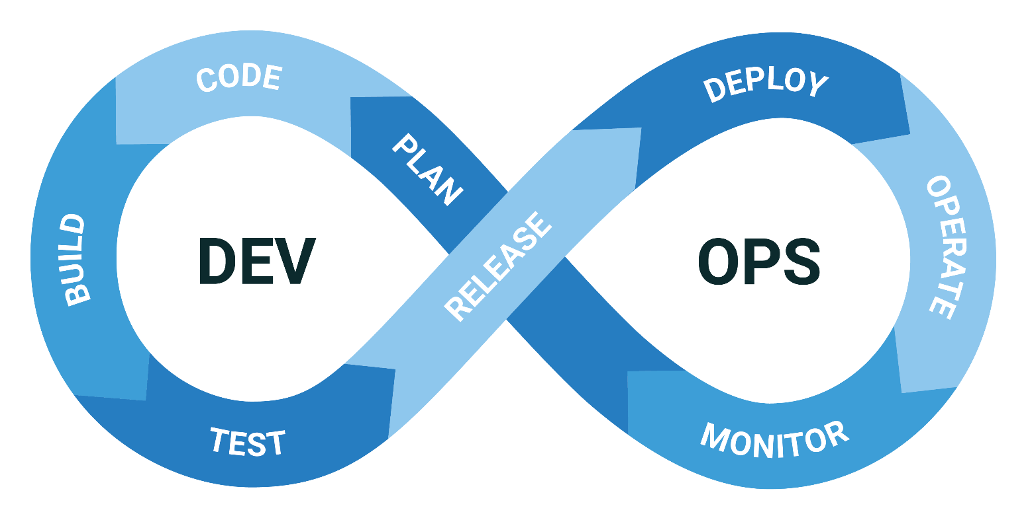
DevOps Lifecycle Explained: A Beginner's Guide
What is DevOps Lifecycle?
The DevOps lifecycle is a series of stages that bridge the gap between software development and IT operations, fostering a culture of collaboration, continuous improvement, and automation

Slide 2

DevOps Lifecycle Explained: A Beginner's Guide
1. Planning
What It Is: The stage where the project vision is defined, requirements are gathered, and tasks are planned.
Key Activities: Setting objectives, defining deliverables, creating user stories, and planning sprints.
Tools: Jira, Trello, Confluence.

Slide 3
DevOps Lifecycle Explained: A Beginner's Guide
2. Coding
What It Is: The stage where developers write the actual code for the application.
Key Activities: Writing code, reviewing code, and merging code changes.
Tools: Git, GitHub, GitLab, Bitbucket.

Slide 4
DevOps Lifecycle Explained: A Beginner's Guide
3. Building
What It Is: The stage where the code is compiled and built into executable files.
Key Activities: Compiling code, running automated tests, and packaging code.
Tools: Jenkins, Maven, Gradle.

Slide 5
DevOps Lifecycle Explained: A Beginner's Guide
4. Testing
What It Is: The stage where the application is tested to ensure it functions correctly and is free of bugs.
Key Activities: Automated testing, manual testing, performance testing, and security testing.
Tools: Selenium, JUnit, TestNG.

Slide 6
DevOps Lifecycle Explained: A Beginner's Guide
5. Releasing
What It Is: The stage where the application is deployed to a production environment.
Key Activities: Preparing release notes, performing final testing, and deploying to production.
Tools: Jenkins, Spinnaker, AWS CodePipeline.

Slide 7
DevOps Lifecycle Explained: A Beginner's Guide
6. Deploying
What It Is: The stage where the application is made available to users.
Key Activities: Continuous deployment, configuration management, and monitoring.
Tools: Kubernetes, Docker, Ansible.

Slide 8
DevOps Lifecycle Explained: A Beginner's Guide
7. Operating
What It Is: The stage where the application is monitored and managed in a live environment.
Key Activities: Monitoring application performance, handling incidents, and performing maintenance.
Tools: Nagios, Prometheus, Splunk.

Slide 9
DevOps Lifecycle Explained: A Beginner's Guide
8. Monitoring
What It Is: The stage where application performance and user feedback are continuously tracked.
Key Activities: Gathering performance metrics, user feedback, and identifying areas for improvement.
Tools: Grafana, ELK Stack, New Relic.

Slide 10
DevOps Lifecycle Explained: A Beginner's Guide
Why DevOps?
Collaboration: Enhances collaboration between development and operations teams.
Automation: Automates repetitive tasks to improve efficiency and reduce errors.
Continuous Improvement: Facilitates a culture of continuous improvement through feedback loops.
Faster Releases: Shortens the software development lifecycle, leading to faster releases and updates.
Quality and Reliability: Improves the quality and reliability of software applications.

Slide 11
DevOps Lifecycle Explained: A Beginner's Guide
Summary
The DevOps lifecycle is about bringing together development and operations to work as a cohesive unit. Each stage plays a crucial role in ensuring that software is developed, tested, and deployed efficiently and reliably.
By understanding and implementing the DevOps lifecycle, organizations can achieve faster delivery, better quality, and more reliable software products.

