Slide 1

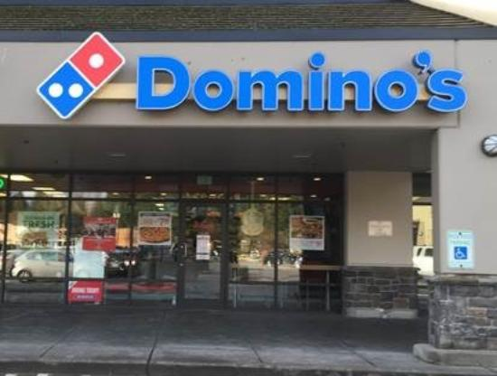
CDN Explained Simply: How the Internet's 'Delivery System' Speeds Up Websites
Imagine you order a pizza for delivery. Now, think of the pizza store as a website, and the pizza delivery person as the internet. When you order a pizza, you want it to be delivered to your home quickly and efficiently. Similarly, when you visit a website, you want it to load quickly on your device.
Now, think of CDN (Content Delivery Network) as having multiple pizza stores in different neighborhoods with many delivery people. Instead of having just one pizza store and one delivery person, there are many stores spread across various areas, each with their own delivery people.
Pizza Store == Website
pizza delivery person == Internet

Slide 2
CDN Explained Simply: How the Internet's 'Delivery System' Speeds Up Websites
So, when you order a pizza from a store nearby, you get your pizza faster because it doesn’t have to travel a long distance. Similarly, a CDN is like having multiple locations (servers) around the world that store copies of a website's content.
When you visit a website using a CDN, it's like the website's content (images, videos, text) being delivered from the closest store (server) to you, rather than coming from a single, far-away location. This makes the website load faster because the content has less distance to travel through the internet, just like getting your pizza faster from a nearby store.
Pizza Store == Website
pizza delivery person == Internet

Slide 3
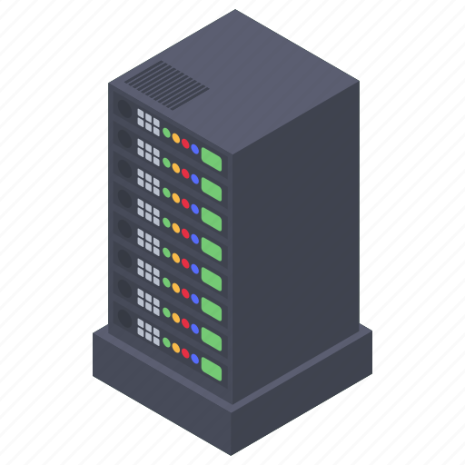


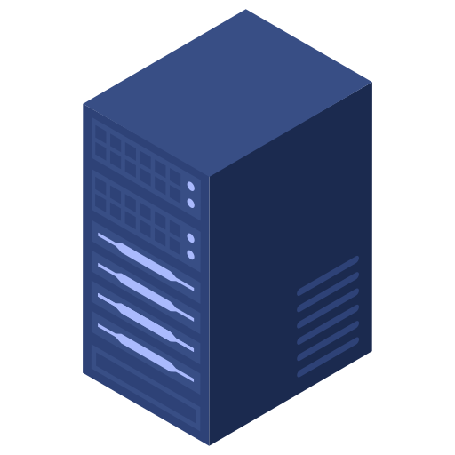

CDN Explained Simply: How the Internet's 'Delivery System' Speeds Up Websites
In simpler terms, a CDN helps websites load quickly by storing their content in different locations around the world, ensuring that when you visit the site, you receive the information from the nearest location, reducing the time it takes for the website to appear on your screen.
USA
India
India

