Slide 1
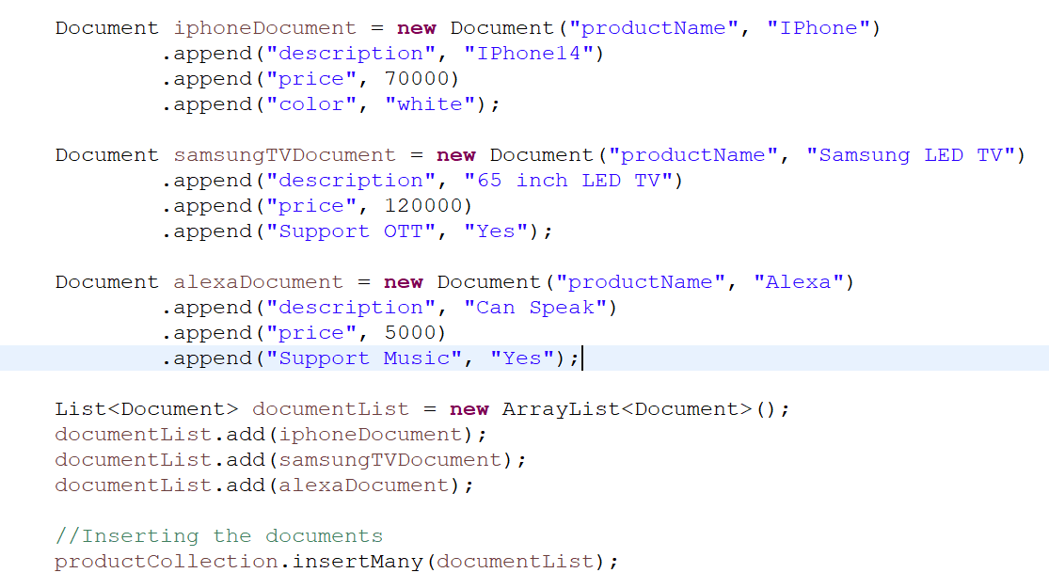

How to Get and Select a Collection and Insert multiple Documents using Java?
Java Program

