Slide 1
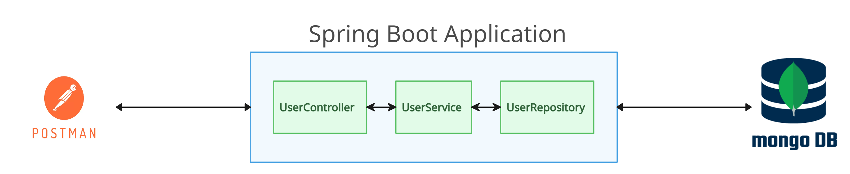
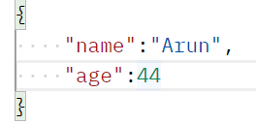

Connecting Your Spring Boot App to MongoDB Atlas
MongoDB Atlas is a cloud-based database service provided by MongoDB, Inc. It offers a fully managed, scalable, and secure version of the MongoDB database

Slide 2
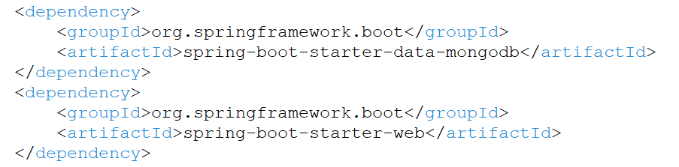
Connecting Your Spring Boot App to MongoDB Atlas
Step 1: Add Dependencies
Include the necessary dependencies in your Spring Boot project's pom.xml file:

Slide 3
Connecting Your Spring Boot App to MongoDB Atlas
Step 2: Configure MongoDB Connection
In your Spring Boot project's application.properties file, specify the MongoDB connection details:
You can adjust the URI and database name according to your MongoDB setup.

Slide 4
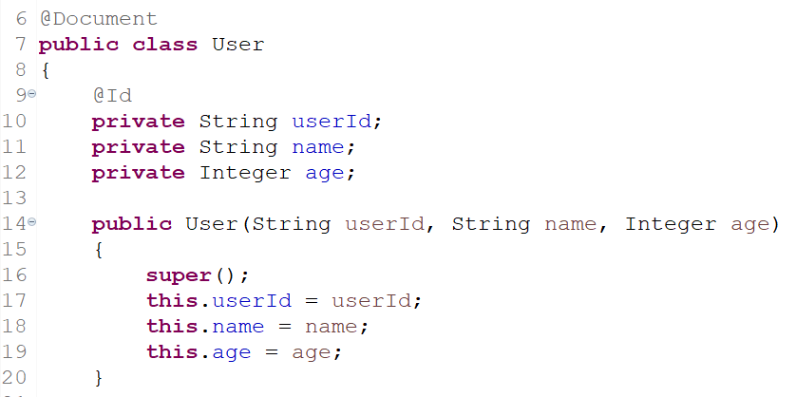
Connecting Your Spring Boot App to MongoDB Atlas
Step 3: Create a MongoDB Entity
Define a MongoDB entity class that represents a document in your MongoDB collection. Annotate the class with @Document and define the fields and their mappings. please keep in mind that your class will be your Collection name (Table name) and the variable will be column name when it will create in your database. For example:

Slide 5
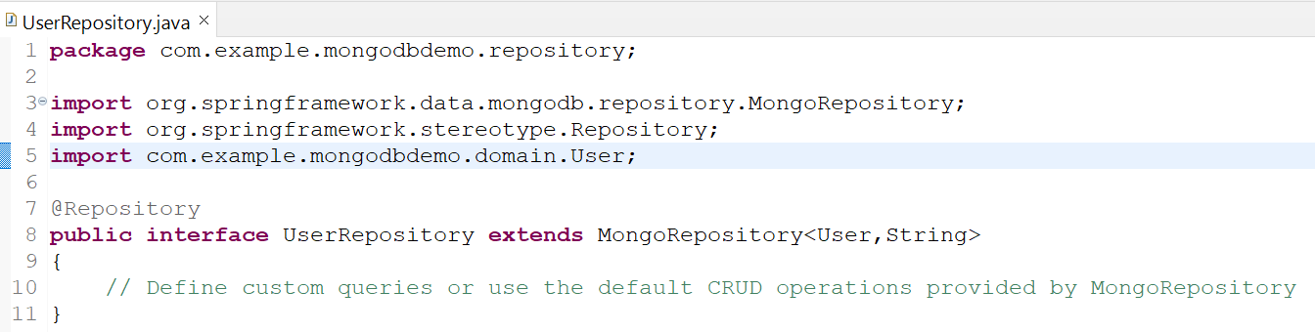
Connecting Your Spring Boot App to MongoDB Atlas
Step 4: Define MongoDB Repository
Create a MongoDB repository interface by extending the MongoRepository Interface provided by Spring Data MongoDB. With the help of this interface we will perform CRUD (Create, Read, Update, Delete) operation in our database.
MongoRepository<User,String> here “User” is my class name and “String” is my userId data type that we already defined in the User class and annotated with “@Id”.

Slide 6
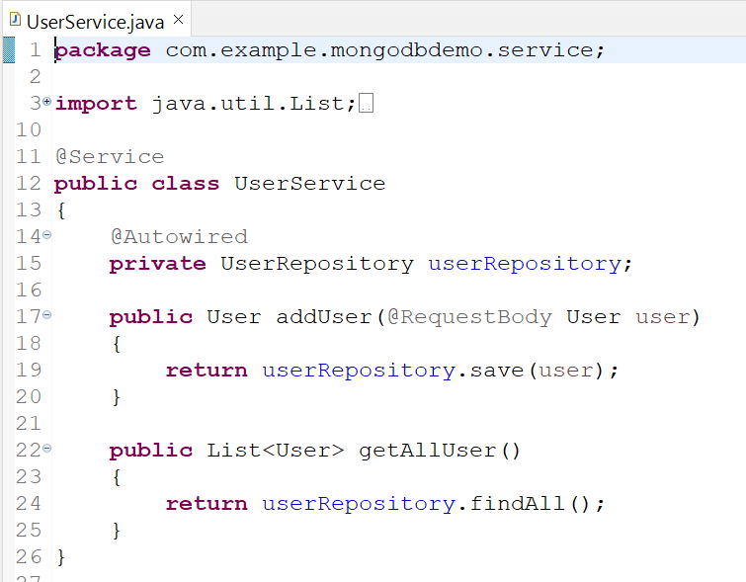
Connecting Your Spring Boot App to MongoDB Atlas
Step 5: Use MongoDB Repository
Inject the MongoDB repository into your Spring Boot service class and use it to perform database operations. For example:

Slide 7
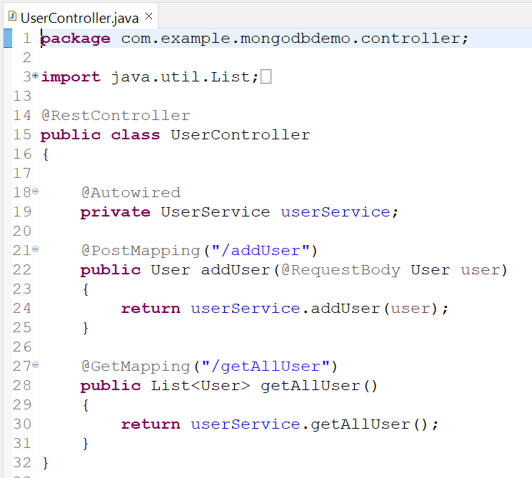
Connecting Your Spring Boot App to MongoDB Atlas
Step 6: Define Controller class which uses Service Class
We will create the controller class from there we will perform CRUD operation in our database. We annotate the controller class with @RestController.
That's it! Now you have connected MongoDB with Spring Boot. You can use the MongoDB repository to perform CRUD operations on your MongoDB database.

