Slide 1
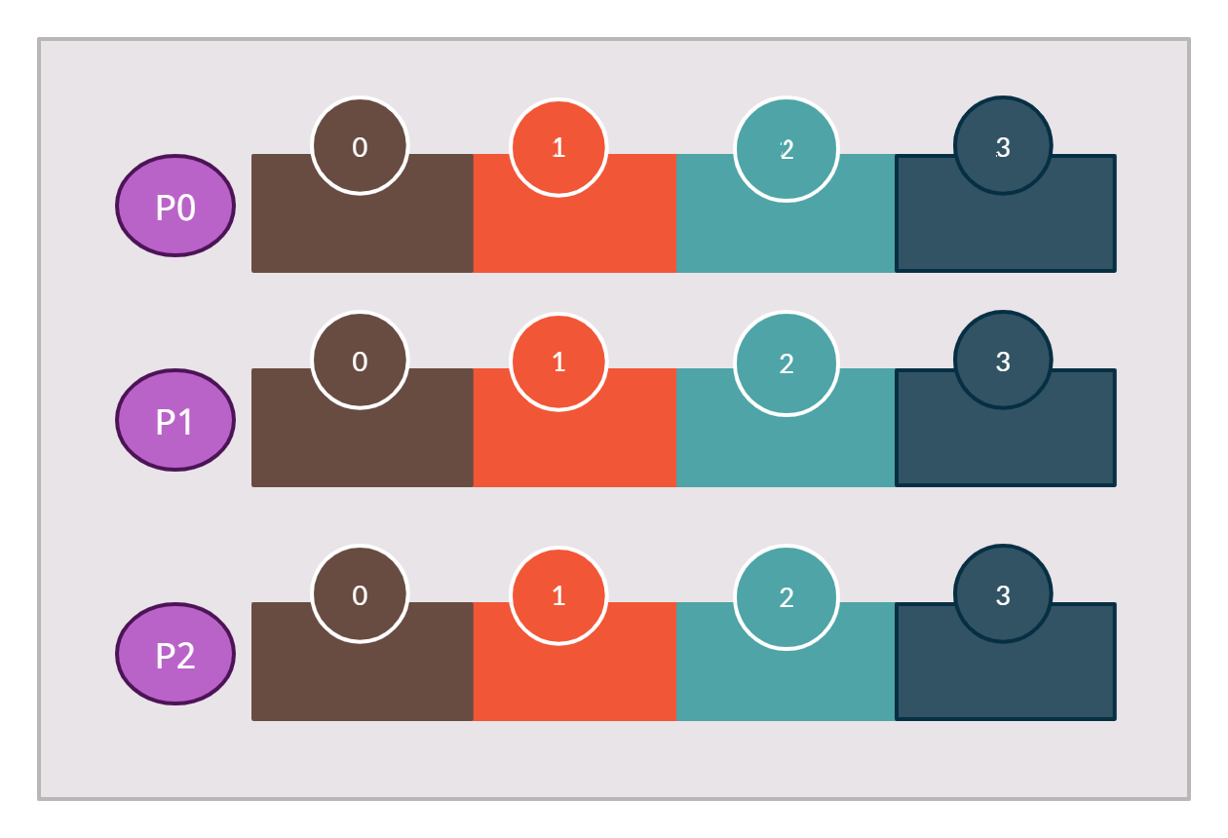

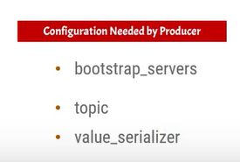
Kafka producer send messages to a single topic partition
The producer can also select the partition of their choice in a topic where the producer wants to publish the message
All the messages will be published to a single partition [P0]
Producer to send the messages to the selected partition we have to pass the Partition number and the key.
Topic with Three Partition and the Single Broker
Broker 1
Topic
Producer

