Slide 1


Java Program to Send JSON Object into Kafka Topic & Consume JSON Object From Kafka Topic
Apache Kafka Ecosystem
Kafka Cluster
Send Animal Object
Consume Animal Object
Broker 1
Topic A
Topic B
Broker 2
Producer
Consumer
Topic X
Topic Z
KafkaProducerDemo
KafkaConsumerDemo
Zookeeper

Slide 2
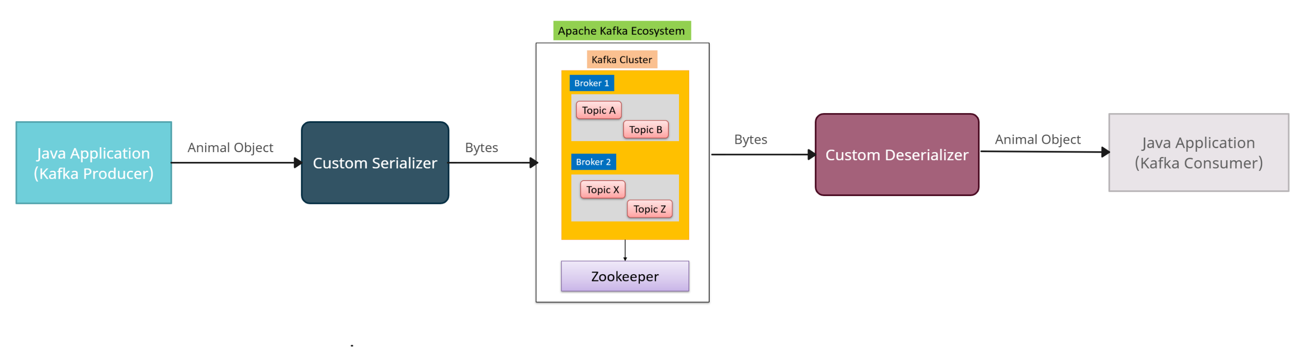
Java Program to Send JSON Object into Kafka Topic & Consume JSON Object From Kafka Topic
Serialization is the process of converting objects into bytes. Deserialization is the inverse process — converting a stream of bytes into an object.
Apache Kafka provides default serializers for several basic types, and it allows us to implement custom serializers:
The below figure shows the process of sending messages to a Kafka topic through the network. In this process, the custom serializer converts the object into bytes before the producer sends the message to the topic. Similarly, it also shows how the deserializer transforms back the bytes into the object for the consumer to properly process it.

Slide 3
Java Program to Send JSON Object into Kafka Topic & Consume JSON Object From Kafka Topic
Apache Kafka provides a pre-built serializer and deserializer for several basic types:
StringSerializer
ShortSerializer
IntegerSerializer
LongSerializer
DoubleSerializer
BytesSerializer
But it also offers the capability to implement custom (de)serializers. In order to serialize our own objects, we'll implement the Serializer interface. Similarly, to create a custom deserializer, we'll implement the Deserializer interface.
Apache Kafka provides the capability of customizing the serializers. It's possible to implement specific converters not only for the message value but also for the key.

Slide 4
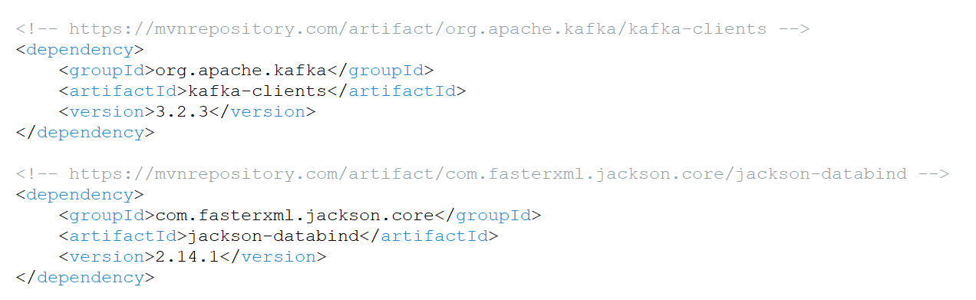
Java Program to Send JSON Object into Kafka Topic & Consume JSON Object From Kafka Topic
Pom.xml

Slide 5
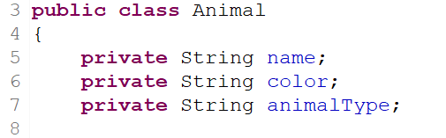
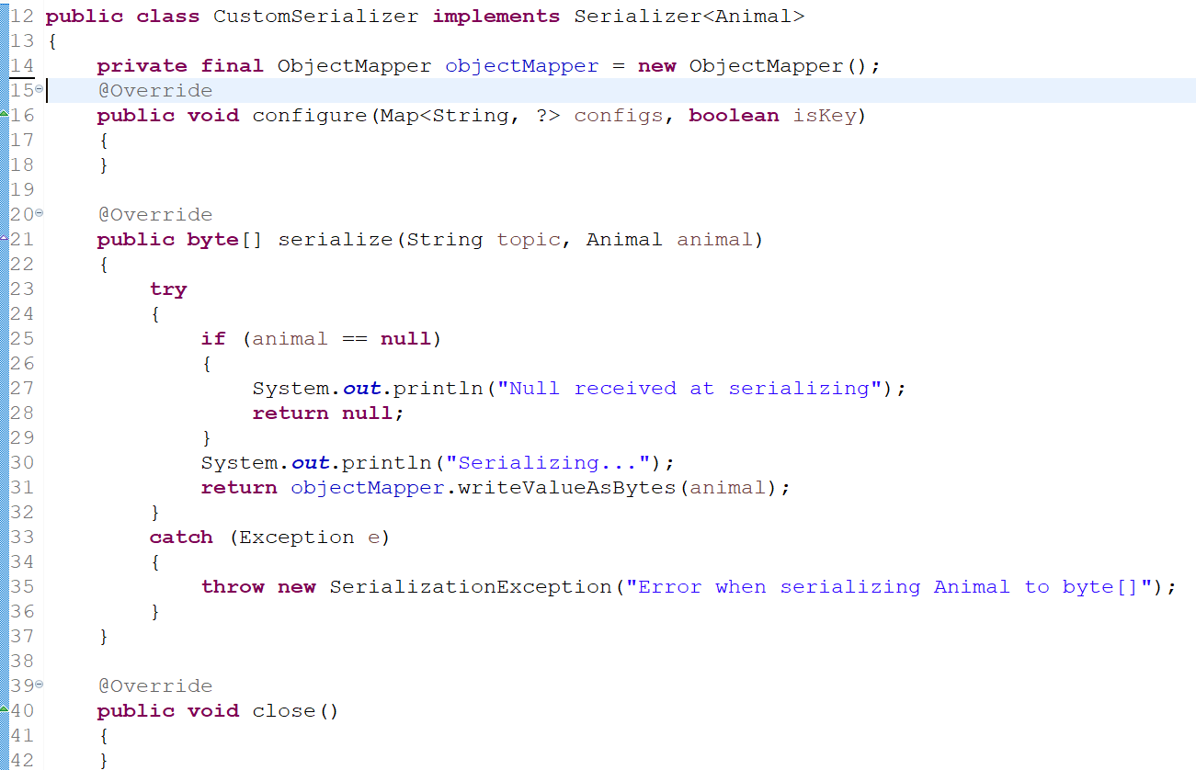
Java Program to Send JSON Object into Kafka Topic & Consume JSON Object From Kafka Topic
configure: used to implement configuration details
Serialize :This method include the actual implementation of our custom serialization.
close: use this method to close the Kafka session
We'll override the serialize method of the interface. Therefore, in our implementation, we'll transform the custom object using a Jackson ObjectMapper. Then we'll return the stream of bytes to properly send the message to the network.

Slide 6
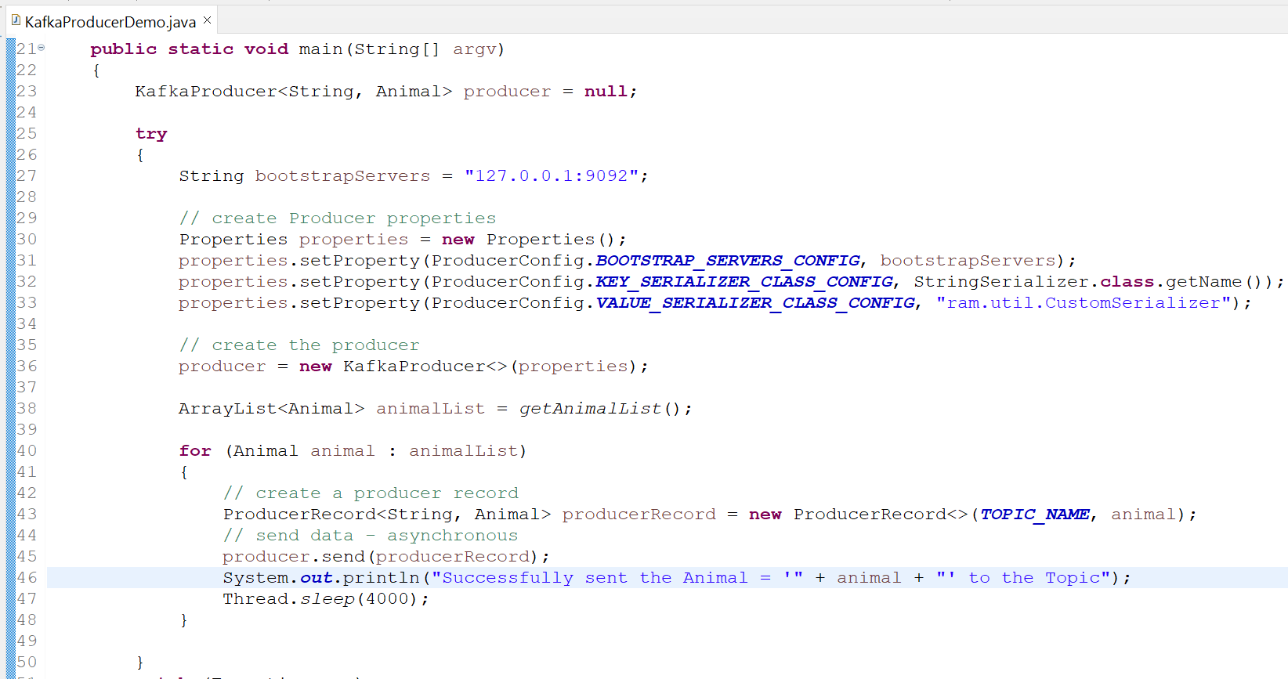
Java Program to Send JSON Object into Kafka Topic & Consume JSON Object From Kafka Topic

Slide 7
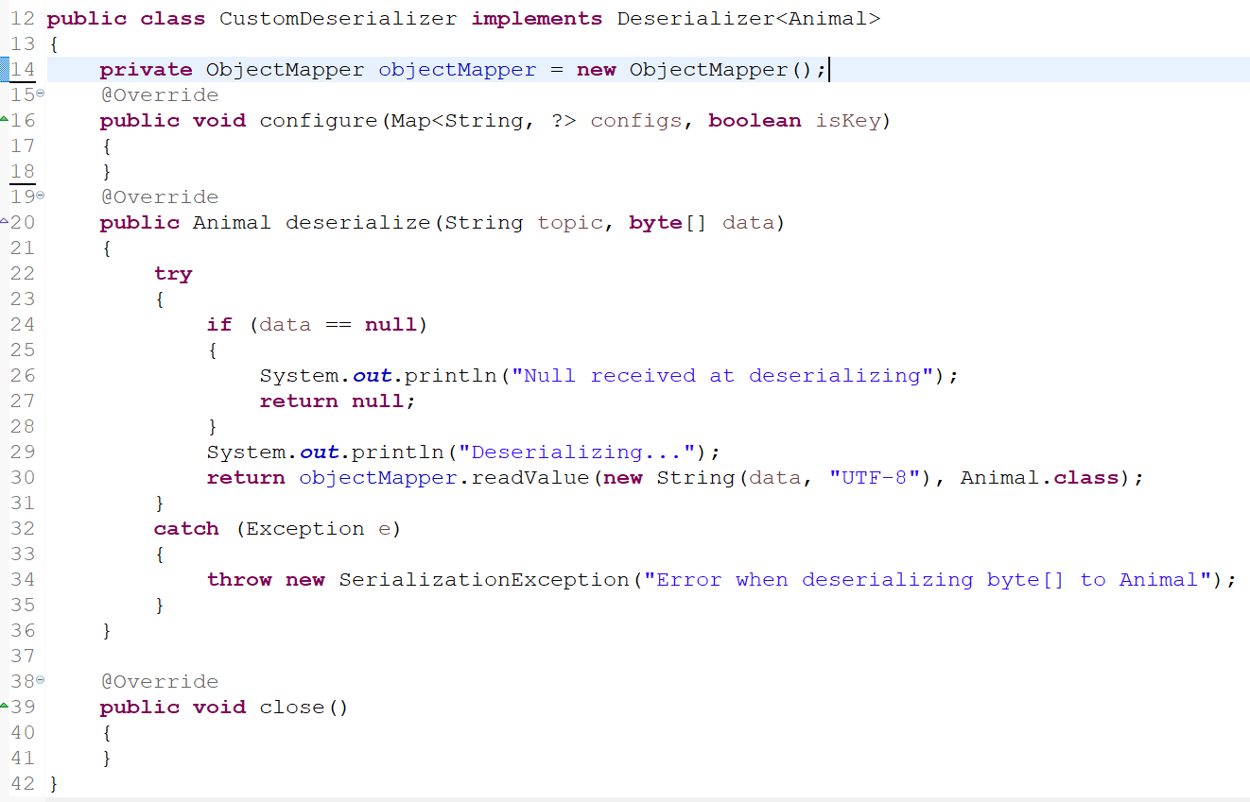
Java Program to Send JSON Object into Kafka Topic & Consume JSON Object From Kafka Topic
configure: used to implement configuration details
Deserialize :This method include the actual implementation of our custom deserialization.
close: use this method to close the Kafka session
we'll override the deserialize method of the interface. Consequently, we'll convert the stream of bytes into the custom object using the same Jackson ObjectMapper.

Slide 8
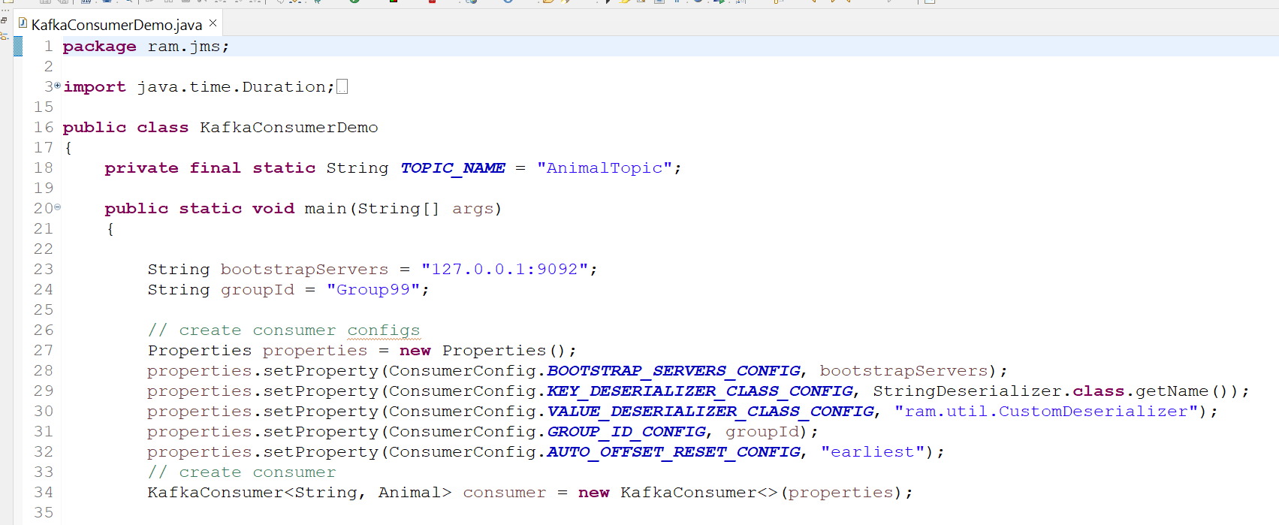
Java Program to Send JSON Object into Kafka Topic & Consume JSON Object From Kafka Topic

Slide 9
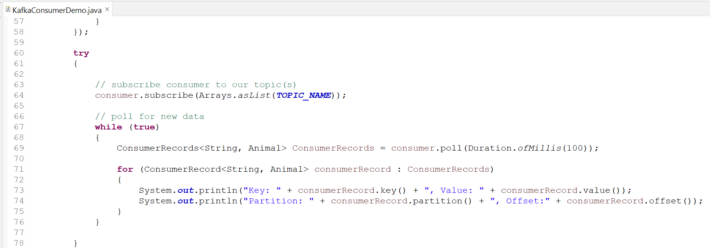
Java Program to Send JSON Object into Kafka Topic & Consume JSON Object From Kafka Topic

