Slide 1
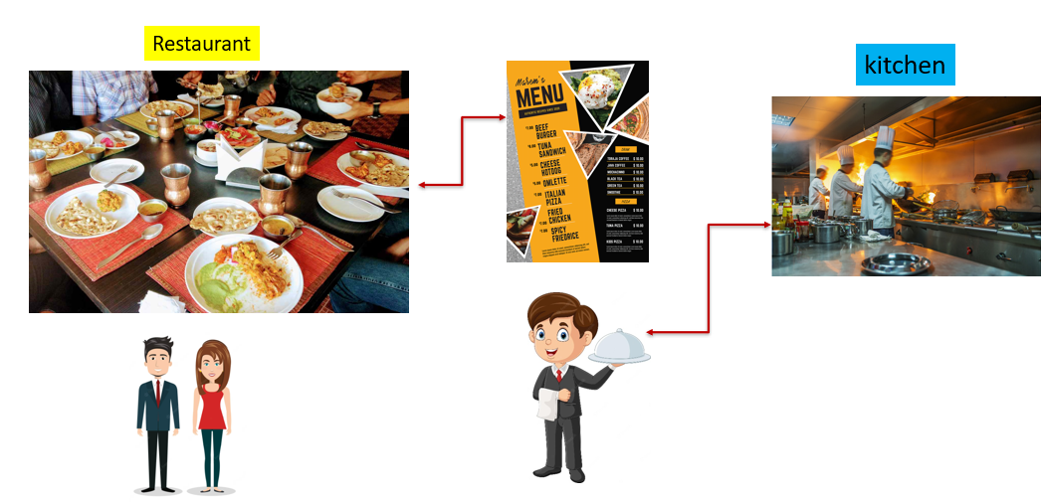
HTTP Methods Simplified: Ordering Food at the Internet Restaurant
Let's explain "HTTP methods" using the analogy of a restaurant: Imagine you're at a restaurant, and you want to interact with the waiter (the website) to do different things:
GET: This is like asking for the restaurant's menu. You're not making any changes or placing an order; you're just looking to see what's available. When you visit a website and read its content, you're using the GET method.
POST: Imagine you're placing an order at the restaurant. You tell the waiter what you want to eat and provide all the details. Similarly, when you submit a form on a website, like filling out a registration form, you're using the POST method to send your information to the server.

Slide 2
HTTP Methods Simplified: Ordering Food at the Internet Restaurant
PUT: This is like telling the restaurant to update your order. You've ordered a burger, but now you want extra cheese on it. With the PUT method, you're asking the server to replace the existing information with the new data you're providing. It's often used for updating existing resources on a website.
DELETE: It's like canceling your order at the restaurant. You initially ordered a pizza, but you changed your mind and no longer want it. When you use the DELETE method, you're asking the server to remove a resource or data from the website.

Slide 3
HTTP Methods Simplified: Ordering Food at the Internet Restaurant
PATCH: Think of this as making a minor change to your order. Let's say you ordered a sandwich with lettuce and tomato, but now you want extra ketchup. You're not replacing the entire order; you're just updating a part of it. The PATCH method is used for making partial updates to a resource on a website.
HEAD: This is like checking if the restaurant is open without actually going inside. When you use the HEAD method, you're asking the server to provide you with information about a resource, but you don't need the full content. It's often used to check if a webpage exists or to retrieve metadata like the last modified date.

Slide 4
HTTP Methods Simplified: Ordering Food at the Internet Restaurant
OPTIONS: Imagine you're asking the restaurant about the dining options they have, such as indoor or outdoor seating. The OPTIONS method is used to ask the server about the available communication options or HTTP methods that can be used with a resource. It's like inquiring about the restaurant's services.
CONNECT: In a restaurant analogy, this would be like requesting a private dining room with a direct connection to the kitchen. The CONNECT method is typically used when a client wants to establish a network connection to a resource, but it's not as commonly used in regular web browsing.
These HTTP methods are like different ways you can interact with a website, just as you have various ways to communicate your needs and requests when dining at a restaurant.

