Slide 1
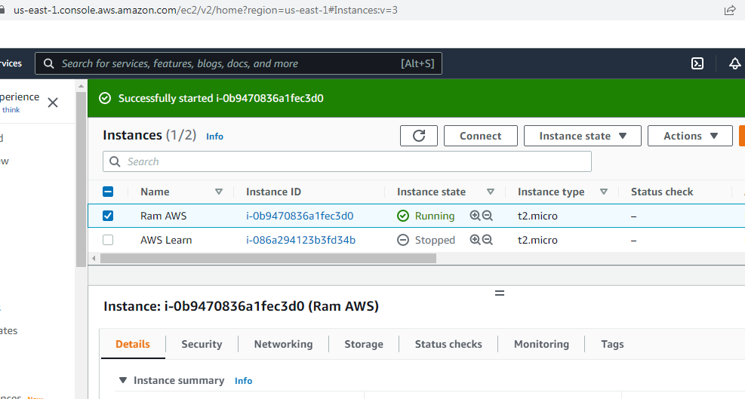
How to install RabbitMQ in Linux Operating System or Amazon EC2 Instance?

Slide 2
How to install RabbitMQ in Linux Operating System or Amazon EC2 Instance?
What is EPEL release RPM?
What is EPEL. EPEL (Extra Packages for Enterprise Linux) is an open-source and free community-based repository project from the Fedora team which provides 100% high-quality add-on software packages for Linux distribution including RHEL (Red Hat Enterprise Linux), CentOS, and Scientific Linux.
sudo yum install epel-release
sudo amazon-linux-extras install epel
sudo yum install erlang
sudo yum install rabbitmq-server
sudo rabbitmq-plugins list
sudo rabbitmq-plugins enable rabbitmq_management
sudo systemctl enable rabbitmq-server
sudo systemctl start rabbitmq-server
sudo systemctl stop rabbitmq-server
whereis rabbitmq
sudo chown -R ec2-user: /var/log/rabbitmq

Slide 3
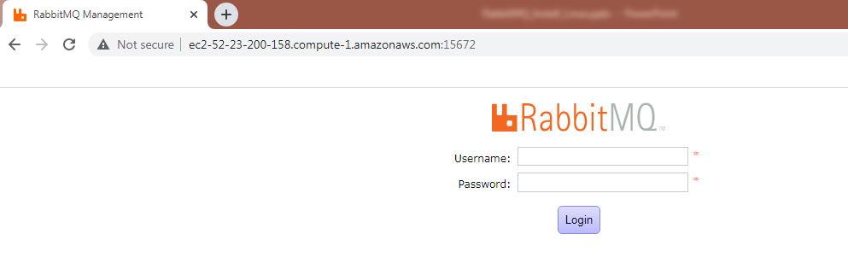
How to install RabbitMQ in Linux Operating System or Amazon EC2 Instance?
Username = Guest
Password = Guest
http://ec2-52-23-200-158.compute-1.amazonaws.com:15672/

