Slide 1
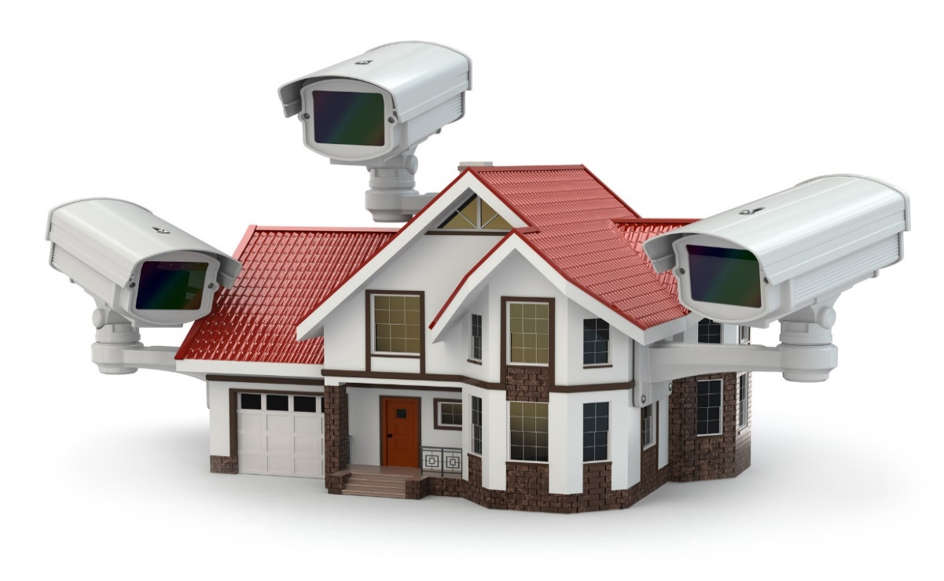
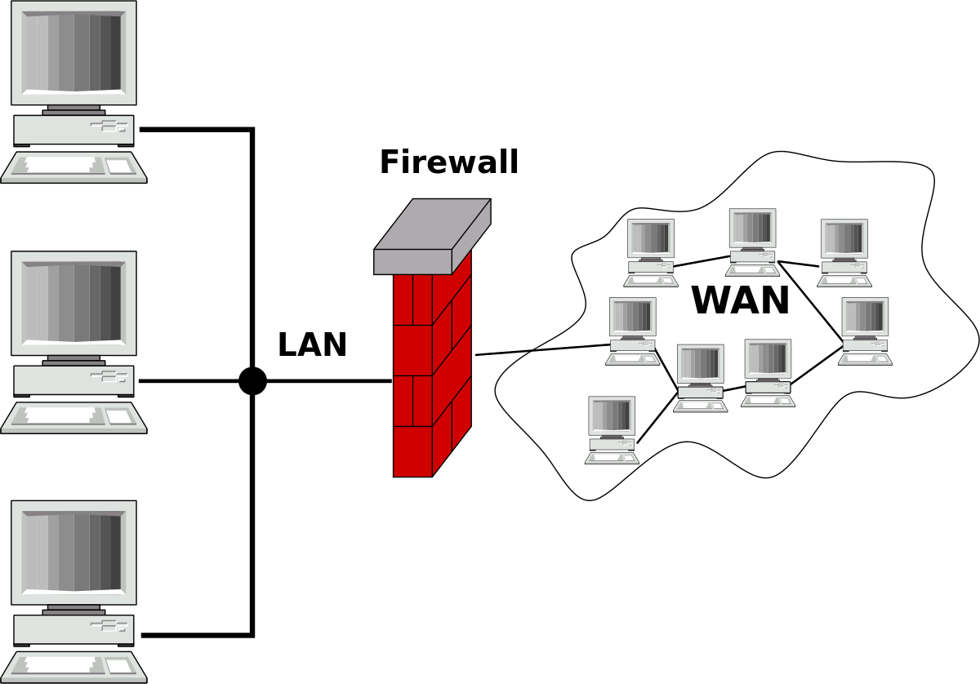
Firewall Explained: Your Digital Security Guard
Imagine your computer or your entire network is like a house. Now, think of a firewall as the security system for that house.
Here's how it works:
Protection from Unwanted Guests: Just like you wouldn't want strangers walking into your house without permission, a firewall keeps unwanted visitors out of your computer or network. It acts as a barrier between your devices and the internet, controlling what can come in and what can go out.
Filters Traffic: Think of the firewall as a gatekeeper. It checks all the data that tries to enter or leave your computer or network. If the data meets certain criteria, it's allowed through, but if it seems suspicious or potentially harmful, the firewall blocks it from getting in.
House with Security System
Computer Network with Firewall

Slide 2

Firewall Explained: Your Digital Security Guard
Prevents Threats: Imagine someone trying to break into your house. A good security system would sound an alarm and prevent them from getting inside. Similarly, a firewall detects and blocks malicious software, like viruses, worms, or hackers, from accessing your computer or network.
Privacy Protection: Just as you wouldn't want strangers snooping around your personal belongings, a firewall helps protect your privacy online. It hides your computer or network from prying eyes on the internet, making it more difficult for hackers to find and target you.
So, in simple terms, a firewall is like a digital security guard for your computer or network, keeping out the bad stuff and letting in only the things you want.
House with Security System
Computer Network with Firewall

