Slide 1
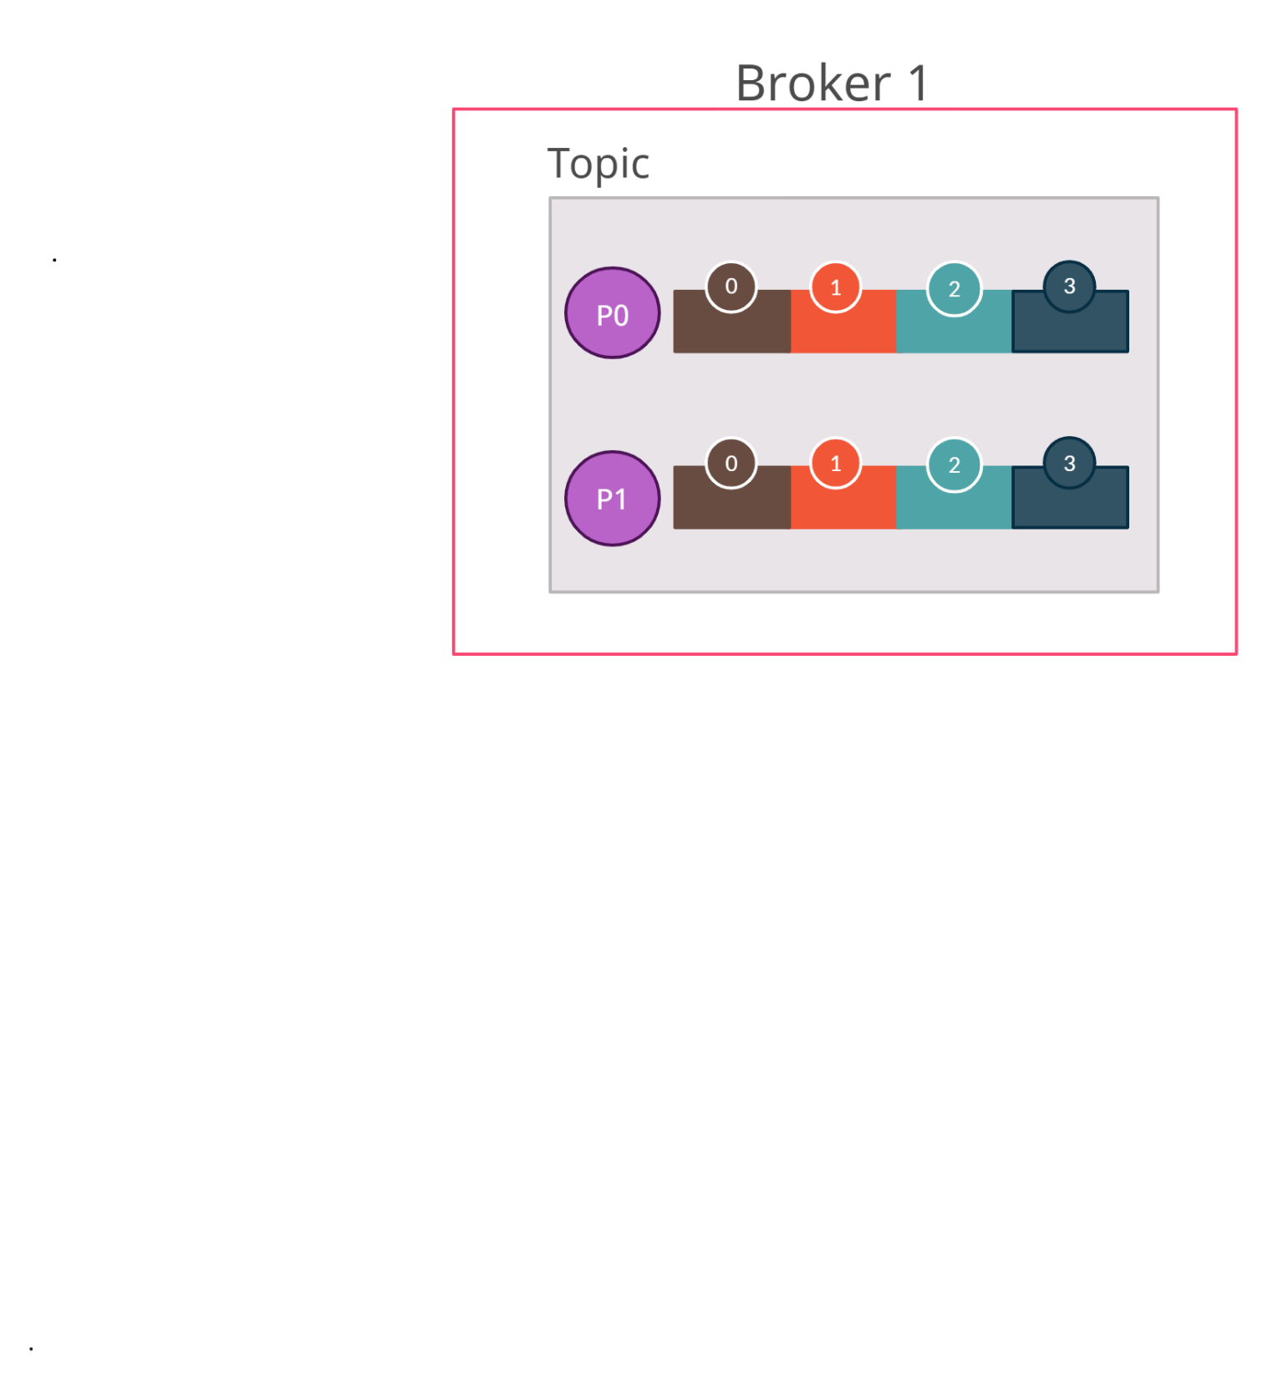


Consumer Group in Kafka with 2 partitions and 2 consumers
Both consumers are registered to the same consumer group
The same partition cannot be assigned to multiple consumers in the same group
Consumer Group
Consumer 1
Producer
Consumer 2

