Slide 1

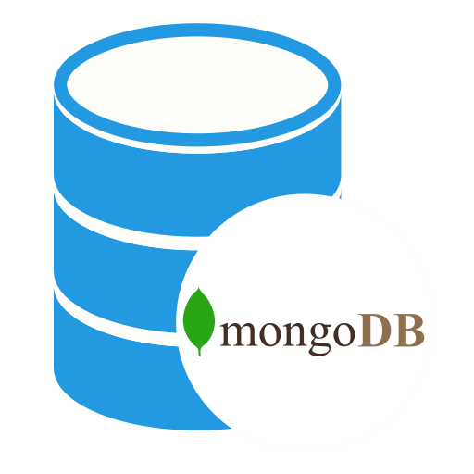
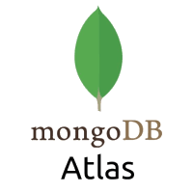
Java Program to Connect to MongoDB Atlas
Java Program

