Slide 1
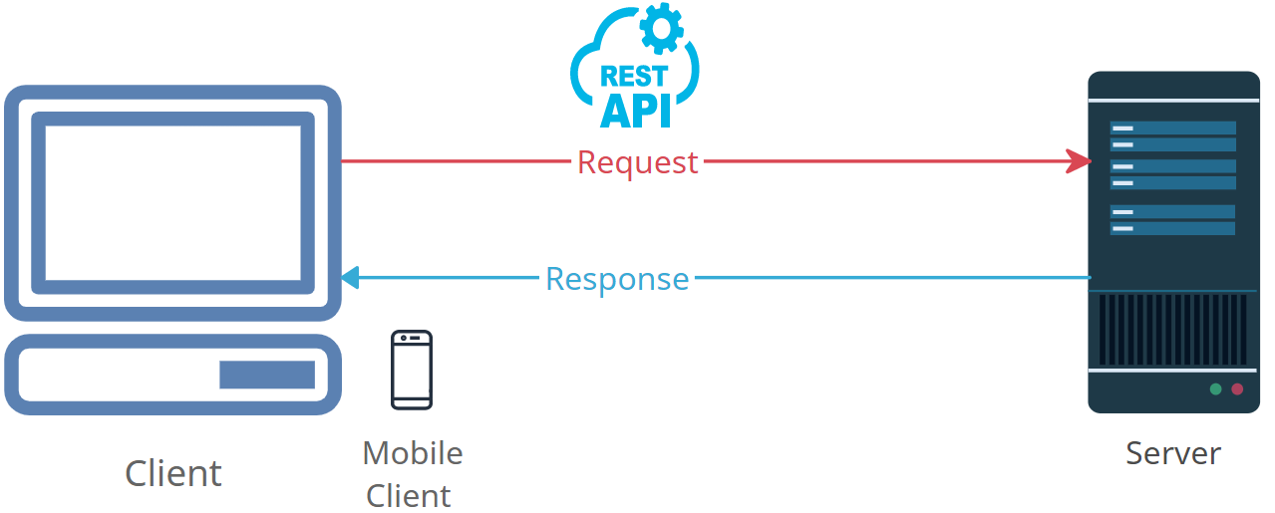




Demystifying HTTP Response: What Happens When You Request Something Online
Think of "HTTP Response" like receiving a package or a letter in the mail. When you send a request, it's like mailing a letter or ordering something online.
So, when you make a request on the internet, like asking for a webpage or a picture, the web server on the other end sends you a response. This response is like getting the package or letter you were waiting for.
Now, this response can contain different things. It might have the webpage you asked for, a picture, or even a message saying, "Sorry, that page doesn't exist." So, the HTTP Response is basically the answer you get when you make a request on the internet. It's like the content that comes back to your computer from a web server, just like when you open a package or read a letter that arrives in your mailbox.

