Slide 1

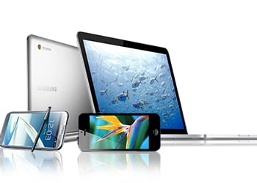
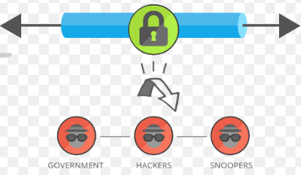
What Is a VPN: How Does It Work and Should You Use It?
What is a VPN?
VPN is a type of network that imitates a private network on a public internet connection. It establishes a secure connection by masking your IP address and encrypting your internet traffic. VPN connections can also grant you access to geo-restricted content.
A virtual private network (VPN) encrypts your personal data and hides your real IP address on a public network. It is one of the most common solutions for protecting internet privacy and security.
VPN Secures your Data
You

Slide 2
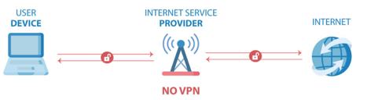
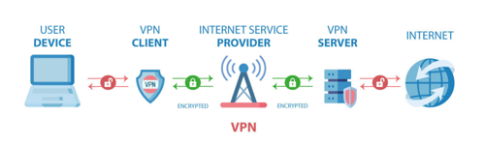
What Is a VPN: How Does It Work and Should You Use It?
How a VPN works:
When connected to the internet without a virtual private network, your internet service provider (ISP) is the main intermediary between your device and the internet. Your ISP assigns your device a unique IP address and tracks all the websites you visit.
On the other hand, when a VPN connection is activated on a device, all web requests travel through an encrypted tunnel and are routed through a VPN server before reaching the target server.
After a request is processed, the data sent back to the device goes through the same encrypted VPN connection and routing process.

Slide 3
What Is a VPN: How Does It Work and Should You Use It?
How a VPN works:
When using a VPN, your device’s internet connection still passes through your internet service provider. However, since it’s encrypted and routed via a VPN server, your ISP won’t see the websites you visit anymore. It just knows that you are connected to a VPN and that encrypted traffic travels from your device to a server.

Slide 4
What Is a VPN: How Does It Work and Should You Use It?
key processes a VPN does and their benefits
Proxying. Like a proxy, a VPN hides your IP address and location to increase your online anonymity. The websites you visit only see the IP address and location of the VPN server instead.
Authentication. The authentication process ensures that your VPN client only interacts with the VPN server you want to connect to. This prevents other third parties from intercepting your data.
Tunneling. A VPN connection activates an encrypted tunnel for the internet traffic. This process encapsulates each data packet inside another data packet, making it difficult for malicious parties to read it.
Encryption. Many websites that use an SSL/TLS, or an HTTPS certificate, will encrypt the data exchanged between your device and the target server. However, this encryption is limited to the websites you visit. Meanwhile, a VPN tunnel encrypts all traffic. Many VPN providers use military-grade encryption, which is nearly impossible to be read by third parties.
These processes work together to protect your data from your internet service provider and other third parties who want to intercept your data.

Slide 5
What Is a VPN: How Does It Work and Should You Use It?
Here are the personal details that VPN technology can hide when it’s activated
IP address. The IP address is the unique identifier of a device. It can infer sensitive information like your internet service provider, country, city, or even home address. A VPN masks your IP address with its own.
Location. Since virtual private networks hide your actual IP address, it can appear as though you are browsing from a different location. For example, if you are located in the US but are connected to a VPN server in the UK, other users will think your location is in the UK.
Search and browsing history. Since your internet connection travels through an encrypted VPN tunnel, your ISP or malicious third parties won’t know what you are searching and browsing online. This helps avoid targeted ads and protect your internet privacy in general.

Slide 6
What Is a VPN: How Does It Work and Should You Use It?
Types of VPN
Personal VPN
Remote Access VPN
Mobile VPN
Site-to-Site VPN

Slide 7
What Is a VPN: How Does It Work and Should You Use It?
Personal VPN
Personal VPN is also called a consumer or commercial VPN, a personal VPN connects its users to the public internet over an encrypted connection via a VPN server. Its primary purpose is to protect online privacy and bypass
geo-blocking.
Personal VPNs are easy to set up on different devices such as PCs, laptops, gaming consoles, and mobile devices. Some examples of personal VPN services include NordVPN, ExpressVPN, and Surfshark.
Remote Access VPN
A remote access VPN lets users connect to a private or local network. This type of VPN is commonly used by employees to securely connect to their company’s office network and access its data and resources.
Remote access VPNs are beneficial for remote workers and employees working from home. With a remote access VPN, they can access their work files as though they are physically at the office. Its encryption is also crucial for protecting sensitive company data when using public Wi-Fi hotspots.

Slide 8
What Is a VPN: How Does It Work and Should You Use It?
Mobile VPN
Similar to a remote access VPN, a mobile VPN is commonly used by employees to connect to their company’s business network remotely.
The key difference is that a mobile VPN stays connected even if the user changes their network connection or loses their connectivity. For this reason, mobile VPNs are recommended for highly mobile users or people with unstable internet connections.
Site-to-Site VPN
This type of VPN merges two networks on different sites. For example, if a company has two offices in Europe and Asia, a site-to-site VPN can merge the two private company networks.
Many global companies use a combination of site-to-site VPN and remote access VPN. The site-to-site VPN merges all of the company’s private networks across the globe, while the remote access VPN allows employees to access all those networks at once.

Slide 9
What Is a VPN: How Does It Work and Should You Use It?
Why You Should Use a VPN Service?
1. Privacy:
A VPN encrypts your network traffic and routes your internet connection through a remote server. It lets you hide online data like your IP address, location, search and browsing history, and downloads. As a result, your internet service provider, the websites you visit, and other third parties won’t be able to read it.
2. Freedom:
A VPN can change its user’s virtual location. This feature gives VPN users the freedom to access blocked content in their region.
For instance, a TV show you want to watch on Netflix may be only available in a specific location, or your country may be censoring a social media site. By changing your location to a different country with a VPN, you will be able to access
geo-blocked content.

Slide 10
What Is a VPN: How Does It Work and Should You Use It?
Why You Should Use a VPN Service?
3. Security:
The internet is unfortunately rife with security threats targeting websites and users. VPN encryption and IP address masking can add a layer of security to an individual’s online activity.
If you are browsing the internet using an untrustworthy connection like a public Wi-Fi network, the risk of falling victim to a cyberattack is high. Connecting to a VPN server will encrypt your internet connection and hide your IP on such unsafe networks.
For remote workers, using a VPN is not only necessary to access company files. It also keeps sensitive company data safe from being read or stolen by third parties with malicious intent.

Slide 11
What Is a VPN: How Does It Work and Should You Use It?
What VPN Services to use?
As a rule of thumb, most free VPN services are not recommended. Free VPNs often collect logs of your online activity or contain malware. Knowing these risks, using a free service might defeat the purpose of using a VPN in the first place.
We recommend using a quality VPN service such as NordVPN, ExpressVPN, or Surfshark. A great VPN service keeps your connection fast, does not store logs of your online activity, and has many global server locations. On average, a VPN service costs $5-10/month.
Many VPN services are easy to set up and use. With VPN client software available on a wide range of computers and mobile devices, you will be able to maintain web privacy, security, and freedom no matter what machine you use.

Slide 12
What Is a VPN: How Does It Work and Should You Use It?
Conclusion
A virtual private network establishes a secure connection to the public internet. It hides your identifiable information, encrypts your internet traffic, and lets you bypass geo-blocking.
A VPN works by routing all web requests from a device to a VPN server through an encrypted tunnel and delivering them to the target server. Once processed, the results are sent back to the device using the same process.
A VPN is a valuable and easy-to-use tool if you are concerned about web privacy, security, and freedom.

