Slide 1
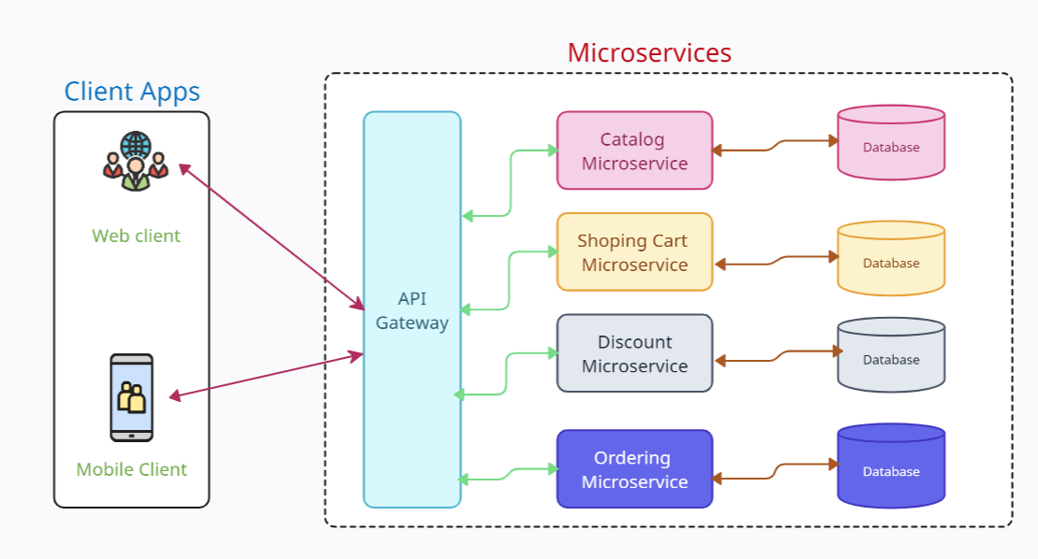
What is API gateway?
Imagine you want to access multiple websites or services, but each one has a different way of communicating or requires different permissions.
It would be quite overwhelming and time-consuming to deal with all these different rules and formats. Here's where an API Gateway comes in. Think of it as a helpful assistant that simplifies the process for you. It acts as a single doorway, or a central hub, that you can interact with to access all those websites or services.
Instead of having to understand and follow the rules and protocols of each website or service, you only need to understand how to communicate with the API Gateway. It takes care of the rest!

Slide 2
What is API gateway?
When you want to interact with a website or service, you send your request to the API Gateway. The API Gateway then takes your request and translates it into a format that the specific website or service understands. It knows the specific rules and formats needed for each one, so you don't have to worry about it.
Additionally, the API Gateway can help ensure that you have the right permissions to access the requested website or service. It handles the security and authentication process, making sure you're authorized to access the resources.

Slide 3
What is API gateway?
The API Gateway can also help improve performance. It can cache certain responses from the websites or services so that if multiple people request the same thing, it can provide the answer quickly without having to go back to the original website or service every time.
Overall, an API Gateway simplifies the process of accessing different websites or services. It acts as a middleman that understands the specific rules and formats of each website or service, allowing you to communicate with them all through a single, easy-to-use interface. It takes care of the complexity behind the scenes, making your life much simpler as a user.

Slide 4
What is API gateway?
An API Gateway is a central component in a system that acts as a middleman between clients (such as applications or devices) and backend services or APIs.
API Gateway serves as a single entry point for clients to access multiple services, providing a simplified and unified interface.

Slide 5
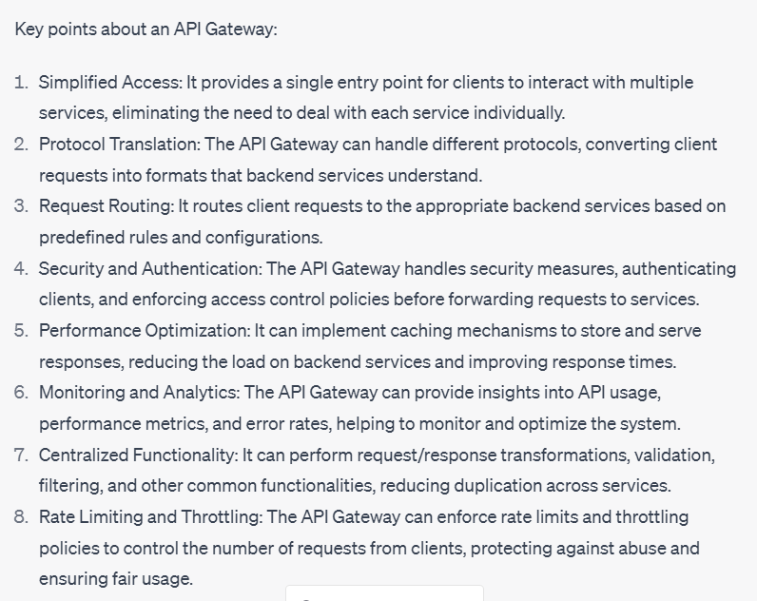
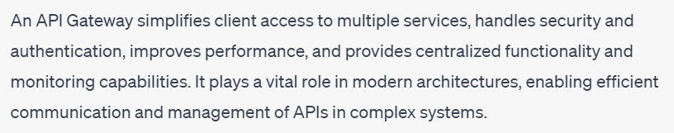
What is API gateway?

