Slide 1
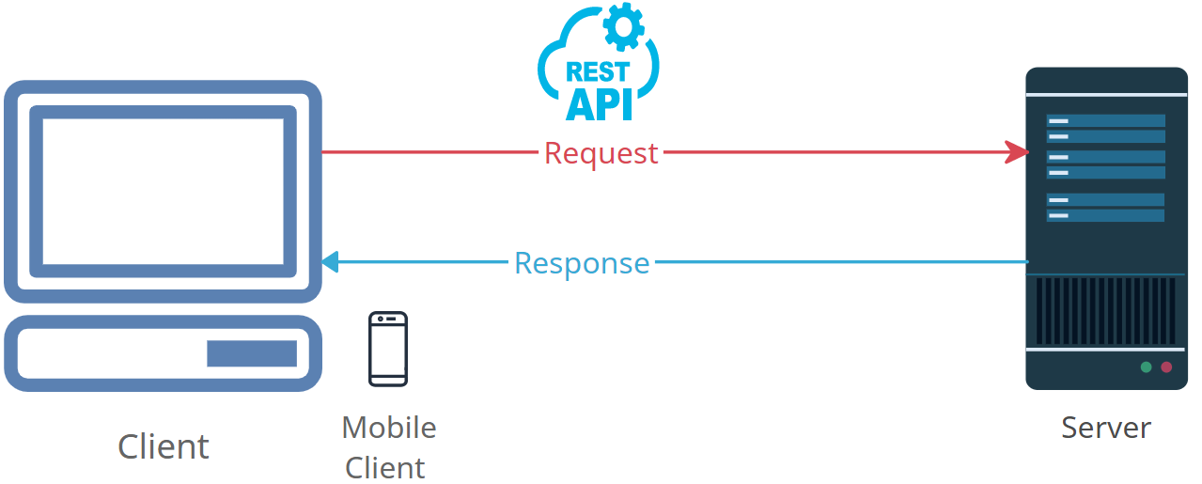
Demystifying HTTP Headers: How the Internet Talks to You
HTTP headers are a fundamental part of the Hypertext Transfer Protocol (HTTP), which is the foundation of data communication on the internet.
HTTP headers provide important information about a request or response being sent between a web browser (client) and a web server.

Slide 2
Demystifying HTTP Headers: How the Internet Talks to You
What Are HTTP Headers?
HTTP headers are additional pieces of information that are sent along with the main content of an HTTP request or response. They consist of key-value pairs and are used to transmit various types of information about the communication between a client and a server.

Slide 3
Demystifying HTTP Headers: How the Internet Talks to You
Request Headers:
When you visit a website, your web browser sends an HTTP request to the server to retrieve a web page or other resources. Request headers contain information about the request itself. Common request headers include:
User-Agent: This header tells the server what browser and operating system you are using.
Accept: It indicates the types of content your browser can handle, such as HTML, images, or JSON.
Host: This header specifies the domain name of the server you want to connect to.

Slide 4
Demystifying HTTP Headers: How the Internet Talks to You
Response Headers:
After receiving an HTTP request, the web server sends back an HTTP response containing the requested content. Response headers provide additional information about the response, including:
Content-Type: This header informs the browser about the type of content being sent, such as HTML, text, images, or videos.
HTTP Status Code: It indicates the outcome of the request, such as success (e.g., 200 OK), redirection (e.g., 301 Moved Permanently), or error (e.g., 404 Not Found).

Slide 5
Demystifying HTTP Headers: How the Internet Talks to You
Cookies:
Cookies are a specific type of header that stores data on the user's computer. They are often used to remember user sessions, track preferences, and provide a personalized browsing experience.

Slide 6
Demystifying HTTP Headers: How the Internet Talks to You
Why Are HTTP Headers Important?
HTTP headers play a crucial role in enabling effective communication between clients (e.g., browsers) and servers. They help ensure that the content is delivered correctly and that the server and client understand each other's capabilities and requirements.
Custom Headers:
In addition to standard headers, developers can create custom headers to include specific information relevant to their applications. These headers can be used to pass data or instructions between the client and server.

Slide 7
Demystifying HTTP Headers: How the Internet Talks to You
Security and Privacy:
Some headers, like the "Content-Security-Policy" and "Strict-Transport-Security," are used to enhance security and privacy on the web. They help protect against security vulnerabilities and ensure secure connections.

Slide 8
Demystifying HTTP Headers: How the Internet Talks to You
In summary, HTTP headers are a critical part of web communication, helping browsers and servers exchange information, understand each other's capabilities, and ensure the correct handling of web content. While some headers are standard and well-known, others can be customized to meet specific needs in web development. Understanding HTTP headers is essential for web developers and anyone interested in how the internet works.

