Slide 1
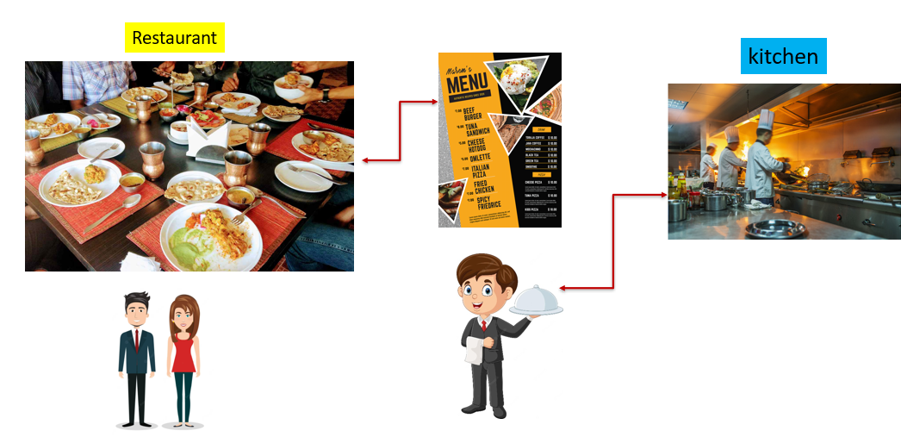
What is a REST API?
Let's imagine you're at a really fancy restaurant, and you want to order some delicious food. You don't just barge into the kitchen to tell the chefs what you want; you have a waiter who takes your order and brings your food back to you.

Slide 2
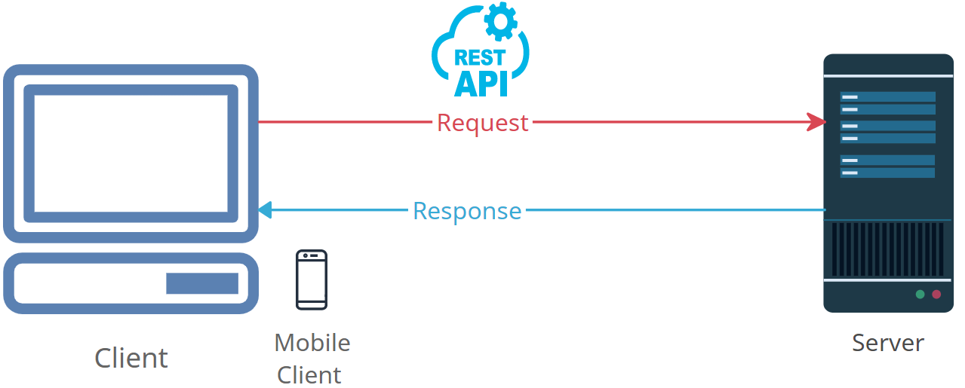
What is a REST API?
Now, think of a REST API like a special waiter in the world of computers. Instead of food, it helps different software applications communicate and share information with each other over the internet.

Slide 3
What is a REST API?
When you use your smartphone to check the weather, it's like you're placing an order with the REST API. You're saying, "Hey, I want to know the weather for today." The API then goes and fetches that weather information from its kitchen, which could be a big database full of weather data. Once it has the information, it brings it back to you, and your phone shows you the weather.

Slide 4
What is a REST API?
Just like a waiter understands a menu and takes your order, a REST API understands a list of instructions (technically, they're called endpoints) and responds with the information you asked for. It's like a helpful middleman that allows different apps and systems to talk to each other and share data smoothly, just like a waiter making sure you get the right dish from the kitchen.

