Slide 1
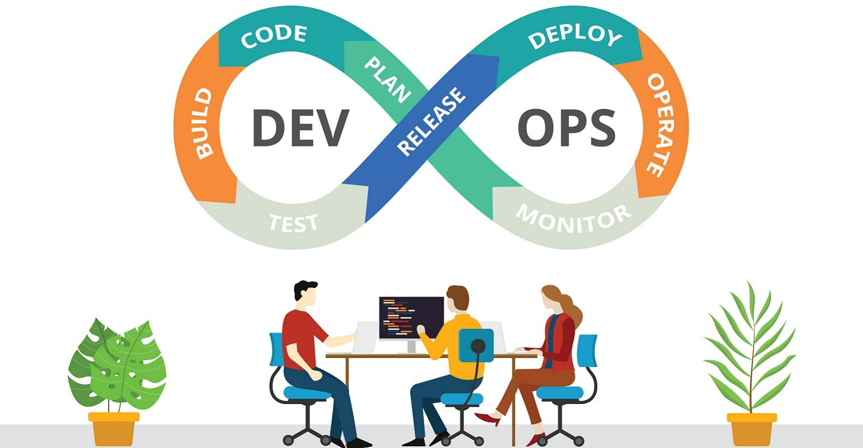
DevOps: The Key to Happy Customers and Successful Software Releases
What is DevOps?
DevOps is a combination of two words: Development (Dev) and Operations (Ops). It’s a way of working that brings together software developers and IT operations teams to collaborate and improve the process of software development, deployment, and maintenance.

Slide 2
DevOps: The Key to Happy Customers and Successful Software Releases
Breaking Down DevOps
Development (Dev):
  This is the part where software is created. Developers write code, add new features, and fix bugs.
Operations (Ops):
  This is the part where the software is deployed, managed, and maintained. Operations teams ensure the software runs smoothly on servers and is available to users.

Slide 3
DevOps: The Key to Happy Customers and Successful Software Releases
The Problem
Traditionally, development and operations teams worked separately. Developers would write the code and then pass it to the operations team to deploy and maintain it. This often led to problems like:
Miscommunication: Different teams might not understand each other’s work and needs.
Delays: Waiting for one team to finish their part before the other can start leads to slow progress.
Errors: Lack of coordination can result in mistakes and software that doesn’t work well.

Slide 4
DevOps: The Key to Happy Customers and Successful Software Releases
The Solution:
DevOps bridges the gap between development and operations by promoting collaboration, communication, and integration between the two. This helps in:
Faster Delivery: Software updates and new features can be delivered to users more quickly.
Improved Quality: Regular testing and monitoring help catch and fix issues early.
Increased Reliability: Continuous monitoring and rapid response to issues ensure stable and reliable software.

Slide 5
DevOps: The Key to Happy Customers and Successful Software Releases
Key Concepts in DevOps
Collaboration: Developers and operations teams work closely together throughout the entire software lifecycle, from planning and development to testing, deployment, and maintenance.
Automation: Many repetitive and manual tasks are automated. This includes:
  Code Integration: Automatically merging code changes from different developers.
  Testing: Running automated tests to check for errors and bugs.
  Deployment: Automatically deploying the software to different environments.
Continuous Integration and Continuous Deployment (CI/CD):
  Continuous Integration (CI): Developers frequently integrate their code changes into a shared repository. Automated tests are run to catch errors early.
  Continuous Deployment (CD): Code changes are automatically deployed to production, ensuring that new features and fixes are released quickly and reliably.
Monitoring and Feedback: Constantly monitoring the software in production to quickly identify and fix any issues. Feedback from users and monitoring tools helps improve the software continuously.

Slide 6
DevOps: The Key to Happy Customers and Successful Software Releases
Tools Commonly Used in DevOps
Version Control: Git, GitHub, GitLab
CI/CD: Jenkins, Travis CI, CircleCI
Configuration Management: Ansible, Chef, Puppet
Containerization: Docker, Kubernetes
Monitoring: Prometheus, Grafana, Nagios
Collaboration: Slack, Microsoft Teams

Slide 7
DevOps: The Key to Happy Customers and Successful Software Releases
Benefits of DevOps
Faster Delivery: New features and bug fixes reach users more quickly.
Improved Quality: Continuous testing and monitoring ensure that issues are identified and resolved early.
Greater Reliability: Automated processes reduce the chances of human error.
Better Collaboration: Developers and operations teams work together, leading to a more cohesive and efficient workflow.

Slide 8
DevOps: The Key to Happy Customers and Successful Software Releases
Real-World Example
Think of a mobile app that gets frequent updates with new features and bug fixes. With DevOps:
Developers continuously add and test new features.
Automated tests ensure the new code doesn’t break existing functionality.
The operations team uses automated deployment tools to release updates quickly.
Monitoring tools check the app’s performance, and any issues are quickly addressed.

Slide 9
DevOps: The Key to Happy Customers and Successful Software Releases
Conclusion
DevOps is a modern approach to software development and operations that emphasizes collaboration, automation, and continuous improvement. It helps teams deliver high-quality software more quickly and reliably, ensuring a better experience for users.
By adopting DevOps practices, organizations can respond faster to market changes, improve their software quality, and create a more efficient and enjoyable work environment for their teams.

