Slide 1
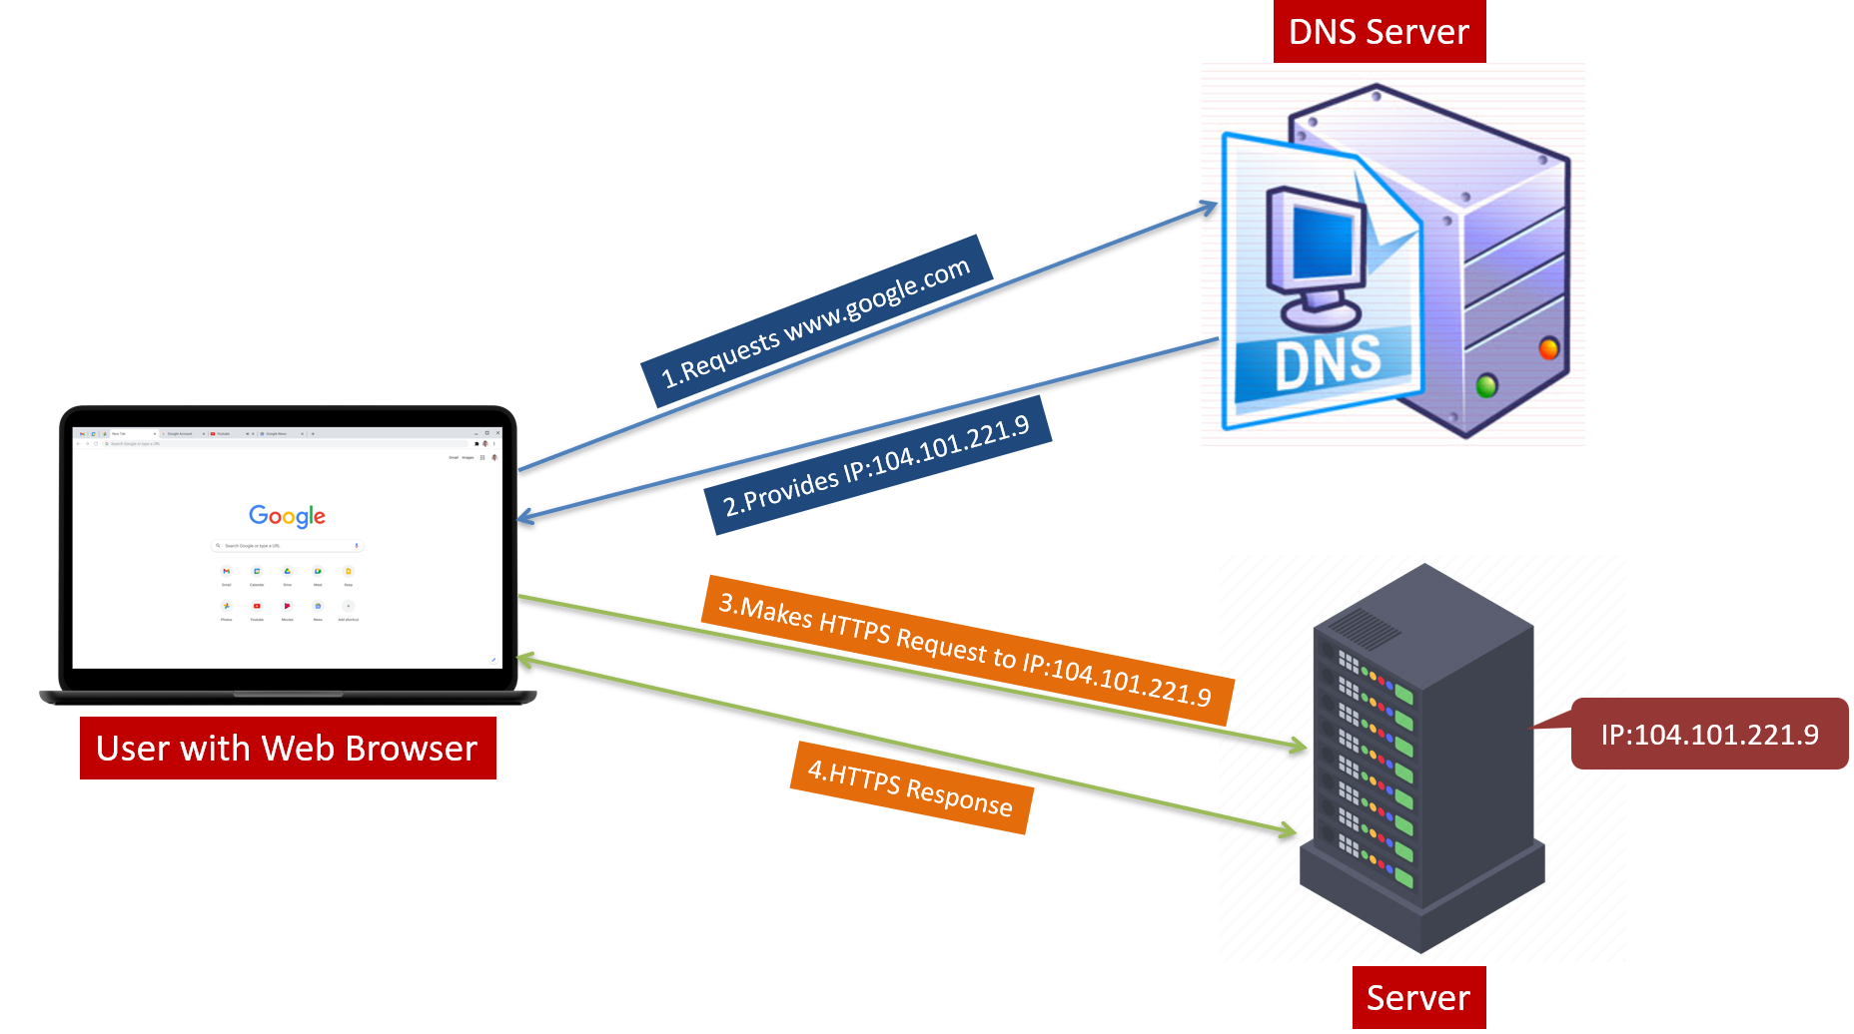
Demystifying DNS: Navigating the Internet's Address Book
Imagine you want to visit your friend's house. You wouldn't memorize the exact coordinates on a map, right? You'd use their address, something like "123 Elm Street." DNS is like the address book for the internet.

Slide 2
Demystifying DNS: Navigating the Internet's Address Book
Here's the deal:
Websites live on computers, and each computer has a unique address called an IP address. It's a bunch of numbers, like 172.16.254.1, which isn't exactly easy to remember.
DNS (Domain Name System) steps in. It translates user-friendly website names, like "google.com" or "youtube.com," into those IP addresses.

Slide 3
Demystifying DNS: A Layman's Guide to Understanding the Internet's Phone Book
How DNS Works?
You type "google.com" in your browser.
Your computer asks a DNS server, like a giant internet phonebook, "Hey, what's the IP address for google.com?“
The DNS server checks its records and replies, "Ok, google.com's IP address is 104.101.221.9" (This is just an example, the real address is different).
With this IP address, your computer can connect to Google and show you the website.
So, DNS saves you the trouble of memorizing numbers and lets you use easy-to-remember names to access websites.

