Slide 1



Email Basics: A Beginner's Guide to Electronic Messaging
Email, which stands for electronic mail, is a way to send messages and information through the internet. It's like sending letters, but everything is digital, and it's one of the most common ways people communicate today.

Slide 2
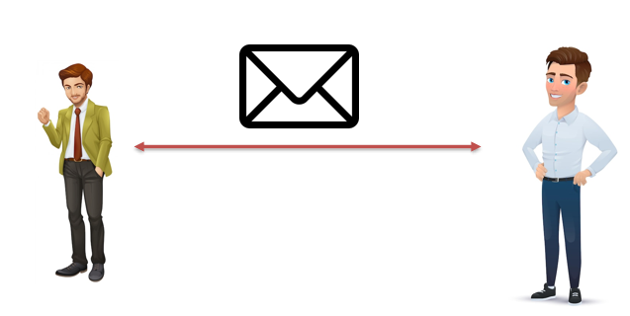
Email Basics: A Beginner's Guide to Electronic Messaging
Here's a simple breakdown of how email works for beginners:
Email Address: Just like you have a physical address for your home, in the digital world, you have an email address. It's a unique name followed by the "@" symbol and a domain name (for example, yourname@emailprovider.com). This is where people can send messages to you.
Email Provider: To send and receive emails, you need an email service. Common email providers include Gmail, Yahoo Mail, Outlook, and many more. You sign up for an email account with one of these providers, and they give you an email address.
Sending an Email: When you want to send an email, you log in to your email account, click on "compose" or "new," and then you enter the recipient's email address. You also write the message you want to send. You can even attach files, like pictures or documents.
Receiving an Email: When someone sends you an email, it goes to your email address. You log in to your email account to see your inbox, where you can read all the messages people have sent you.
Replying: If you want to respond to an email, you simply click "reply" and type your message. It's just like having a conversation, but in writing.
Attachments: Emails can carry more than just text. You can attach photos, videos, documents, and other files to share with the person you're emailing.
Organization: You can organize your emails into folders, mark them as important, or archive them for later. This helps you keep your inbox neat and tidy.

Slide 3
Email Basics: A Beginner's Guide to Electronic Messaging
Email is a fantastic tool for communicating with friends, family, and colleagues. It's used for sending personal messages, work-related information, pictures, and so much more. It's quick, convenient, and has become an essential part of modern communication.

