Slide 1



Understanding Proxies: A Beginner's Guide to Forward and Reverse Proxy Servers
Proxy
A proxy is an intermediary server or software that acts as a middleman between a user's device (such as a computer or smartphone) and the internet. When you send a request to access a website or online resource, instead of connecting directly to the destination server, your request goes through the proxy server first. The proxy then forwards your request to the destination server, receives the response, and sends it back to you. Proxies are commonly used for various purposes, including improving security, enhancing privacy, caching content, and controlling access to resources.
You
Internet

Slide 2
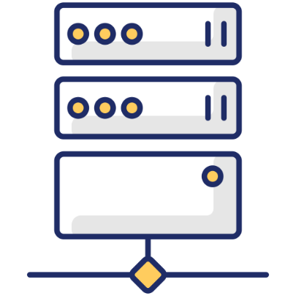
Understanding Proxies: A Beginner's Guide to Forward and Reverse Proxy Servers
Forward Proxy
A forward proxy, also known as a proxy server or simply a proxy, sits between a user's device and the internet. When a user requests access to a website or online service, the request is first sent to the forward proxy server. The proxy server then forwards the request to the destination server on behalf of the user.
Forward proxies are often used by individuals and organizations to control access to the internet, filter content, mask IP addresses, and improve performance through caching.
Internet
You
Forward Proxy Server

Slide 3
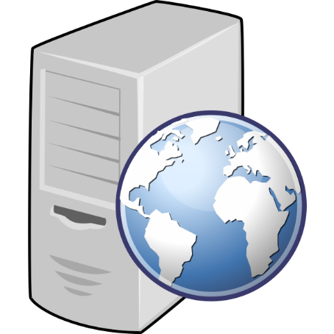


Understanding Proxies: A Beginner's Guide to Forward and Reverse Proxy Servers
Reverse Proxy
A reverse proxy is similar to a forward proxy but operates in the opposite direction. Instead of sitting between a user's device and the internet, a reverse proxy sits between the internet and one or more backend servers. When a user sends a request to access a website or online service, the request goes to the reverse proxy first. The reverse proxy then forwards the request to the appropriate backend server based on predefined rules, such as load balancing, content caching, or security policies. Reverse proxies are commonly used to improve scalability, reliability, and security for web applications and services.
Web Server 1
Internet
Reverse Proxy Server
Web Server 2

Slide 4
Understanding Proxies: A Beginner's Guide to Forward and Reverse Proxy Servers
In summary, proxies act as intermediaries between users and the internet, forwarding requests and responses between the two. Forward proxies sit between users and the internet, while reverse proxies sit between the internet and backend servers. Both types of proxies serve different purposes but are essential components of modern networking and web infrastructure.

