Slide 1
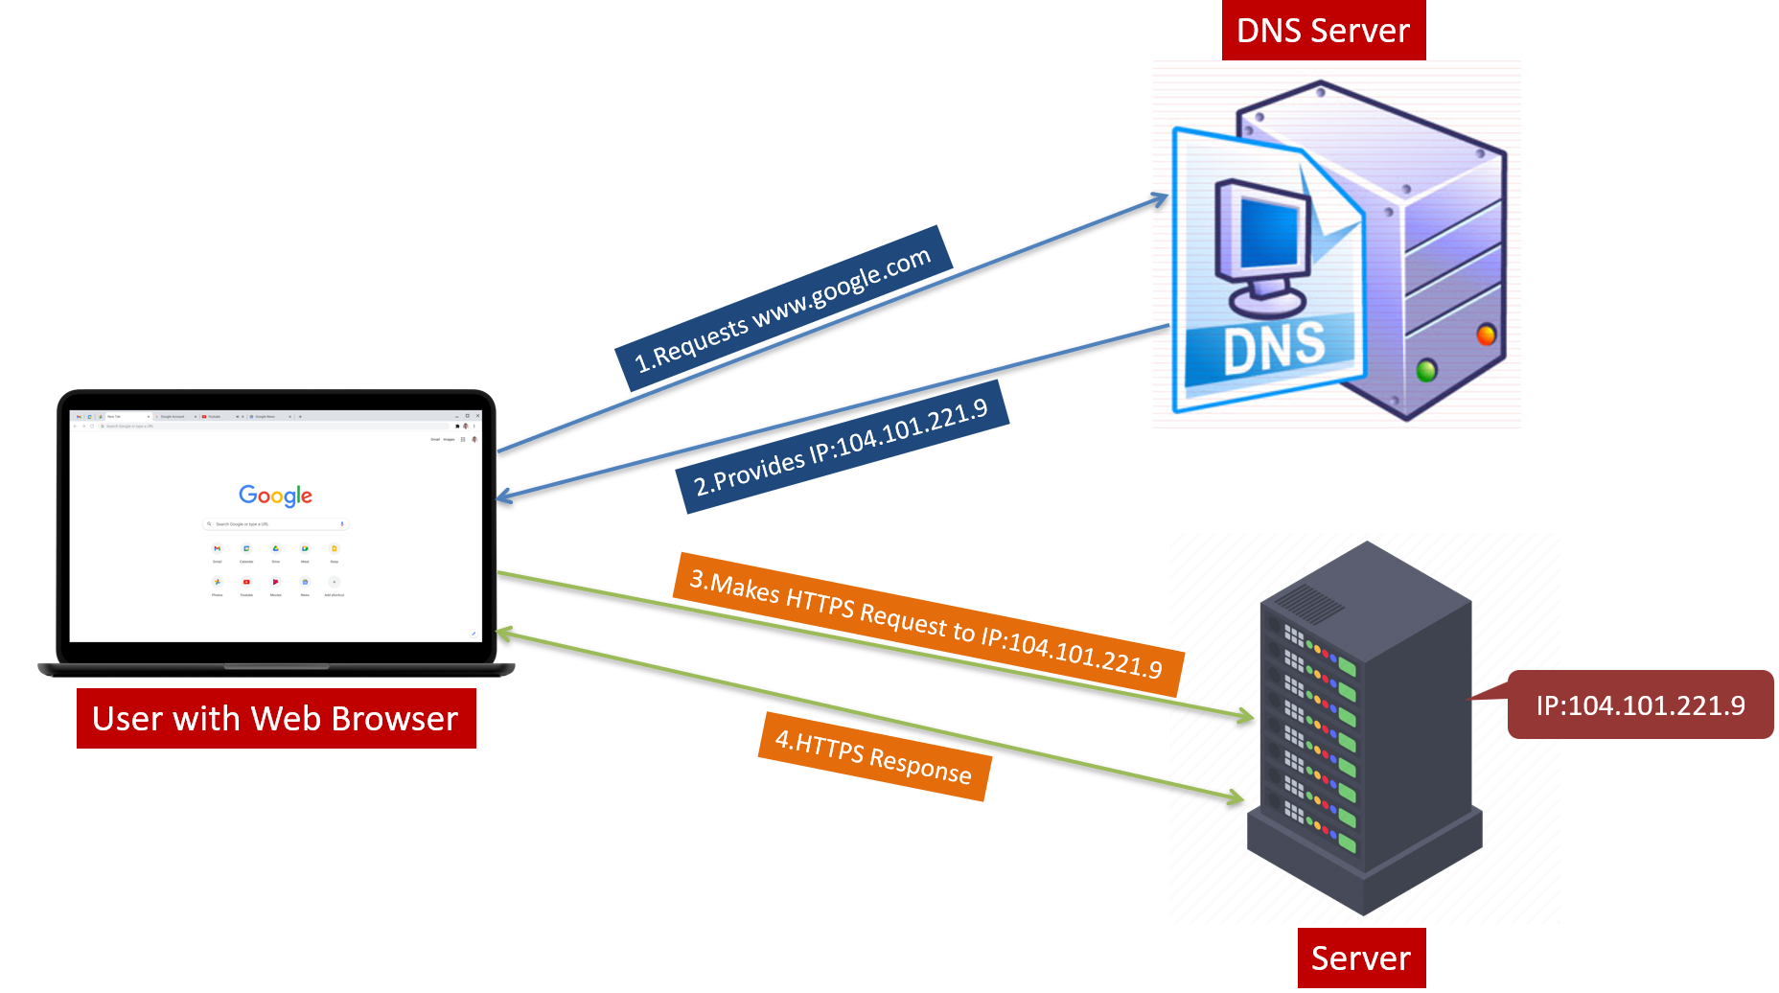
Understanding DNS: A Beginner's Guide
What is DNS?
DNS is like a translator for the internet. It converts the human-readable website names (like www.google.com) into machine-readable IP addresses (like 172.217.3.196).

Slide 2
Understanding DNS: A Beginner's Guide
How does DNS work?
When you type a website name into your browser, your computer sends a request to a DNS server.
The DNS server checks its records to find the corresponding IP address for that website.
Once the IP address is found, your computer uses it to connect to the website's server and load the webpage.

Slide 3
Understanding DNS: A Beginner's Guide
Why is it important?
DNS makes it easy for us to navigate the internet using names instead of numbers.
Imagine if you had to remember the IP address for every website you wanted to visit – it would be very hard!

Slide 4
Understanding DNS: A Beginner's Guide
Example
Think of DNS as a phonebook. When you want to call a friend, you look up their name in the phonebook to find their phone number. DNS does the same thing, but for websites.

Slide 5
Understanding DNS: A Beginner's Guide
In Summary:
DNS helps computers find websites on the internet by translating their names into IP addresses.
It's a crucial part of how the internet works, making it simple and easy for us to browse the web without needing to remember complex numbers.

