Slide 1
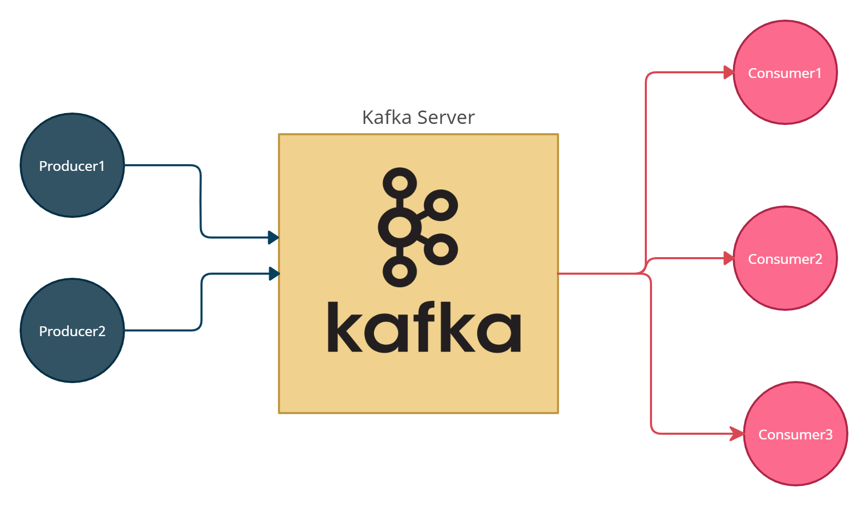

What is Kafka and How does it work?
Kafka is just like a messaging system

Slide 2
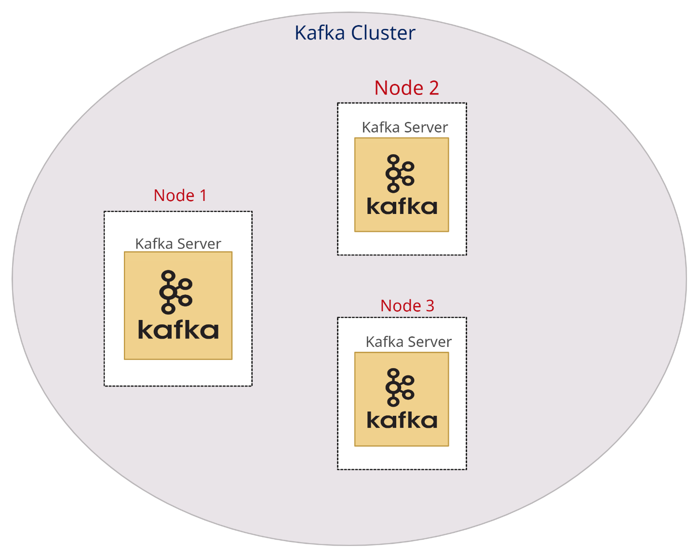
What is Kafka and How does it work?
Kafka is a distributed platform/Application
In the production environment, Kafka is referred to as a Kafka cluster.
A cluster is made up of more than one Kafka server
Each Kafka server is referred to as Broker

Slide 3
What is Kafka and How does it work?
Kafka is fault-tolerant - The ability of a system to continue operating without interruption when one or more of its components fails
In the Kafka-cluster messages are replicated in multiple Kafka brokers or Kafka servers
Replication factor
M1
M1
M1

Slide 4
What is Kafka and How does it work?
Kafka is a scalable system
We can add new brokers
we can increase the number of consumers

